Slide 1



Chem
With
Com

Slide 2
Acids, Bases, and pH
Chapter 14.1 (Bronsted-Lowry Acids and Bases)
Chapter 14.2 (pH and pOH)
Adapted From: Paul Flowers, Edward J. Neth, William R. Robinson, PhD, Klaus Theopold, Richard Langley; Chemistry: Atoms First 2e; OpenStax; Feb 14, 2019; Houston Texas; https://openstax.org/books/chemistry-atoms-first-2e/pages/1-introduction

Slide 3
Acids and Bases
Chapter 14.1 (Bronsted-Lowry Acids and Bases)
Adapted From: Paul Flowers, Edward J. Neth, William R. Robinson, PhD, Klaus Theopold, Richard Langley; Chemistry: Atoms First 2e; OpenStax; Feb 14, 2019; Houston Texas; https://openstax.org/books/chemistry-atoms-first-2e/pages/1-introduction

Slide 4
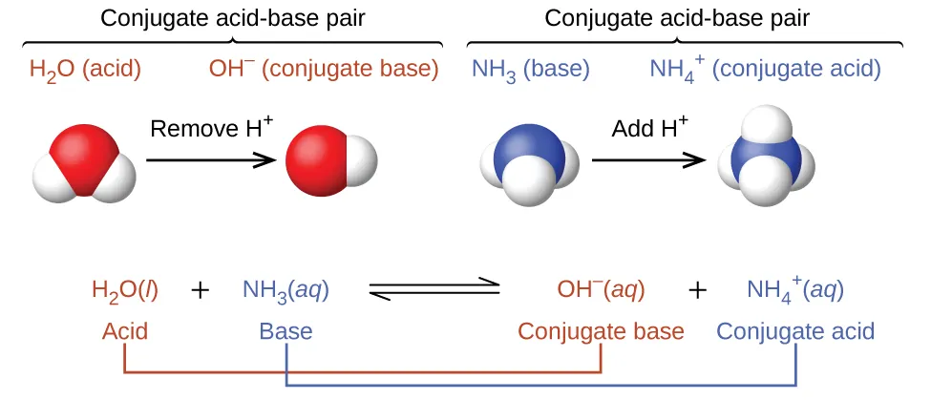
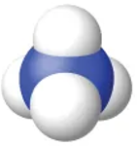
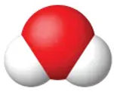
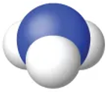
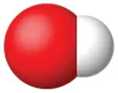
Acids donate H¹⁺ and bases receive H¹⁺ ions (protons)
ACIDS
donates H¹⁺
BASES
receives H¹⁺
Notes:
H¹⁺ are called a proton
H¹⁺ is a shortcut for H₃O¹⁺
Acid-Base reactions usually occur in water
Chapter 14.1

Slide 5
Acid-Base Conjugate Pairs
Conjugate Base:
What the acid turned into after it lost it’s proton
ACIDS
donates H¹⁺
Conjugate Acid:
What the base turned into after it gained it’s proton
BASES
receives H¹⁺
Chapter 14.1

Slide 6
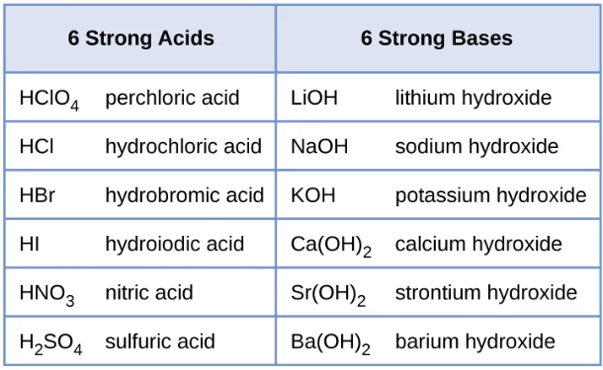

Common Acids and Bases
CO₃²⁻ is amphoteric, and it can donate or receive a proton
Another common moderately strong base:
Na₂CO₃ sodium carbonate (CO₃²⁻ accepts the protons)
Chapter 14.3

Slide 7
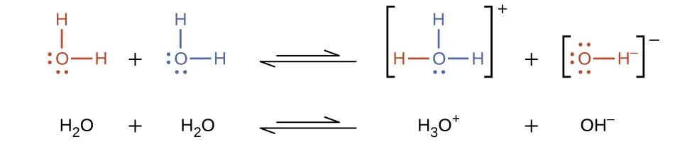
Water autoionizes (turns into ions naturally)
When water autoionizes the concentration of each product (H₃O¹⁺ and OH¹⁻) is very low at 1 x 10⁻⁷ M @25 ºC
hydronium
hydroxide
The ion-product constant of water is K_{W} =
[H₃O¹⁺]
[OH¹⁻]
1 x 10⁻⁷ M
1 x 10⁻⁷ M
K_{W} =
1 x 10⁻¹⁴ M
Chapter 14.1

Slide 8


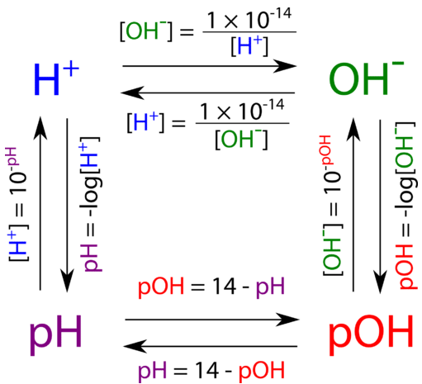
The ion-product constant of water allows us to calculate [H¹⁺] or [OH¹⁻] if we know one of them
K_{W} = 1 x 10⁻¹⁴
K_{W} = [H¹⁺] [OH¹⁻]
Brackets mean molarity [M]
1.0 x 10⁻¹⁴ = [H¹⁺] [OH¹⁻]
Use this if you know [OH⁻] and want to calculate [H⁺]
Use this if you know [H⁺] and want to calculate [OH⁻]
Chapter 14.1, LibreTexts: The pOH Concept by CK12 is licensed CK-12. Original source: https://flexbooks.ck12.org/cbook/ck-12-chemistry-flexbook-2.0/.

Slide 9
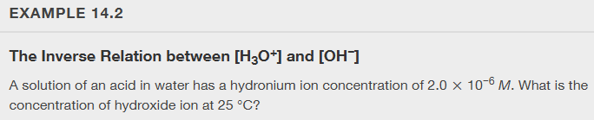
X`
1.0 x 10⁻¹⁴ = [H¹⁺] [OH¹⁻]
Chapter 14.1
Notes:
5.0 x 10^-9

Slide 10

1.0 x 10⁻¹⁴ = [H¹⁺] [OH¹⁻]
Chapter 14.1
Notes:
[H₃O⁺] = 1 × 10⁻¹¹ M

Slide 11
pH and pOH
Chapter 14.2 (pH and pOH)
Adapted From: Paul Flowers, Edward J. Neth, William R. Robinson, PhD, Klaus Theopold, Richard Langley; Chemistry: Atoms First 2e; OpenStax; Feb 14, 2019; Houston Texas; https://openstax.org/books/chemistry-atoms-first-2e/pages/1-introduction

Slide 12
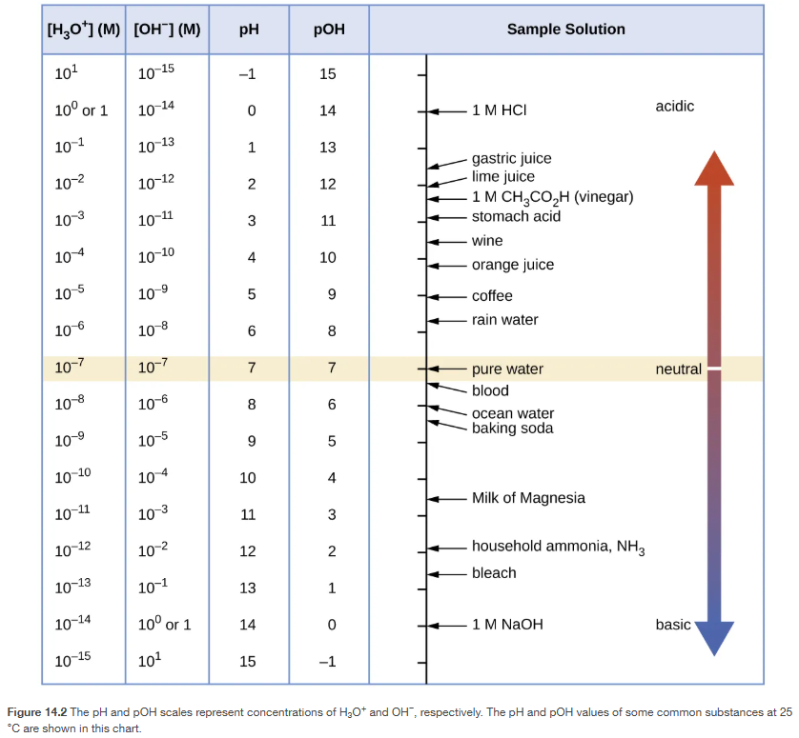
pH and pOH Scale
Chapter 14.2

Slide 13
“p” means -log
pH = -log[H⁺]
pOH = -log[OH⁻]
pH is the negative log of the molarity of H⁺
pOH is the negative log of the molarity of OH⁻
[H⁺] = 1 x 10⁻²
[OH⁻] = 1 x 10⁻¹⁴
pH = -log[1x10⁻²]
pOH = -log[1x10⁻¹⁴]
pH = 2.0
pOH = 14.0
Chapter 14.2

Slide 14
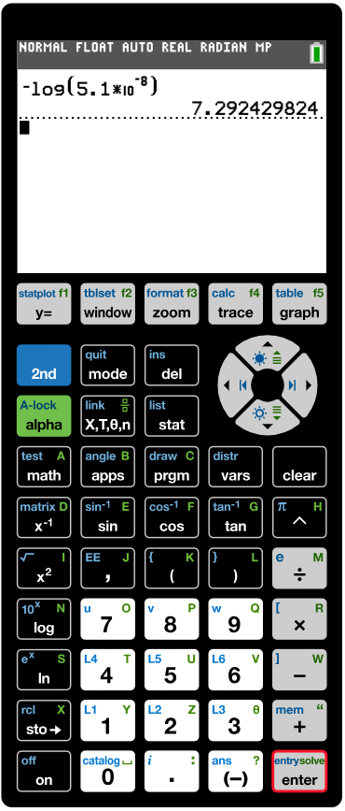
Practice on your calculator!
You may have to use the “2nd” button to get to the 10^{x} which will allow you to input exponents. Another option is the ^ symbol
“log” button
Sometimes you may have to press “2nd” or “alpha” or “shift” to get to the function
On some calculators, the negative sign and minus signs are different
If you aren’t sure when to use brackets, use them on all numbers with exponents like (5.1 x 10⁻⁸)
Chapter 14.2, https://ti84calc.com/ti84calc

Slide 15
Finding the [H⁺] or [OH⁻] from pH and pOH
[H⁺] = 10^{-pH}
[OH⁻] = 10^{-pOH}
pH = 3.0
pOH = 13.00
[H⁺] = 10^{-3.0}
[OH⁻] = 10^{-13.00}
[H⁺] = 1 x 10⁻³
[OH⁻] = 1.0 x 10⁻¹³
Chapter 14.2

Slide 16
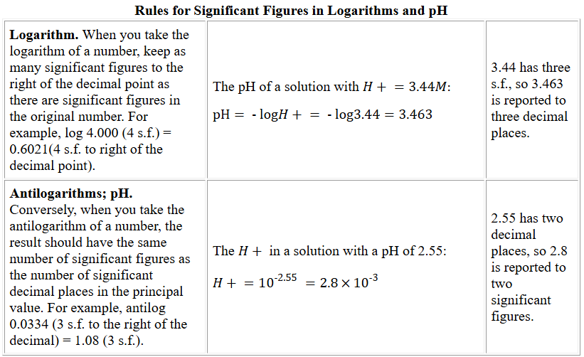
SigFigs and Logarithms
Calculate pH if the [H⁺] is 1.34 x 10⁻²
pH = -log[H⁺]
[H⁺] = 1.34 x 10⁻²
pH = -log[1.34 x 10⁻²]
pH = 1.873
3 significant figures, 3 decimals
Calculate [OH⁻] if the pOH is 13.00
[OH⁻] = 10^{-pOH}
pOH = 13.35
2 decimals,
2 sigfigs
[OH⁻] = 10^{-13.35}
[OH⁻] = 4.5 x 10⁻¹⁴
https://cxp.cengage.com/contentservice/assets/owms01h/references/significantfigures/index.html

Slide 17
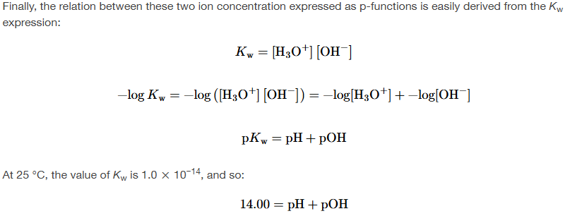
pH to pOH is the simplest of them all!
Chapter 14.2

Slide 18
pH, pOH, [H⁺], and [OH⁻] conversions
LibreTexts: The pOH Concept by CK12 is licensed CK-12. Original source: https://flexbooks.ck12.org/cbook/ck-12-chemistry-flexbook-2.0/.

Slide 19
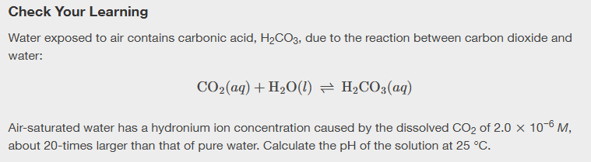
Chapter 14.2
Notes:
pH = 5.70

Slide 20
Chapter 14.2
Notes:
12 M

Slide 21
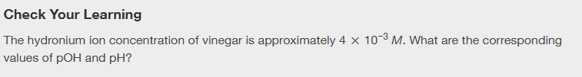
Chapter 14.2
Notes:
pOH = 11.6, pH = 2.4

