Slide 1


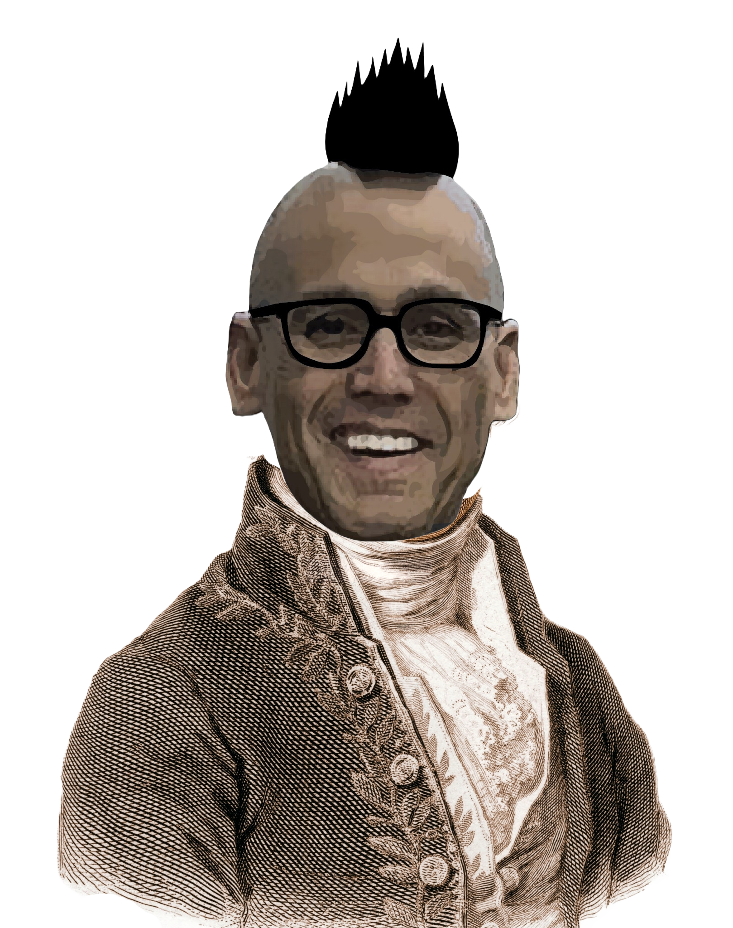
Chem
With
Com

Slide 2
Gases
Chapter 8.1 (Gas Pressure)
Chapter 8.2 (Relating Pressure, Volume, Amount (Moles), and Temperature: The Ideal Gas Law
Adapted From: Paul Flowers, Edward J. Neth, William R. Robinson, PhD, Klaus Theopold, Richard Langley; Chemistry: Atoms First 2e; OpenStax; Feb 14, 2019; Houston Texas; https://openstax.org/books/chemistry-atoms-first-2e/pages/1-introduction

Slide 3
Gas Pressure
Chapter 8.1 (Gas Pressure)
Adapted From: Paul Flowers, Edward J. Neth, William R. Robinson, PhD, Klaus Theopold, Richard Langley; Chemistry: Atoms First 2e; OpenStax; Feb 14, 2019; Houston Texas; https://openstax.org/books/chemistry-atoms-first-2e/pages/1-introduction

Slide 4

Can you feel water pressure now? What about in water?

Slide 5

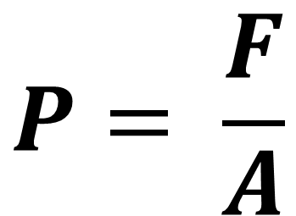
What is pressure?
$$P= \frac{F}{A}$$
F = Force
A = Area
Chapter 8.1

Slide 6
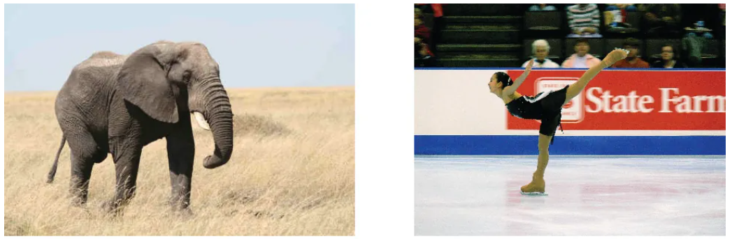
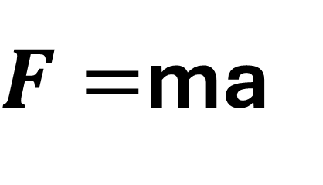
Mass contributes to pressure.
F = Force
m = mass
a = acceleration
$F=$ma
Chapter 8.1

Slide 7

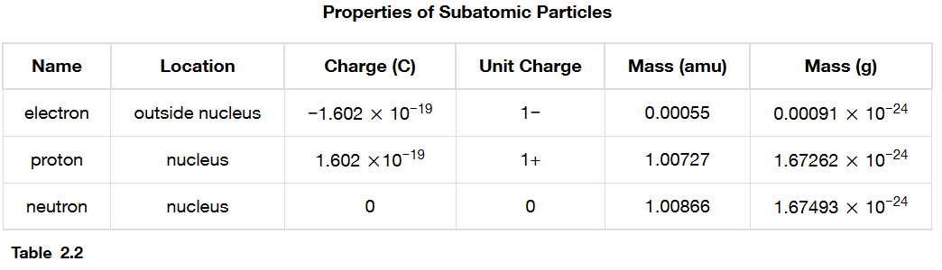
Moving atoms have mass and can exert pressure.
Chapter 8.1, 2.3

Slide 8

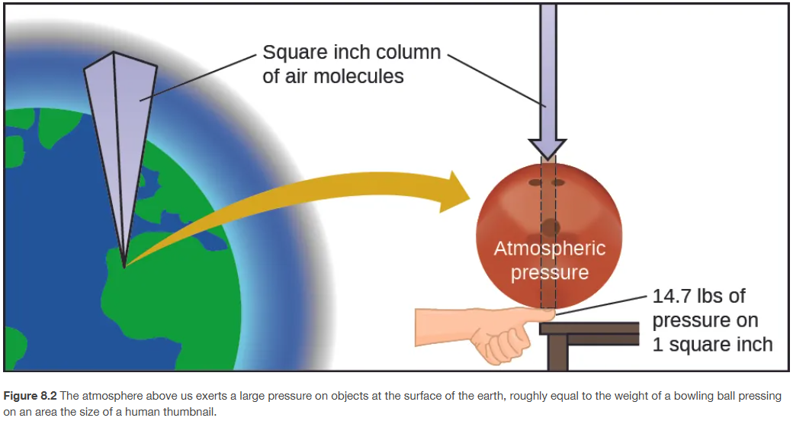
We’re all under pressure!
Chapter 8.1

Slide 9
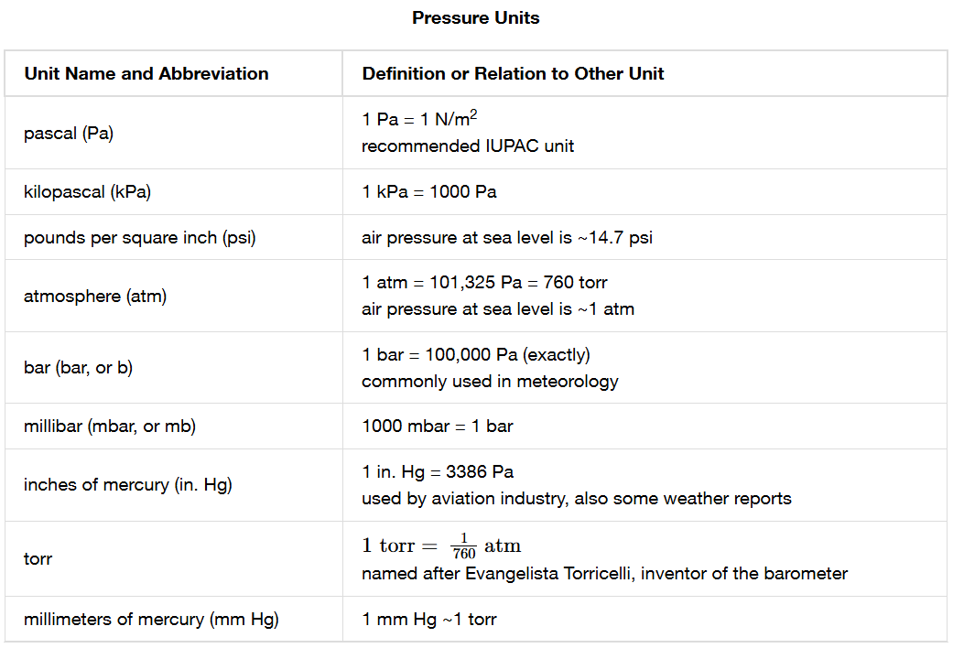
Pressure has many different units.
Chapter 8.1

Slide 10
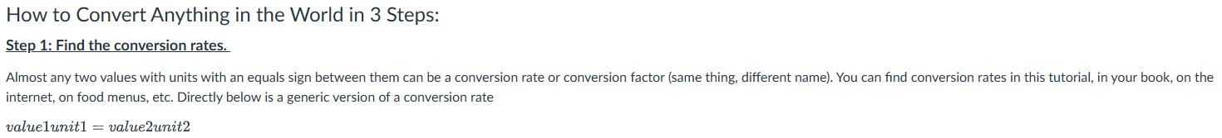
Remember conversions! (Topic 6: Dimensional Analysis)
Problem: convert 327 g to kg
Chapter 1.6

Slide 11
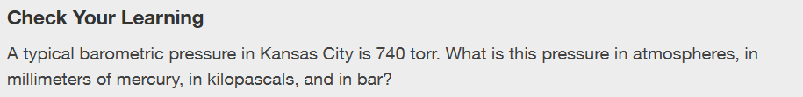
Chapter 8.1
Notes:
0.974 atm; 740 mm Hg; 98.7 kPa; 0.987 bar

Slide 12
Gas Laws
Chapter 8.2 (Relating Pressure, Volume, Amount (Moles), and Temperature: The Ideal Gas Law
Adapted From: Paul Flowers, Edward J. Neth, William R. Robinson, PhD, Klaus Theopold, Richard Langley; Chemistry: Atoms First 2e; OpenStax; Feb 14, 2019; Houston Texas; https://openstax.org/books/chemistry-atoms-first-2e/pages/1-introduction

Slide 13
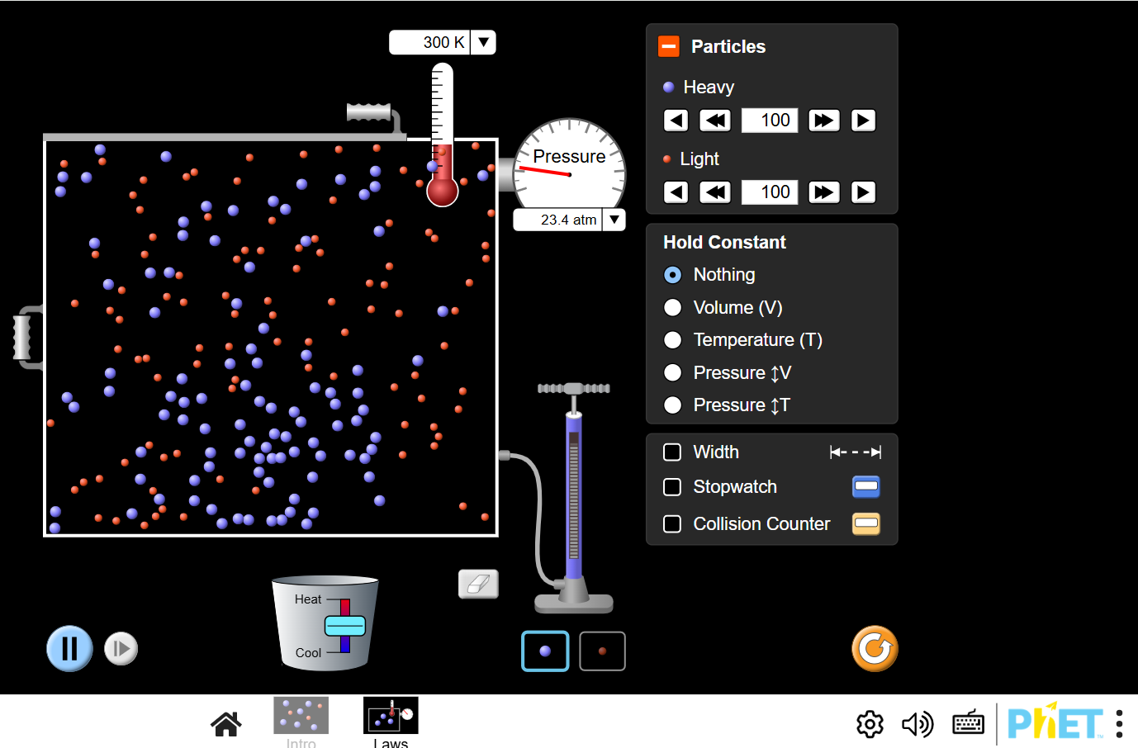
Gas Simulation
https://phet.colorado.edu/sims/html/gases-intro/latest/gases-intro_all.html
Or web search: PHET gases

Slide 14
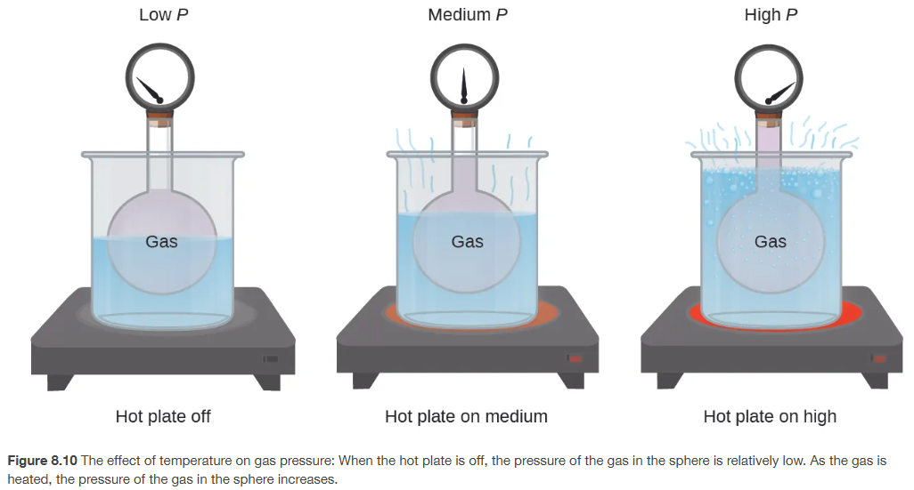
Pressure and Temperature: Amontons’s Law
Chapter 8.2

Slide 15

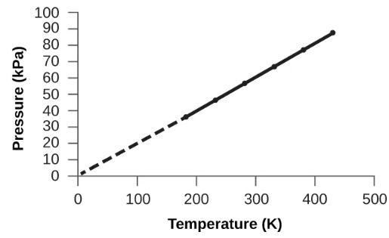

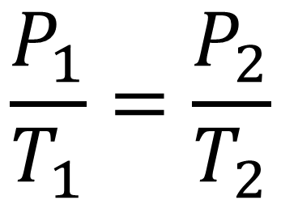
Pressure is proportional to temperature
P T
$$∝$$
$$\frac{P_{1}}{T_{1}}=\frac{P_{2}}{T_{2}}$$
P T
P T
All temperatures for gas problems should be converted to K → K = ºC + 273.15
Chapter 8.2

Slide 16
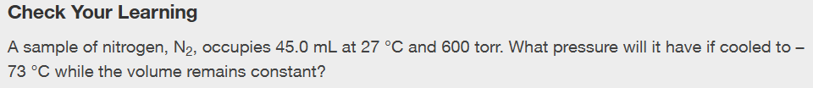
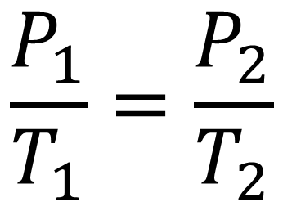
$$\frac{P_{1}}{T_{1}}=\frac{P_{2}}{T_{2}}$$
All temperatures for gas problems should be converted to K → K = ºC + 273.15
Chapter 8.2
Notes:
400 torr

Slide 17
$$\frac{P_{1}}{T_{1}}=\frac{P_{2}}{T_{2}}$$
All temperatures for gas problems should be converted to K → K = ºC + 273.15
Chapter 8.2
Notes:
400 torr

Slide 18

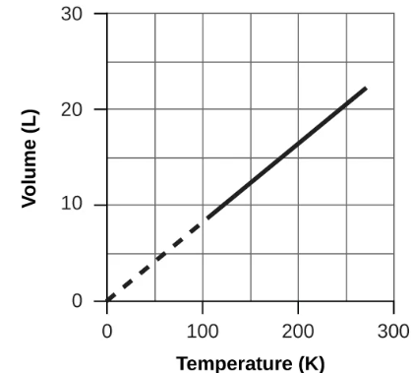
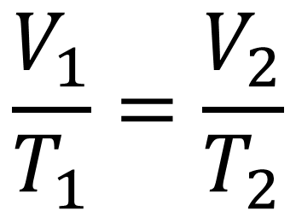
Volume is proportional to temperature: Charles’s Law
V T
$$∝$$
$$\frac{V_{1}}{T_{1}}=\frac{V_{2}}{T_{2}}$$
V T
V T
All temperatures for gas problems should be converted to K → K = ºC + 273.15
Chapter 8.2

Slide 19
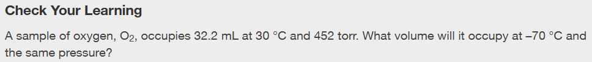
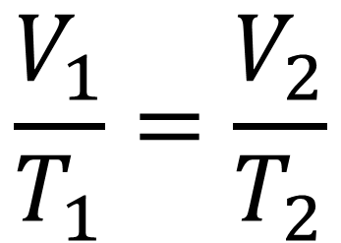
$$\frac{V_{1}}{T_{1}}=\frac{V_{2}}{T_{2}}$$
All temperatures for gas problems should be converted to K → K = ºC + 273.15
Chapter 8.2
Notes:
21.6 mL

Slide 20
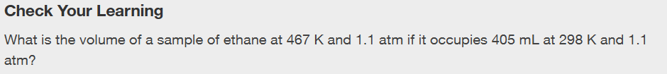
$$\frac{V_{1}}{T_{1}}=\frac{V_{2}}{T_{2}}$$
All temperatures for gas problems should be converted to K → K = ºC + 273.15
Chapter 8.2
Notes:
635 mL

Slide 21
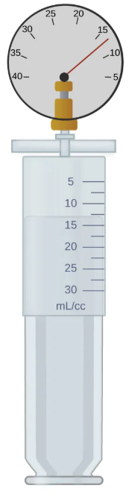
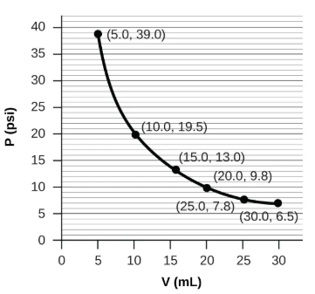
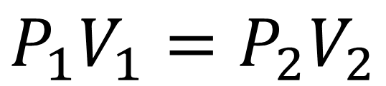
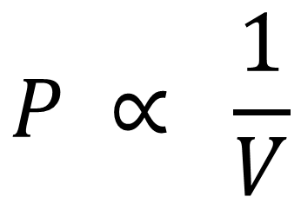
Volume is inversely proportional to pressure: Boyle’s Law
$$P ∝ \frac{1}{V}$$
$$P_{1}V_{1}=P_{2}V_{2}$$
P V
P V
Chapter 8.2

Slide 22
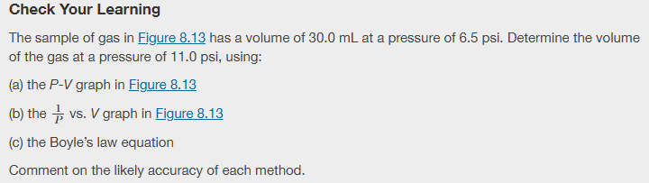
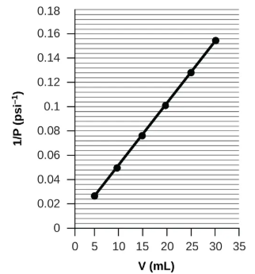
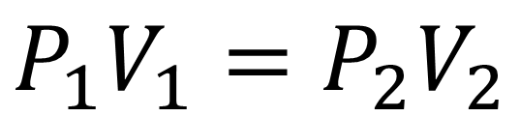
$$P_{1}V_{1}=P_{2}V_{2}$$
Chapter 8.2
Notes:
(a) about 17–18 mL; (b) ~18 mL; (c) 17.7 mL; it was more difficult to estimate well from the P-V graph, so (a) is likely more inaccurate than (b); the calculation will be as accurate as the equation and measurements allow

Slide 23
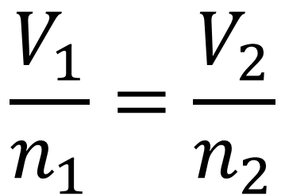
Moles of gas is proportional to volume: Avogadro’s Law
V n
$$∝$$
$$\frac{V_{1}}{n_{1}}=\frac{V_{2}}{n_{2}}$$
V n
V n
Chapter 8.2

Slide 24
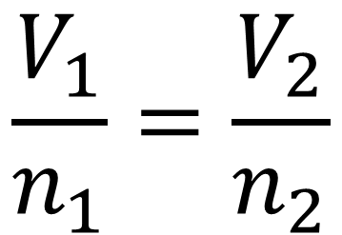
$$\frac{V_{1}}{n_{1}}=\frac{V_{2}}{n_{2}}$$
Chapter 8.2, This page titled 11.7: Avogadro’s Law- Volume and Moles is shared under a CK-12 license and was authored, remixed, and/or curated by Marisa Alviar-Agnew & Henry Agnew
Notes:
0.350 L

Slide 25
Combined and Ideal Gas Law
Chapter 8.2 (Relating Pressure, Volume, Amount (Moles), and Temperature: The Ideal Gas Law
Adapted From: Paul Flowers, Edward J. Neth, William R. Robinson, PhD, Klaus Theopold, Richard Langley; Chemistry: Atoms First 2e; OpenStax; Feb 14, 2019; Houston Texas; https://openstax.org/books/chemistry-atoms-first-2e/pages/1-introduction

Slide 26
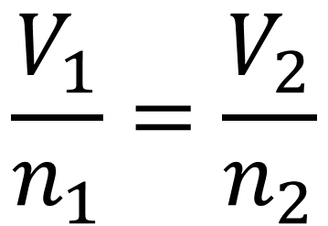
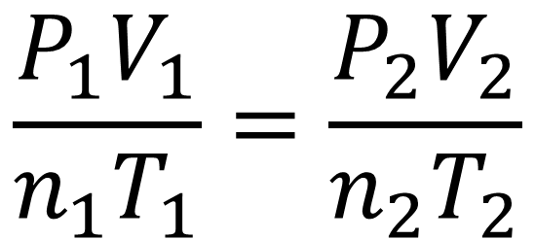
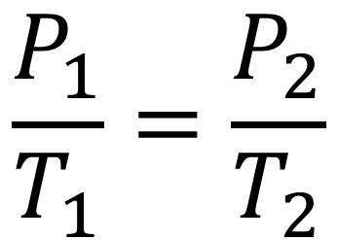
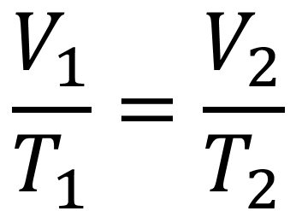
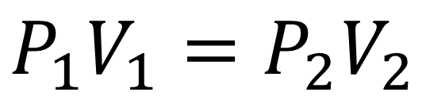
The combined gas law does it all!
$$\frac{P_{1}}{T_{1}}=\frac{P_{2}}{T_{2}}$$
$$\frac{V_{1}}{T_{1}}=\frac{V_{2}}{T_{2}}$$
$$\frac{P_{1}V_{1}}{n_{1}T_{1}}=\frac{P_{2}V_{2}}{n_{2}T_{2}}$$
$$P_{1}V_{1}=P_{2}V_{2}$$
$$\frac{V_{1}}{n_{1}}=\frac{V_{2}}{n_{2}}$$
Chapter 8.2

Slide 27
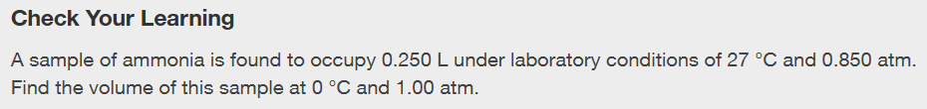
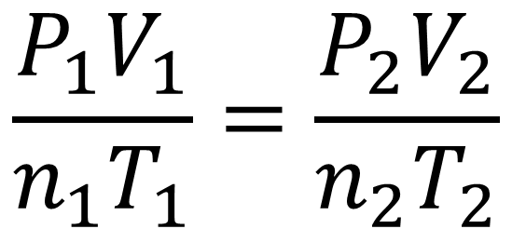
$$\frac{P_{1}V_{1}}{n_{1}T_{1}}=\frac{P_{2}V_{2}}{n_{2}T_{2}}$$
Chapter 8.2
Notes:
0.193 L

Slide 28
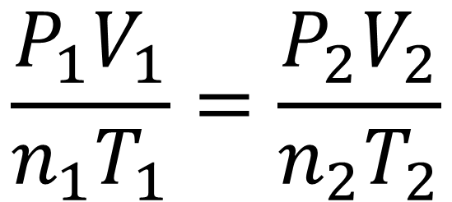
$$\frac{P_{1}V_{1}}{n_{1}T_{1}}=\frac{P_{2}V_{2}}{n_{2}T_{2}}$$
Chapter 8.2
Notes:
(a) about 17–18 mL; (b) ~18 mL; (c) 17.7 mL; it was more difficult to estimate well from the P-V graph, so (a) is likely more inaccurate than (b); the calculation will be as accurate as the equation and measurements allow

Slide 29
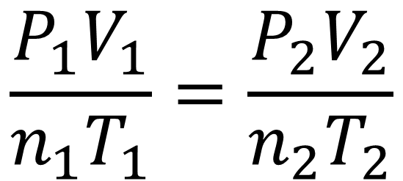
$$\frac{P_{1}V_{1}}{n_{1}T_{1}}=\frac{P_{2}V_{2}}{n_{2}T_{2}}$$
This page titled 11.7: Avogadro’s Law- Volume and Moles is shared under a CK-12 license and was authored, remixed, and/or curated by Marisa Alviar-Agnew & Henry Agnew
Notes:
0.350 L

Slide 30




The ideal gas law relates pressure, volume, moles, and temp
P T
$$∝$$
Gas Constant (R)
R = 0.08206 L · atm
mol · K
V n
$$∝$$
V T
$$∝$$
_______
$$∝$$
PV nT
PV = nRT
Chapter 8.2

Slide 31
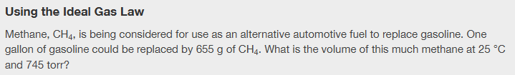


760 torr = 1 atm
K = ºC + 273.15
PV=nRT
R = 0.08206 L · atm
mol · K
___
Chapter 8.2
Notes:
1.02 x 10^3 L

Slide 32
1 atm = 101,325 Pa = 760 torr K = ºC + 273.15
PV=nRT
R = 0.08206 L · atm
mol · K
1 bar = 100,000 Pa
___
Chapter 8.2
Notes:
350 bar

Slide 33
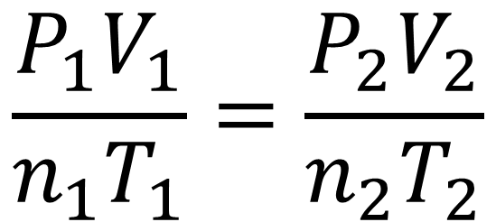
Important Gas Equations and Conversions
$$\frac{P_{1}V_{1}}{n_{1}T_{1}}=\frac{P_{2}V_{2}}{n_{2}T_{2}}$$
PV = nRT
____
R = 0.08206 L · atm
mol · K
K = ºC + 273.15
Chapter 8.1, 8.2

