Slide 1



Chem
With
Com

Slide 2
Stoichiometry
Chapter 7.3 (Reaction Stoichiometry)
Chapter 7.4 (Reaction Yields)
Chapter 7.5 (Quantitative Chemical Analysis)
Adapted From: Paul Flowers, Edward J. Neth, William R. Robinson, PhD, Klaus Theopold, Richard Langley; Chemistry: Atoms First 2e; OpenStax; Feb 14, 2019; Houston Texas; https://openstax.org/books/chemistry-atoms-first-2e/pages/1-introduction

Slide 3
Stoichiometry Basics
Chapter 7.3 (Reaction Stoichiometry)
Adapted From: Paul Flowers, Edward J. Neth, William R. Robinson, PhD, Klaus Theopold, Richard Langley; Chemistry: Atoms First 2e; OpenStax; Feb 14, 2019; Houston Texas; https://openstax.org/books/chemistry-atoms-first-2e/pages/1-introduction

Slide 4
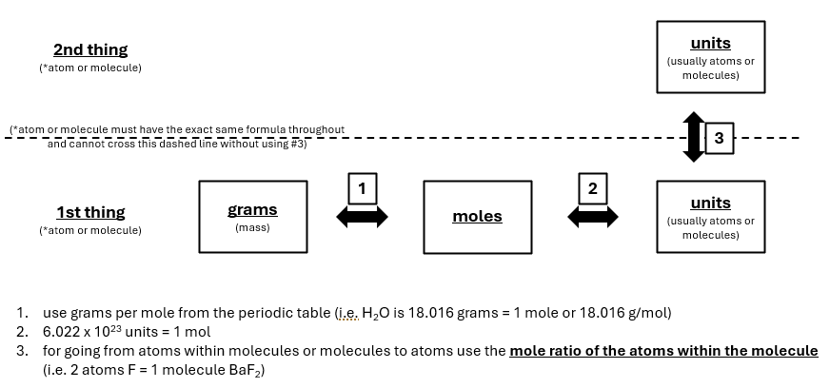
Review
Topic 6: Measurements, Prefixes, and Dimensional Analysis
Part 4 of 4: Dimensional Analysis (grams to moles to units)

Slide 5
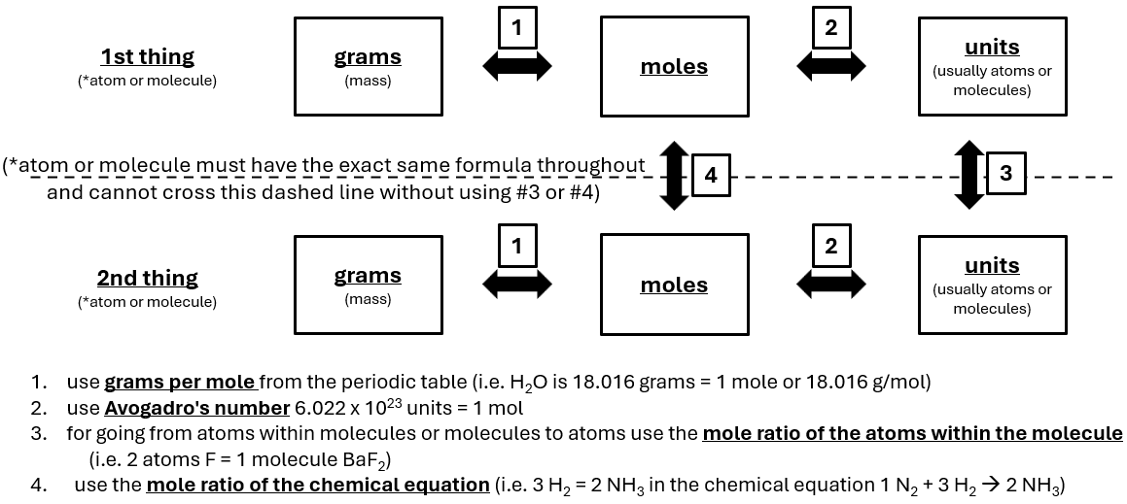
Stoichiometry expands on this using the mole ratio.

Slide 6
A recipe lets you know how much you need of things, and how much you can make of something
Ratio
2 bread : 1 cheese
1 cheese : 1 sandwich
2 bread : 1 sandwich
2 Bread + 1 Cheese → 1 Sandwich
+ →
If we have 10 bread, how many cheese do we need?
If we have 20 sandwiches, how many pieces of bread do we have?
If we have 3 pieces of cheese, how many sandwiches can we make if we had unlimited bread?
Chapter 7.1

Slide 7
A balanced equation lets you know how much you need of things, and how much you can make of something
Mole Ratio
2 Ag : 1 S
1 S : 1 Ag₂S
2 Ag : 1 Ag₂S
2 Ag (s) + 1 S (s) → 1 Ag₂S (s)
Ag
+ →
S
S
Ag
Ag
Ag
If we have 10 silver, how many sulfur do we need?
If we have 20 silver sulfides, how many silver to we have?
If we have 3 sulfur, how many silver sulfides can we make if we had unlimited silver?
Chapter 7.1

Slide 8
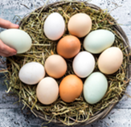
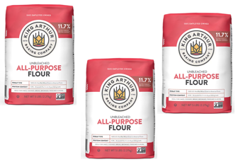
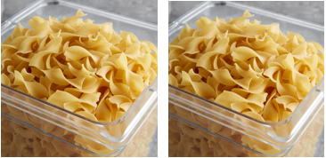
The mole ratio works for food
1 pack eggs + 3 packs of flour → 2 boxes of noodles
1 pack eggs to 3 packs of flour
1 pack eggs to 2 boxes of noodles
3 packs of flour to 2 boxes of noodles
Ratios
3 packs flour : 2 boxes noodles
3 dozen packs flour : 2 dozen boxes noodles
3 hundred packs flour : 2 hundred boxes noodles
3 moles of packs of flour : 2 moles of boxes of noodles
3 x (6.022 x 10²³) packs of flour : 2 x (6.022 x 10²³) boxes of noodles

Slide 9
The mole ratio works for chemical equations.
1 pack eggs + 3 packs of flour → 2 boxes of noodles
1 N₂(g) + 3 H₂(g) → 2 NH₃(g)
H
N
H
N
N
H
H
H
N
H
H
H
H
H
H
H
1 N₂ to 3 H₂
1 N₂ to 2 NH₃
3 H₂ to 2 NH₃
Ratios
3 H₂ : 2 NH₃
3 dozen H₂ : 2 dozen NH₃
3 hundred H₂ : 2 hundred NH₃
3 moles H₂ : 2 moles NH₃
3 x (6.022 x 10²³) H₂ : 2 x (6.022 x 10²³) NH₃
Chapter 7.3

Slide 10
The mole ratio works for molecules as well.
Sandwich
Water
O
H
H
Mole Ratio
2 bread : 1 cheese
1 cheese : 1 sandwich
2 bread : 1 sandwich
Mole Ratio
2 H : 1 O
1 O : 1 H₂O
2 H : 1 H₂O

Slide 11
The mole ratio is used for calculations involving various products and reactants as well as atoms within molecules.
Mole ratio of atoms to molecules
Mole ratio within/between reactants and products

Slide 12
Converting between moles of something to moles of something else requires the mole ratio

Slide 13
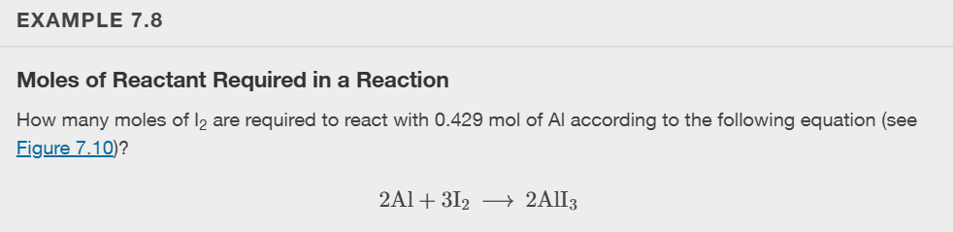
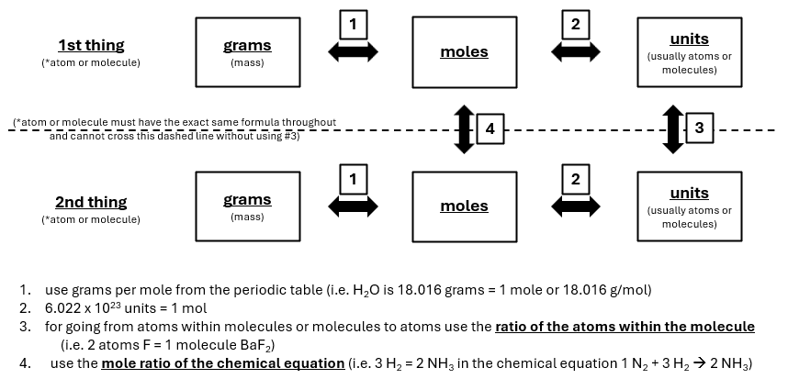
Multiply the value you are trying to convert by the mole ratio with the unit you are trying to cancel out on the bottom
2 Al : 3 I₂
0.429 mol Al x 3 mol I₂ = 0.6435 mol I₂
________
2 mol Al
mole ratio
4 Al : 6 I₂
2 to 3 ratio
20 Al : 30 I₂
2 to 3 ratio
1 Al : 1.5 I₂
2 to 3 ratio
0.5 Al : 0.75 I₂
2 to 3 ratio
0.429 Al : 0.6435 I₂
2 to 3 ratio
Chapter 7.3

Slide 14
Practice Problems
N₂(g) + 3H₂(g) → 2NH₃(g)
How many mol of H₂ do we need to fully react 2 mol of N₂?
How many mol H₂ do you need to synthesize 12 mol NH₃?
If we have 1.5 mol N₂, how many mol NH₃ can we make if we had unlimited H₂?

Slide 15
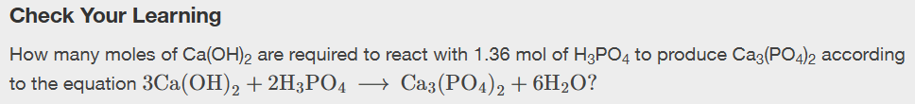
Chapter 7.3
Notes:
2.04 mol Ca(OH)₂

Slide 16
Stoichiometry
Chapter 7.3 (Reaction Stoichiometry)
Adapted From: Paul Flowers, Edward J. Neth, William R. Robinson, PhD, Klaus Theopold, Richard Langley; Chemistry: Atoms First 2e; OpenStax; Feb 14, 2019; Houston Texas; https://openstax.org/books/chemistry-atoms-first-2e/pages/1-introduction

Slide 17
Stoichiometry Expands On This

Slide 18
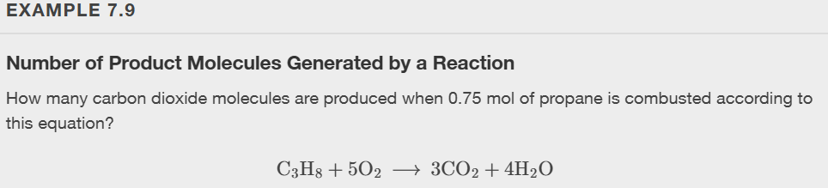
Step 1: Write one reactant or product on one side of the dotted line
Step 2: Write the other reactant or product on the other side of the dotted line
Step 3: Label your start and end points
Step 4: Move through the boxes only using the arrows and use the numbered conversion factors listed
C₃H₈
Start
CO₂
End
0.75 mol C₃H₈ x
3 mol CO₂ x
1 mol C₃H₈
6.022 x 10²³ molecules CO₂
1 mol CO₂
= 1.4 x 10²⁴ molecules CO₂
Chapter 7.3
Notes:
1.4 x 10^24 CO2 molecules

Slide 19
Chapter 7.3
Notes:
1.4 x 10^23 CO2 molecules

Slide 20
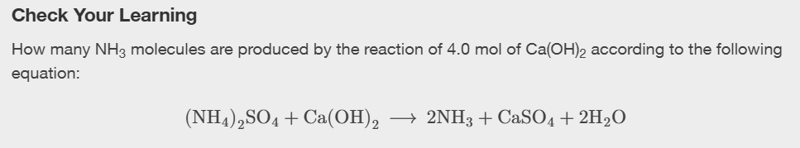
Chapter 7.3
Notes:
4.8 × 10²⁴ NH₃ molecules

Slide 21
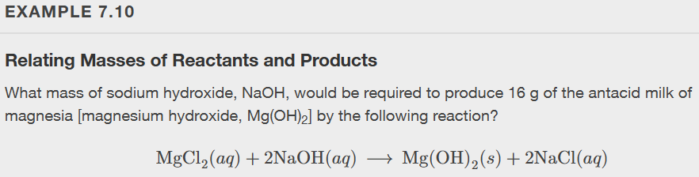




Chapter 7.3
Notes:
22 g NaOH

Slide 22
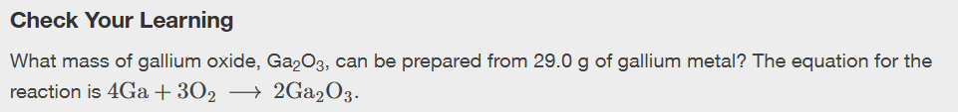

Chapter 7.3
Notes:
39.0 g Ga2O3

Slide 23
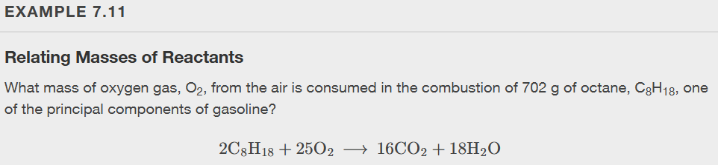

Chapter 7.3
Notes:
2.46 x 10^3 g O2

Slide 24
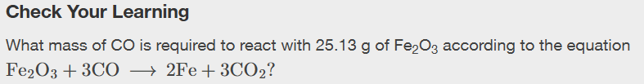

Chapter 7.3
Notes:
13.22 g CO

Slide 25
Limiting Reactants
Chapter 7.4 (Reaction Yields)
Adapted From: Paul Flowers, Edward J. Neth, William R. Robinson, PhD, Klaus Theopold, Richard Langley; Chemistry: Atoms First 2e; OpenStax; Feb 14, 2019; Houston Texas; https://openstax.org/books/chemistry-atoms-first-2e/pages/1-introduction

Slide 26
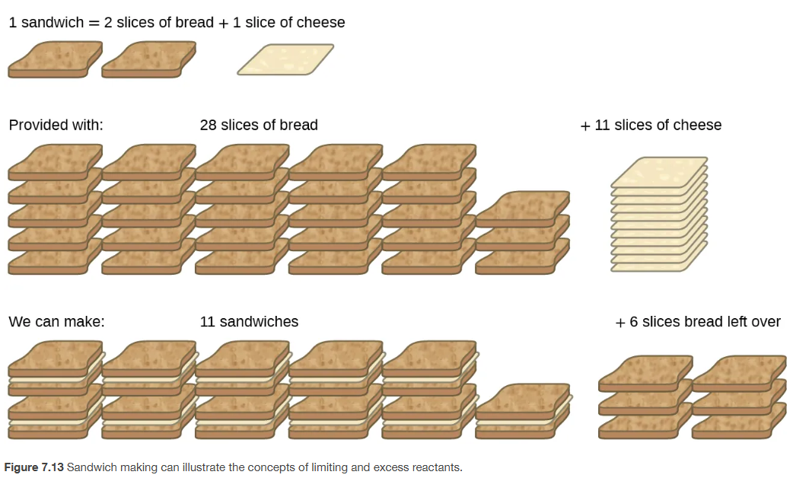
Limiting Reactants
Chapter 7.4

Slide 27

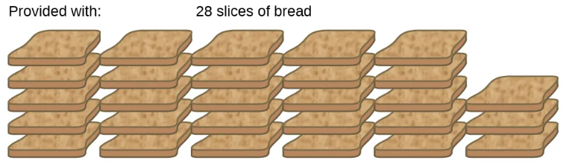
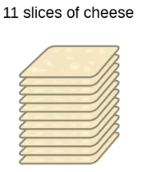
Test both reactants to see which is limiting.
Our recipe →
What we actually have →
(example, just made this up)
28 slices of bread
11 slices of cheese
What we have →
Test ingredient 1 with unlimited of ingredient 2
+ Unlimited Cheese
→ 14 sandwiches
Since 14 sandwiches is more than 11 sandwiches, the bread is the excess ingredient
Test ingredient 2 with unlimited of ingredient 1
What we have →
+ Unlimited Bread
→ 11 sandwiches
Since 11 sandwiches is less than 14 sandwiches, the cheese is the limiting ingredient
Chapter 7.4

Slide 28

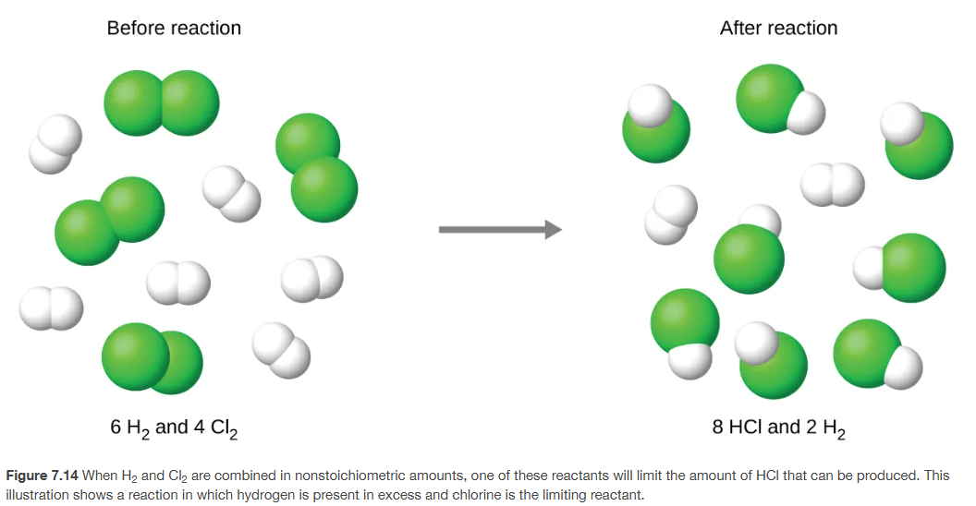
Test both reactants to see which is limiting.
What we actually have →
(example, just made this up)
6 moles H₂
4 mole Cl₂
Our recipe →
Chapter 7.4

Slide 29

Test both reactants to see which is limiting.
What we actually have →
(example, just made this up)
3 moles H₂
2 mole Cl₂
Our recipe →
What we have →
3 moles H₂
Test reactant 1 with unlimited of reactant 2
Since 6 mol HCl is more than 4 mol HCl, the H₂ is the excess ingredient
Test reactant 2 with unlimited of reactant 1
What we have →
2 mole Cl₂
Since 4 mol HCl is less than 6 mol HCl, the Cl₂ is the limiting reactant
Chapter 7.4

Slide 30
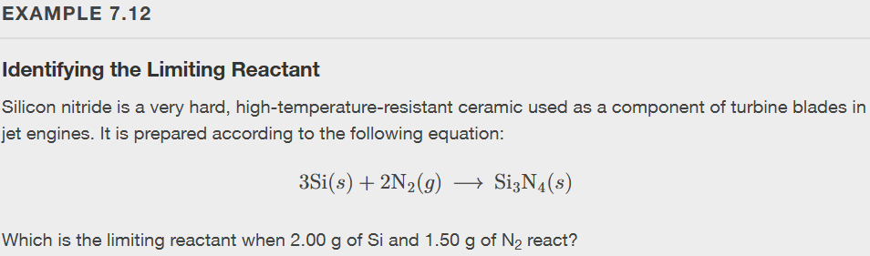


Chapter 7.4
Notes:
Since silicon yields the lesser amount of product, it is the limiting reactant.

Slide 31

Chapter 7.4

Slide 32
Quantitative Chemical Analysis
Chapter 7.5 (Quantitative Chemical Analysis)
Adapted From: Paul Flowers, Edward J. Neth, William R. Robinson, PhD, Klaus Theopold, Richard Langley; Chemistry: Atoms First 2e; OpenStax; Feb 14, 2019; Houston Texas; https://openstax.org/books/chemistry-atoms-first-2e/pages/1-introduction

Slide 33
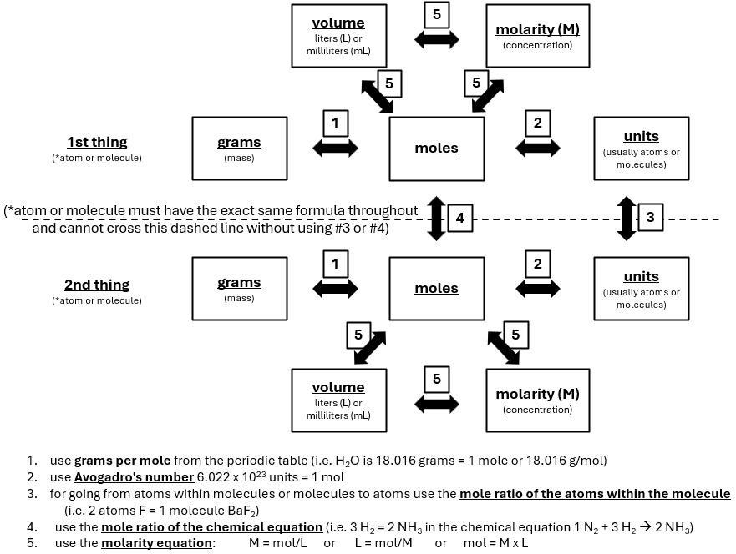
The molarity equation lets us convert moles to volume to M
Chapter 7.5

Slide 34
The molarity equation lets us convert moles to volume to M
start
Ca(OH₂)
Ca(OH₂)(aq) + 2HBr(aq) → CaBr₂(aq) + 2H₂O(l)
125 mL Ca(OH₂)
0.0100 M Ca(OH₂)
0.0105 M HBr
Step 1: Write one reactant or product on one side of the dotted line
Step 2: Write the other reactant or product on the other side of the dotted line
Step 3: Label your start and end points
Step 4: Move through the boxes only using the arrows and use the numbered conversion factors listed
HBr
end
convert mL to L
molarity/volume to moles
mol ratio of HBr to Ca(OH)₂
125 mL Ca(OH₂) x
1 L x
1000 mL
0.125 L Ca(OH₂) x
0.0100 M Ca(OH)₂ =
0.00125 mol Ca(OH)₂ x
2 mol HBr =
1 mol Ca(OH)₂
mol to volume using M from problem
0.00250 mol HBr
0.00250 mol HBr = 0.238 L or 238 mL
0.0105 M HBr
Chapter 7.5
continued

Slide 35
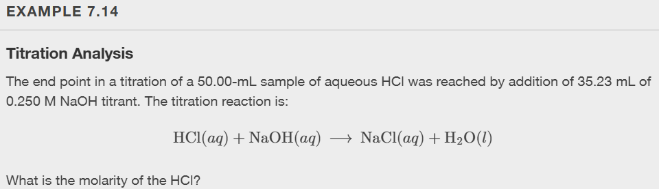
Chapter 7.5
Notes:
0.176 M HCl

Slide 36
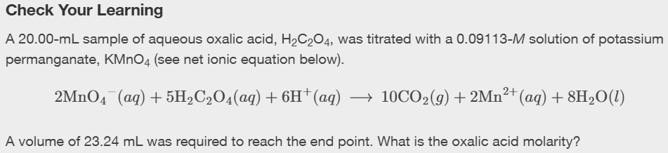
Chapter 7.5
Notes:
0.2648 M H2C2O4

