Slide 1



Chem
With
Com

Slide 2
Chemical Equations and Chemical Reactions
Chapter 1.3 (Physical and Chemical Properties)
Chapter 7.1 (Writing and Balancing Chemical Equations)
Chapter 7.2 (Classifying Chemical Reactions)
Adapted From: Paul Flowers, Edward J. Neth, William R. Robinson, PhD, Klaus Theopold, Richard Langley; Chemistry: Atoms First 2e; OpenStax; Feb 14, 2019; Houston Texas; https://openstax.org/books/chemistry-atoms-first-2e/pages/1-introduction

Slide 3
Chemical Equations and Balancing
Chapter 7.1 (Writing and Balancing Chemical Equations)
Adapted From: Paul Flowers, Edward J. Neth, William R. Robinson, PhD, Klaus Theopold, Richard Langley; Chemistry: Atoms First 2e; OpenStax; Feb 14, 2019; Houston Texas; https://openstax.org/books/chemistry-atoms-first-2e/pages/1-introduction

Slide 4
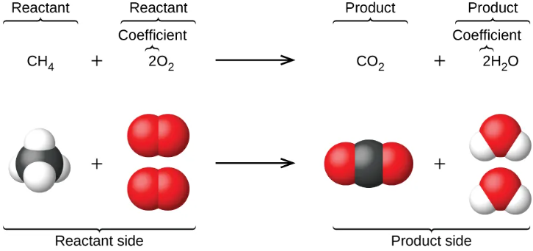
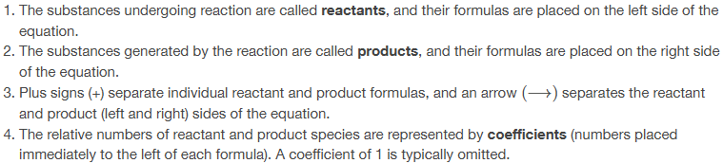
Chemical Equations
Chapter 7.1

Slide 5



Cooking is similar to chemistry
1 pie mix
+
2 bananas
2 banana pies
Pie Mix
+
Chapter 7.1

Slide 6

States of Matter
Phase | Symbol | Examples | Notes
Solid | (s) | PbI₂ (s), H₂O (s) | These can be suspended solids in a liquid or dry solids
Liquid | (l) (lowercase “L”) | H₂O (l), C₈H₁₈ (l)
Gas | (g) | N₂ (g), O₂ (g), H₂O (g)
Aqueous | (aq) | NaCl (aq), Ag¹⁺ (aq) | Dissolved in water. Compounds like NaCl (aq) are actually separate like Na¹⁺ (aq) and Cl¹⁻ (aq)
Chapter 7.1

Slide 7
Ingredients List vs Recipe
Bread + Cheese → Sandwich
Ingredients list = unbalanced equation
How much do we need of each??
2 Bread + 1 Cheese → 1 Sandwich
Recipe = balanced equation
Ratio
2 bread : 1 cheese
1 cheese : 1 sandwich
2 bread : 1 sandwich
Chapter 7.1

Slide 8
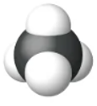



Ingredients List vs Recipe
CH₄ + O₂ → CO₂ + H₂O
Ingredients list = unbalanced equation
How much do we need of each??
CH₄ + 2 O₂ → CO₂ + 2 H₂O
Recipe = balanced equation
Ratio
1 CH₄ : 2 H₂O
1 CH₄ : 2 O₂
2 O₂ : 1 CO₂
1 CO₂ : 2 H₂O
Many more ratios!
Chapter 7.1

Slide 9
Chemical reactions are just rearrangement of atoms
Bread + Cheese → Sandwich
At your house you have many ingredients. Most of the time you don’t just have 2 pieces of bread and 1 piece of cheese.
Bread + Cheese → Sandwich
We know if there is an ingredient or product, we must have at least one of those.
2 Bread + 1 Cheese → 1 Sandwich
Chemical reactions are just rearrangements of atoms so whatever quantity of ingredients we start with, we have to finish with. Since the product is a sandwich, we must have 2 pieces of bread and 1 piece of cheese as ingredients.
Chapter 7.1

Slide 10
Chemical reactions are just rearrangement of atoms
CH₄ + O₂ → CO₂ + H₂O
In a chemical reaction you have many reactants. You don’t just have the exact amount of reactants.
CH₄ + O₂ → CO₂ + H₂O
We know if there is a reactant or product, we must have at least one of those.
CH₄ + 2 O₂ → CO₂ + 2 H₂O
Chemical reactions are just rearrangements of atoms so whatever quantity of reactants we start with, we have to finish with. Since the products have 4 oxygen atoms, 4 hydrogen atoms, and 1 carbon atom, we need the same in the reactants
Chapter 7.1

Slide 11

Ratios of ingredients and products can be in any quantities but chemists use moles. This is the mole ratio!
CH₄ + 2 O₂ → CO₂ + 2 H₂O
Ratio
1 CH₄ : 2 O₂
1 dozen CH₄ : 2 dozen O₂
1 hundred CH₄ : 2 hundred O₂
1 mole CH₄ : 2 moles O₂
1 x (6.022 x 10²³) CH₄ : 2 x (6.022 x 10²³) O₂
Chapter 7.1

Slide 12
Balancing Equations = creating a recipe and using up all the ingredients
You’ve been invited to a potluck style party. You were tasked with bringing surf and turf burgers for everyone (1 hamburger patty+1 crispy fish patty+3 buns+1 piece of cheese). You go to the burger shop and they don’t have any so you decide the closest thing is to buy a crispy fish sandwich and a cheeseburger and assemble them yourself. You don’t want to waste anything so you assemble all the ingredients you don’t need into something else as well.
Cheeseburger
CHB₂
Crispy Fish Sandwich
CFB₂
Surf and Turf Burger
CFHB₃
Bun
B
Cheese
C
KEY
C = cheese
H = Hamburger
F = Crispy Fish Patty
B = Bun
+
+
+
+
Can’t really serve a piece of bread and cheese so you need to buy more ingredients to use everything up
2 Cheeseburgers
2 CHB₂
2 Crispy Fish Sandwiches
2 CFB₂
2 Surf and Turf Burgers
2 CFHB₃
1 Grilled Cheese
1 C₂B₂
+
+

Slide 13
How to balance chemical equations – Com’s Way
Take inventory of all the atoms (or polyatomic ions) in the reactants and products.
Select a reactant or product with the most atoms.
Within your selection, choose an atom (or polyatomic ion) and balance them on both sides of the reaction arrow by increasing the coefficient on the reactant or product.
Retake inventory of all the atoms in the reactant and products
Repeat steps 3 and 4 with the other atom (or polyatomic ion) that was in your original selection.
Choose another atom or reactant or product to balance and repeat steps 3 and 4
Repeat step 6 as many times as necessary
Note: If polyatomic ions are together in the reactants and products, keep them together and don’t separate into atoms
NO₃ the same on both sides of reaction
NH₄ NOT the same on both sides of reaction
Chapter 7.1

Slide 14
How to balance chemical equations – Com’s Way
CH₄ + O₂ → CO₂ + H₂O
Step 1: Take inventory of all the atoms or polyatomic ions in the reactants and products
C = 1
H = 4
O = 2
C = 1
H = 2
O = 3
Step 2: Select a reactant or product with the most atoms. (CH₄ has the most atoms)
5 atoms
CH₄ + O₂ → CO₂ + 2 H₂O
C = 1
H = 4
O = 2
C = 1
H = 2
O = 3
Step 3: Within your selection, choose an atom (or polyatomic ion) and balance them on both sides of the reaction arrow by increasing the coefficient on the reactant or product. (choosing H)
4
4
Step 4: Retake inventory of all the atoms in the reactant and products. (Even though we picked H, we also change O because we increased the coefficient that affected the oxygen in the product)
Step 5: Repeat steps 3 and 4 with the other atom (or polyatomic ion) that was in your original selection. (C in CH₄ already balanced)
CH₄ + 2 O₂ → CO₂ + 2 H₂O
C = 1
H = 4
O = 2
C = 1
H = 2
O = 3
4
4
4
Step 6: Choose another atom or reactant or product to balance and repeat steps 3 and 4. (oxygen is the last atom needing balancing)
Step 4: again
Step 7: Repeat step 6 as many times as necessary
Chapter 7.1
Step 3: again

Slide 15

Unbalanced equation N₂ (g) + O₂ (g) → N₂O₅ (s)
Chapter 7.1
Notes:
2N2 + 5O2 -> 2N2O5

Slide 16
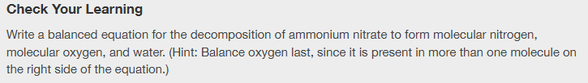
Unbalanced equation NH₄NO₃ (s) → N₂ (g) + O₂ (g) + H₂O (l)
Chapter 7.1
Notes:
2NH4NO3 -> 2N2 + O2 + 4H2O

Slide 17
Balancing Practice
Chapter 7.1

Slide 18
Building Molecular Equations and Net Ionic Equations
Chapter 1.3 (Physical and Chemical Properties)
Chapter 7.1 (Writing and Balancing Chemical Equations)
Adapted From: Paul Flowers, Edward J. Neth, William R. Robinson, PhD, Klaus Theopold, Richard Langley; Chemistry: Atoms First 2e; OpenStax; Feb 14, 2019; Houston Texas; https://openstax.org/books/chemistry-atoms-first-2e/pages/1-introduction

Slide 19
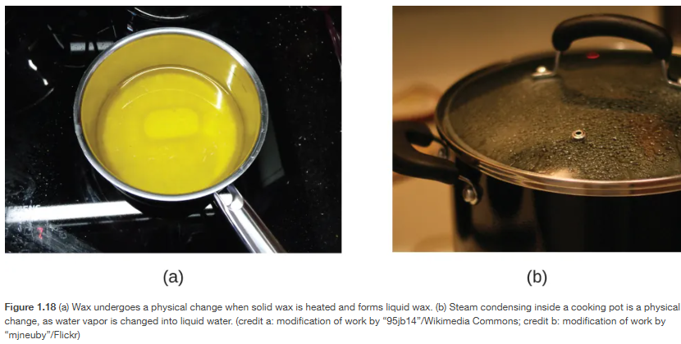
Physical changes are the same chemical formula, but just in different states of matter – solid, liquid, gas
Chapter 1.3

Slide 20
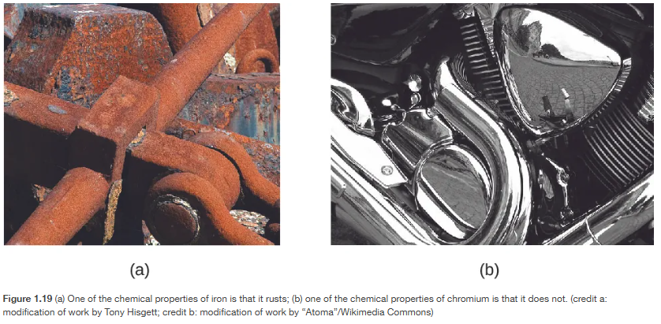
Changing matter into something else and changing the chemical formula is a chemical change
Chapter 1.3

Slide 21
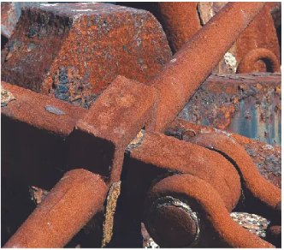
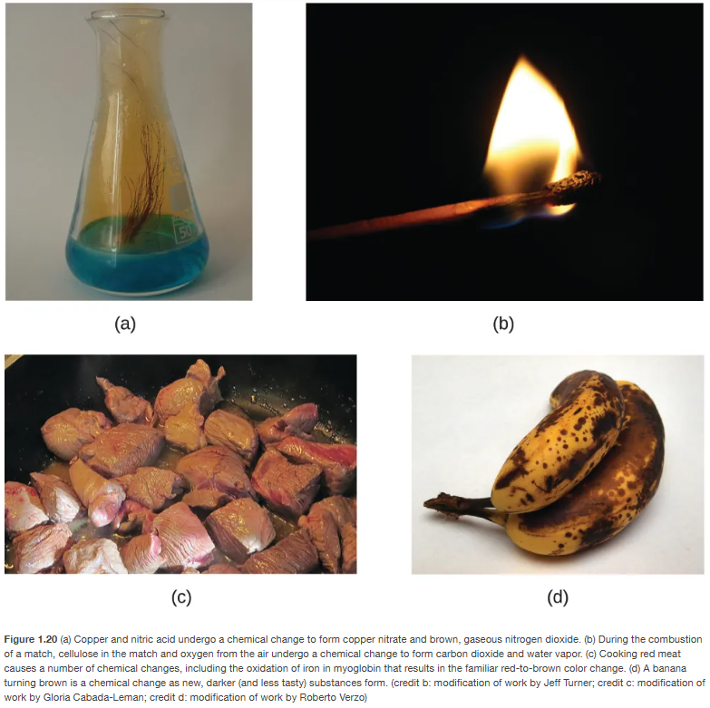
Rusting
Burning
Rotting
Cooking
Chapter 1.3

Slide 22


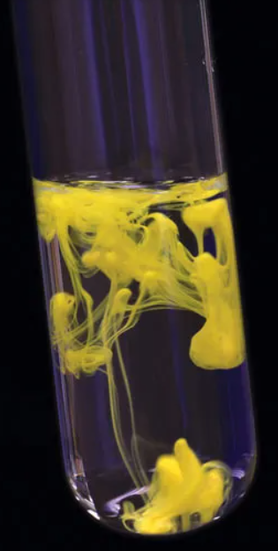
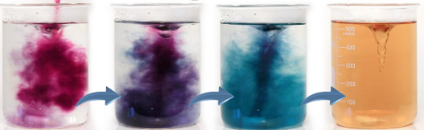
Did a chemical reaction occur??
Gas Formed – bubbles, vapor, odor
Energy Transfer – light, heat, cold
Precipitate – solid forming in various solutions (opposite of dissolving)
Color Change
https://www.britannica.com/science/chemical-reaction/Precipitation-reactions
YouTube – DIY bama

Slide 23
Building a balanced molecular equations from words
Nomenclature Review (Topic 5)
Go word by word and write chemical symbols, reaction symbols, phases, and charges. (Topic 5)
Build chemical reaction by making neutral compounds. (Topic 5)
Balance
CO₂
(aq)
(aq)
Na¹⁺
OH¹⁻
→
+
(aq)
Na¹⁺
CO₃²⁻
(l)
H₂O
CO₂ (aq)
+
NaOH (aq)
→
Na₂CO₃ (aq)
H₂O (l)
+
Aqueous because it said dissolved in a aqueous solution
1 Na¹⁺ and 1 OH¹⁻ because together they make a neutral compound
2 Na¹⁺ and 1 CO₃²⁻ because together they make a neutral compound
CO₂ (aq)
+
2 NaOH (aq)
→
Na₂CO₃ (aq)
H₂O (l)
+
Chapter 7.1

Slide 24
Chapter 7.1

Slide 25
Net Ionic Equations – Where the action is!
complete balanced molecular equation
CO₂ (aq)
+
2 NaOH (aq)
→
Na₂CO₃ (aq)
H₂O (l)
+
total ionic equation
CO₂ (aq)
+
+
2 Na¹⁺ (aq)
2 OH¹⁻ (aq)
+
+
→
2 Na¹⁺ (aq)
CO₃²⁻ (aq)
H₂O (l)
net ionic equation
CO₂ (aq)
+
2 OH¹⁻ (aq)
+
→
CO₃²⁻ (aq)
H₂O (l)
Chapter 7.1

Slide 26
Net Ionic Equations – Where the action is!
Build a complete balanced molecular equation from words
Total Ionic Equation - separate all ionic aqueous reactants and products
Polyatomic ions stay together!
Net Ionic Equation – leave out spectator ions. Spectator ions are ions that are exactly the same on the reactant and product sides. Spectator ions don’t really do anything but watch the other ions work!
complete balanced molecular equation
CO₂ (aq)
+
2 NaOH (aq)
→
Na₂CO₃ (aq)
H₂O (l)
+
aqueous but not ionic
liquid so not aqueous
total ionic equation
CO₂ (aq)
+
+
2 Na¹⁺ (aq)
2 OH¹⁻ (aq)
+
+
→
2 Na¹⁺ (aq)
CO₃²⁻ (aq)
H₂O (l)
net ionic equation
CO₂ (aq)
+
2 OH¹⁻ (aq)
+
→
CO₃²⁻ (aq)
H₂O (l)
Chapter 7.1

Slide 27
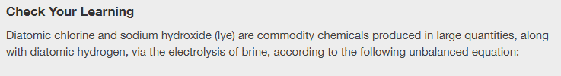
(sodium chloride) in water
Chapter 7.1

Slide 28
Write the complete balanced molecular equation, total ionic equation, and net ionic equation for the following:
Chapter 7.1

Slide 29
Precipitation and Acid-Base Reactions
Chapter 7.2 (Classifying Chemical Reactions)
Adapted From: Paul Flowers, Edward J. Neth, William R. Robinson, PhD, Klaus Theopold, Richard Langley; Chemistry: Atoms First 2e; OpenStax; Feb 14, 2019; Houston Texas; https://openstax.org/books/chemistry-atoms-first-2e/pages/1-introduction

Slide 30
Types of Reactions
Precipitation Reactions – two solutions mixed together create a solid
Acid-Base Reactions – combining and acid and a base to make water and a “salt”
Oxidation-Reduction (Redox) Reactions – a transfer of electrons
Chapter 7.2

Slide 31
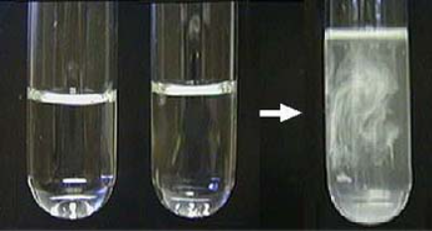
Precipitation Reactions
Combining two solutions results in the formation of a solid (precipitate)
The opposite of dissolving
Most are ionic reactions
Usually from double replacement reactions (A and C are swapping places)
AB + CD → AD + CB
Chapter 7.2, Harper College

Slide 32
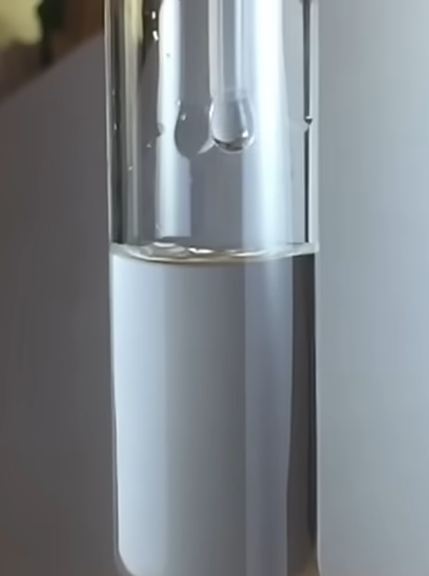
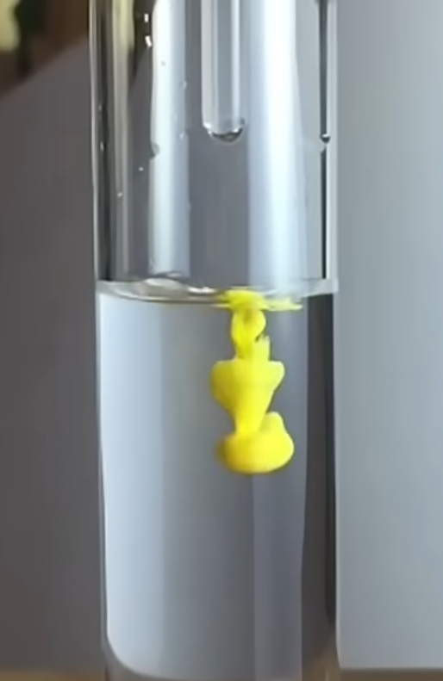
Precipitation Reactions
Lead(II) Nitrate + Potassium Iodide
Potassium Nitrate + Lead(II) Iodide
Pb(NO₃)₂ (aq) + 2 KI (aq)
2 KNO₃ (aq) + PbI₂ (s)
Chapter 7.2, YouTube – “H de G” – Lead Iodide Precipitating

Slide 33
Precipitation Reactions
EVERYTHING TOGETHER
NO₃¹⁻
I¹⁻
Pb(NO₃)₂ (aq)
Aqueous means these are separate and dissolved in water.
KI (aq)
Aqueous means these are separate and dissolved in water.
KNO₃ (aq)
Aqueous means these are still separate and dissolved in water.
PbI₂ (s)
Solid means these are now ionically bonded together and have precipitated out of solution and will eventually settle to the bottom
Pb²⁺
K¹⁺
NO₃¹⁻
I¹⁻
NO₃¹⁻
Pb²⁺
K¹⁺
K¹⁺
NO₃¹⁻
I¹⁻
NO₃¹⁻
Pb²⁺
K¹⁺
K¹⁺
NO₃¹⁻
I¹⁻
K¹⁺
NO₃¹⁻
K¹⁺
NO₃¹⁻
PbI₂
PbI₂
Pb(NO₃)₂ (aq) + 2 KI (aq)
2 KNO₃ (aq) + PbI₂ (s)
Pb²⁺ (aq) + 2 NO₃¹⁻ (aq) + 2 K¹⁺ (aq) + 2 I¹⁻ (aq)
2 KNO₃ (aq) + PbI₂ (s)
swap cations
Chapter 7.2, YouTube – “H de G” – Lead Iodide Precipitating

Slide 34
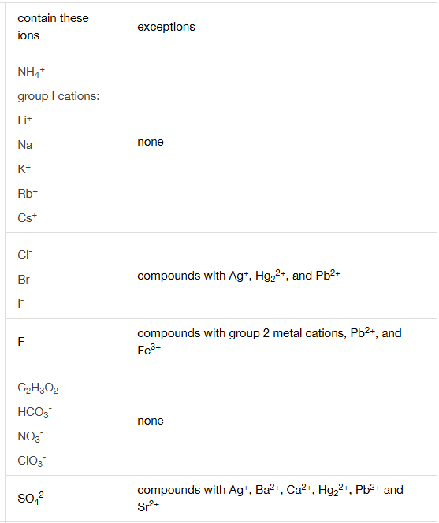
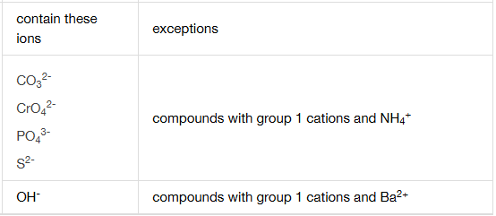
How do we know what becomes solid? Experimentally
Chapter 7.2

Slide 35
How to figure out precipitation reactions
Break apart compounds in the reactants side into cations (+) and anions (-)
Swap the cations with each other
Make neutral compounds in the products
Balance atoms in the reactants and products
Check the solubility table and see if precipitates form in the products
K₂SO₄ (aq) + Ba(NO₃)₂ (aq)
Step 1: break apart compounds
2 K¹⁺ (aq) + SO₄²⁻ (aq) + Ba²⁺ (aq) + 2 NO₃¹⁻ (aq)
BaSO₄ (??) + KNO₃ (??)
swap cations
Step 2: Swap cations
Step 3: Make neutral compounds
K₂SO₄ (aq) + Ba(NO₃)₂ (aq)
BaSO₄ (??) + 2 KNO₃ (??)
Step 4: Balance
K₂SO₄ (aq) + Ba(NO₃)₂ (aq)
BaSO₄ (s) + 2 KNO₃ (aq)
Step 5: assign phases based on solubility table

Slide 36

Chapter 7.2
Notes:
sodium sulfate, BaSO₄

Slide 37
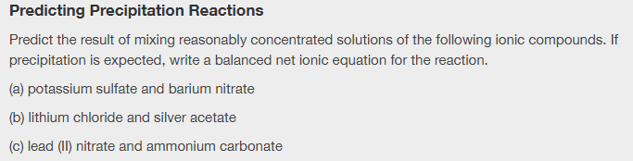
Chapter 7.2

Slide 38
Chapter 7.2

Slide 39
Acid-Base Reactions
Acids – can release a hydrogen into water
HCl (aq) → H¹⁺ (aq) + Cl¹⁻ (aq)
H₂SO₄ (aq) → 2 H¹⁺ (aq) + SO4²⁻ (aq)
Base – can accept a hydrogen
OH¹⁻ + H¹⁺ → H₂O
CO₃²⁻ + 2 H¹⁺ → H₂CO₃
Acids usually start with an H in the formula
Product is usually water
Most common base is OH¹⁻ or CO₃²⁻ but there are many other bases.
Chapter 7.2

Slide 40

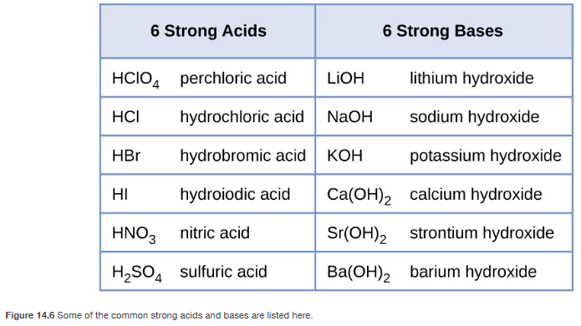
Chapter 7.2, 14.3

Slide 41
Oxidation-Reduction (redox) Reactions
Chapter 7.2 (Classifying Chemical Reactions)
Adapted From: Paul Flowers, Edward J. Neth, William R. Robinson, PhD, Klaus Theopold, Richard Langley; Chemistry: Atoms First 2e; OpenStax; Feb 14, 2019; Houston Texas; https://openstax.org/books/chemistry-atoms-first-2e/pages/1-introduction

Slide 42
Oxidation-Reduction (Redox) Reactions
Oxidation = loss of electrons; Reduction = gain of electrons
Oxidation-Reduction (redox) reactions = transfer of electrons
  An element has a different oxidation number (see next slide) in the reactants and products
Types of redox reactions:
  Combustion -
    Very common - has some C, H and O₂ in the reactants and CO₂ and H₂O in products.
  CH + O₂ → CO₂ + H₂O
  Single replacement -
    usually formation of ionic compounds
  A + BC → B + AC
  Combination -
    Things coming together
  A + B → AB
  Decomposition –
    Things coming apart
  AB → A + B
Chapter 7.2

Slide 43
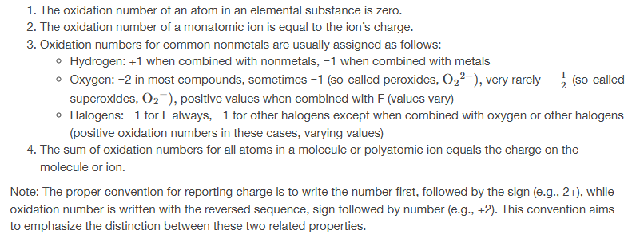
Oxidation Numbers = Book way
Oxidation Numbers = Com’s Way (beginner rules)
All of the same elements in a molecule/compound will have the same oxidation number.
Oxidation numbers within a compound, element, or ion must add up to the net electric charge.
Oxidation numbers are USUALLY the same as their expected charges. Assign them in order from highest to lowest priority. (Highest Priority) Group 1, Group 2, Fluorine, Oxygen, Group 17 (Lowest Priority)
Chapter 7.2

Slide 44
Oxidation Numbers = Com’s Way (beginner rules)
Do these in priority order starting with #1
All of the same elements in a molecule/compound will have the same oxidation number. i.e. All H will be the same in H₂O
Oxidation numbers within a compound, element, or ion must add up to the net electric charge.
Oxidation numbers are USUALLY the same as their expected charges. Assign them in order from highest to lowest priority. (Highest Priority) Group 1, Group 2, Fluorine, Oxygen, Group 17 (Lowest Priority)
Note: Rules will change and get more detailed in more advanced chemistry classes.
Al = there is no charge listed and there is only 1 atom so the oxidation number is 0
Al³⁺ = there is a 3+ charge listed and there is only 1 atom so the oxidation number is 3+
H₂ = there is no charge listed so and there are 2 H atoms so the oxidation number for 2 H’s have to add up to 0 so H + H = 0 so 0 + 0 = 0 so the oxidation # is 0
Cu₂O = there is no charge listed and there are 2 Cu and 1 O atom so Cu + Cu + O = 0.
SO₄²⁻ = there is a 2- charge listed and there is 1 S atom and 4 O atoms so S + O + O + O + O = -2
H₂O = there is no charge listed and there are 2 H atoms and 1 O atom so H + H + O = 0
H + H + O = 0
(+1)+(+1)+ O = 0
O = -2
Oxidation Numbers
H = +1
O = -2
H₂O = (no charge listed) H + H + O = 0;
assign H first (Group 1) and the usual charge is 1+ so:
Oxidation Numbers
S = +6
O = -2
SO₄²⁻ = (2- charge listed) S + O + O + O + O = -2;
assign O first (Group 16) and the usual charge is 2- so:
S + O + O + O + O = -2
S +(-2) +(-2) +(-2) +(-2) = -2
S = +6
Chapter 7.2

Slide 45
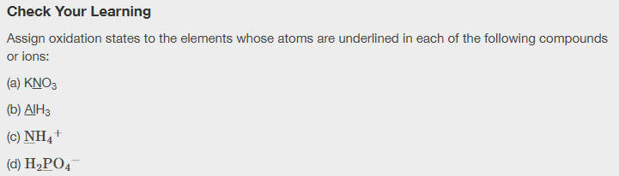
All of the same elements in a molecule/compound will have the same oxidation number.
Oxidation numbers within a compound, element, or ion must add up to the net electric charge.
Oxidation numbers are USUALLY the same as their expected charges. Assign them in order from highest to lowest priority. (Highest Priority) Group 1, Group 2, Fluorine, Oxygen, Group 17 (Lowest Priority)
Chapter 7.2

Slide 46
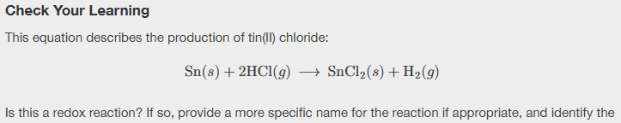
All of the same elements in a molecule/compound will have the same oxidation number.
Oxidation numbers within a compound, element, or ion must add up to the net electric charge.
Oxidation numbers are USUALLY the same as their expected charges. Assign them in order from highest to lowest priority. (Highest Priority) Group 1, Group 2, Fluorine, Oxygen, Group 17 (Lowest Priority)
Chapter 7.2

Slide 47
Reaction Summary
Precipitation Reactions – two solutions mixed together create a solid
  AB (aq) + CD (aq) → AD (s) + CB (aq)
Acid-Base Reactions – combining and acid and a base to make water and a “salt”
  Acid (H¹⁺) + Base (OH¹⁻ or CO₃²⁻) → H₂O + Salt
Oxidation-Reduction (Redox) Reactions – a transfer of electrons
  Combustion -
    usually has some C, H and O₂ in the reactants and CO₂ and H₂O in the products.
  CH + O₂ → CO₂ + H₂O
  Single replacement -
    usually formation of ionic compounds
  A + BC → B + AC
  Combination -
    Things coming together
  A + B → AB
  Decomposition –
    Things coming apart
  AB → A + B
Chapter 7.2

