Slide 1



Chem
With
Com

Slide 2
Solutions and Empirical Formula
Chapter 1.2 (Phases and Classifications of Matter)
Chapter 11.2 (Electrolytes) - how things mix - ion-dipoles
Chapter 11.3 (Solubility) – miscibility
Chapter 6.3 (Molarity)
Chapter 6.4 (Other Units for Solution Concentrations)
Chapter 6.2 (Determining Empirical and Molecular Formulas)
Adapted From: Paul Flowers, Edward J. Neth, William R. Robinson, PhD, Klaus Theopold, Richard Langley; Chemistry: Atoms First 2e; OpenStax; Feb 14, 2019; Houston Texas; https://openstax.org/books/chemistry-atoms-first-2e/pages/1-introduction

Slide 3
Mixtures
Chapter 1.2 (Phases and Classifications of Matter)
Chapter 11.2 (Electrolytes) - how things mix - ion-dipoles
Chapter 11.3 (Solubility) – miscibility
Adapted From: Paul Flowers, Edward J. Neth, William R. Robinson, PhD, Klaus Theopold, Richard Langley; Chemistry: Atoms First 2e; OpenStax; Feb 14, 2019; Houston Texas; https://openstax.org/books/chemistry-atoms-first-2e/pages/1-introduction

Slide 4
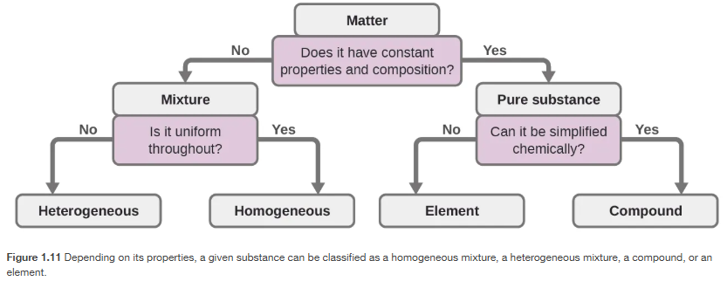
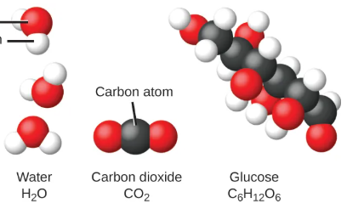
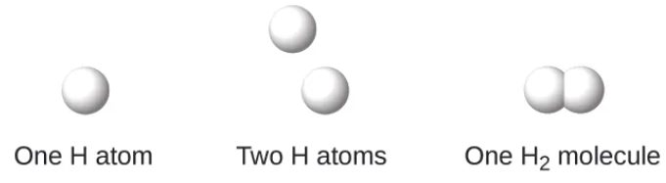
Mixtures
Chapter 1.2, 2.4

Slide 5
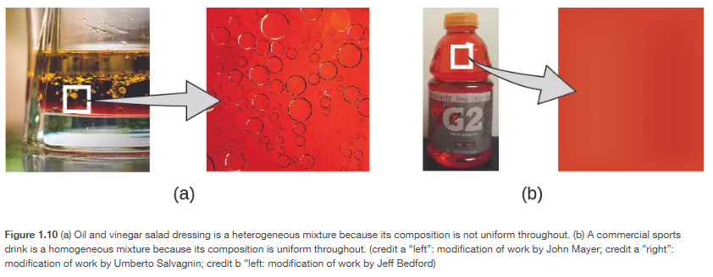
Mixtures
Solution!
Chapter 1.2

Slide 6
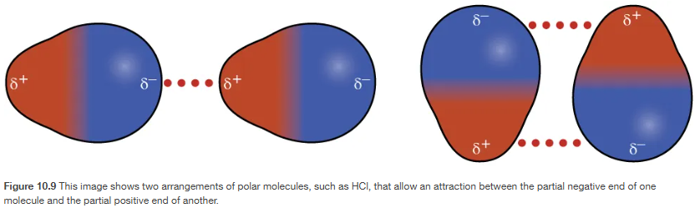
Dipole-Dipole Attractions (polar-polar)
Dipole-Dipole Attractions
Review: Topic 7
Chapter 10.1

Slide 7
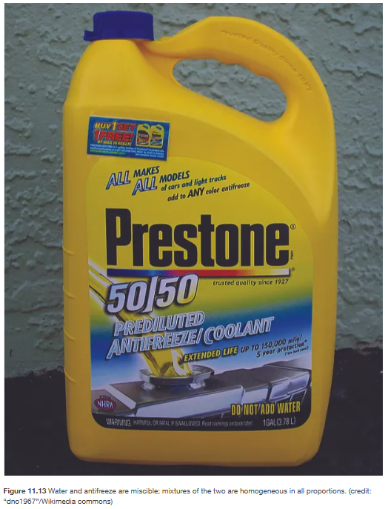
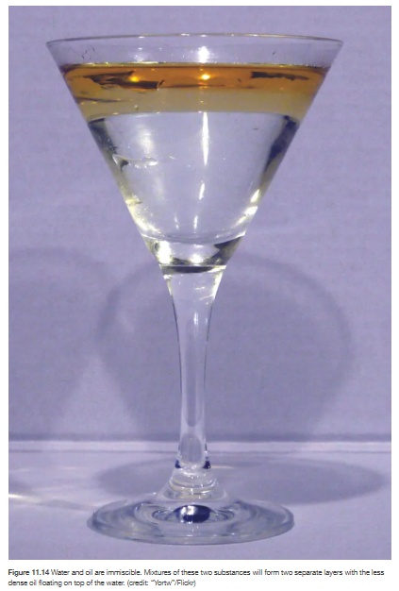
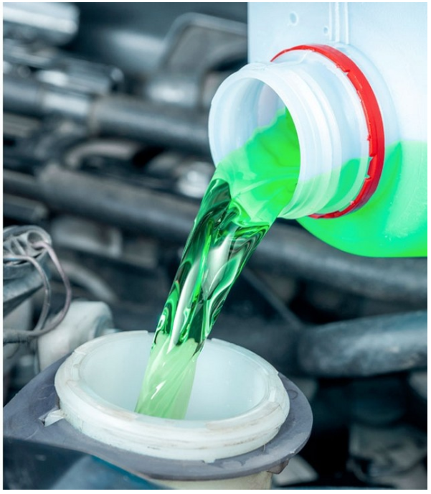
Like dissolves like – polar dissolves polar and nonpolar dissolves nonpolar
Miscible
(mixes well)
Immiscible
(doesn’t mix)
water - H₂O
polar (dipole)
+
antifeeze – C₂H₆O₂
polar (dipole)
oil
nonpolar
(no dipole)
water - H₂O
polar (dipole)
Chapter 11.3

Slide 8
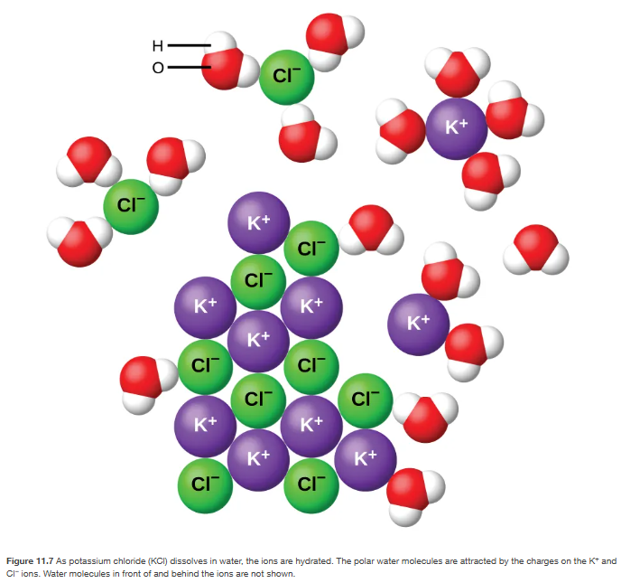
Like dissolves like - for liquids and solids as well (salt+water)
water - H₂O
polar (dipole)
Partially charged molecule
Miscible
(mixes well)
K¹⁺ or Cl¹⁻
fully charged molecule
Chapter 11.4

Slide 9
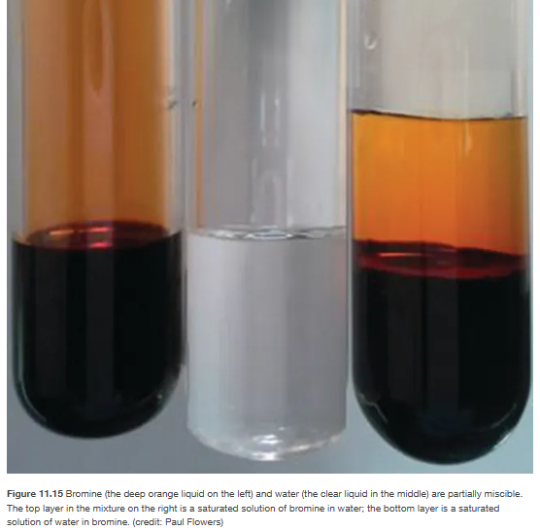
Some things are partially miscible
Chapter 11.3

Slide 10
Solutions
Chapter 6.3 (Molarity)
Chapter 6.4 (Other Units for Solution Concentrations)
Adapted From: Paul Flowers, Edward J. Neth, William R. Robinson, PhD, Klaus Theopold, Richard Langley; Chemistry: Atoms First 2e; OpenStax; Feb 14, 2019; Houston Texas; https://openstax.org/books/chemistry-atoms-first-2e/pages/1-introduction

Slide 11
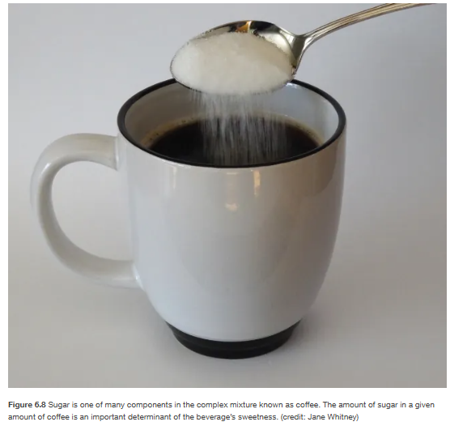
Solvent + Solute = Solution
Solvent = “more of”
Solute = “less of”
If water is the solvent, this is an aqueous solution. Aqueous solutions are annotated with an (aq) after a chemical formula
Chapter 6.3

Slide 12




Concentration Equations
Molarity Equation
Dilution Equation
Mass Percentage
or
Chapter 6.3, 6.4

Slide 13
Molarity = moles solute / liters of solution
Common unit of concentration in chemistry and biology
We also know we can readily convert moles to grams and grams to moles
Chapter 6.3

Slide 14

Chapter 6.3
Notes:
0.05 M

Slide 15

Chapter 6.3
Notes:
0.674 M

Slide 16

Chapter 6.3
Notes:
5.55 g CaCl₂

Slide 17



Chapter 6.3
Notes:
0.370 L

Slide 18
Dilution Equation
or
M = molarity
L = liters
1 = initial or starting
2 = final or ending
C = concentration
V = volume
1 = initial or starting
2 = final or ending
Chapter 6.3

Slide 19

Chapter 6.3
Notes:
0.102 M CH₃OH

Slide 20

Chapter 6.3
Notes:
3.76 L

Slide 21

Chapter 6.3
Notes:
0.261 L

Slide 22
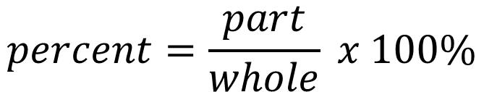
Mass Percent
$$percent=\frac{part}{whole} x 100\%$$
Chapter 6.4
*percent equation used in chapter 2

Slide 23

Chapter 6.4
Notes:
14.8%

Slide 24

Chapter 6.4

Slide 25
Percent Composition and Empirical Formula
Chapter 6.2 (Determining Empirical and Molecular Formulas)
Adapted From: Paul Flowers, Edward J. Neth, William R. Robinson, PhD, Klaus Theopold, Richard Langley; Chemistry: Atoms First 2e; OpenStax; Feb 14, 2019; Houston Texas; https://openstax.org/books/chemistry-atoms-first-2e/pages/1-introduction

Slide 26

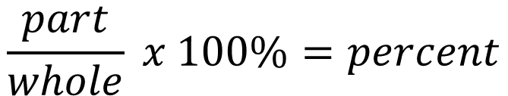



Percent Composition
$$\frac{part}{whole} x 100\%=percent$$
A sample contains 1.2 g zinc and 0.75 g oxygen, what is the percent of each component?
zinc + oxygen
1.2 g zinc
0.75 g oxygen
1.95 g total
To find the percent zinc:
$$\frac{part}{whole} x 100\%=percent$$
+
grams cancel out
2 sigfigs
$$\frac{1.2 g}{1.95g} x 100\%=percent$$
$$\frac{1.2 g}{1.95g} x 100\%=percent$$
$$62\%=percent zinc$$
To find the percent oxygen, repeat with 0.75 g oxygen instead of 1.2 g zinc.
Alternatively you could take 100% (both zinc and oxygen) and subtract 62% (zinc).
Chapter 6.2
Do not use the percent button on your calculator. Treat the % sign like a variable.

Slide 27

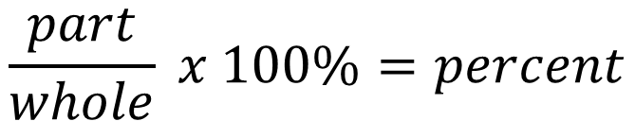
$$\frac{part}{whole} x 100\%=percent$$
Chapter 6.2
Notes:
12.1% C, 16.1% O, 71.79% Cl

Slide 28




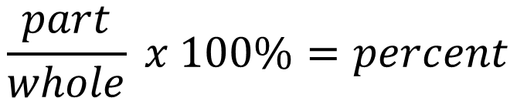



Percent Composition from chemical formula
$$\frac{part}{whole} x 100\%=percent$$
Percent hydrogen in water?
H₂O
2 hydrogens
1 oxygen
$$\frac{part}{whole} x 100\%=percent$$
$$\frac{all hydrogens}{the whole molecule} x 100\%=\% H$$
From the periodic table
with 4 sigfigs
$$\frac{(H x 2)}{\left(H x 2\right)+(O x 1)} x 100\%=\%H$$
$$\frac{(1.008 g/mol x 2)}{\left(1.008 g/mol x 2\right)+(16.00 g/mol x 1)} x 100\%=\%H$$
$$11.19\%=percent H$$
To find the percent oxygen, repeat with 1 oxygen instead of 2 hydrogen.
Alternatively you could take 100% (both hydrogen and oxygen) and subtract 11.19% (hydrogen).
Chapter 6.2

Slide 29


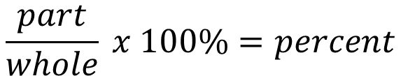
$$\frac{part}{whole} x 100\%=percent$$
Chapter 6.2
Notes:
69.9% Fe

Slide 30
Determination of Empirical Formula
For brief review: Topic 3, subtopic 3: Molecules, Compounds, and Chemical Formulas
Empirical formula – same ratio of atoms as the molecular formula but lowest subscripts
Chapter 6.2

Slide 31
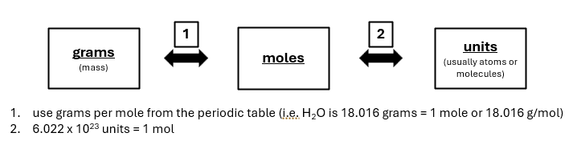
Determination of Empirical Formula
Some chemistry experiments will allow us to determine the mass or percent composition of a substance. From this information, we can calculate the empirical formula.
MgO means there is 1 magnesium atom and 1 oxygen atom. This is the “mole ratio”. In order for us to calculate the empirical formula from the mass or percent data from a chemical experiment we must first convert the mass or percent data to moles. Grams to Moles! (review Topic 6: Dimensional Analysis)
Chapter 6.2

Slide 32
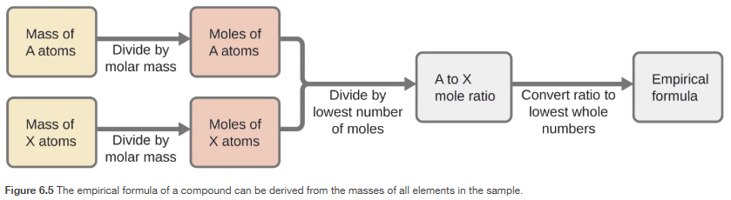
Determination of Empirical Formulas – book way
Chapter 6.2

Slide 33
Determination of Empirical Formulas – Com’s way
Percent of 1st element
1
Mass of 1st element
2
Moles of 1st element
3
Moles of each element in a specific form
1st _{moles of 1st} 2nd _{moles of 2nd}
Divide moles of both elements by whichever had the lowest moles
Multiply and/or round both numbers to get to nearest whole number
4
5
Percent of 2nd element
Mass of 2nd element
Moles of 2nd element
1
2
3
Just change the % sign to grams. You can do this because if you use 100 g of something it will be the same number. There can be more than two elements as well.
Sometimes the problem starts you with mass. Use the periodic table to convert to moles. Multiply the mass by 1 mol/g element (the molar mass in grams per mole from the periodic table with the fraction inverted).
Writing it this way helps you keep track of the moles and position (i.e. Fe_{0.2055}O_{0.3169})
Which ever moles is lower between the 1st element or 2nd element, divide both the numbers by that same number. This will result in one of your elements being 1 and the other element greater than 1. i.e. Fe_{0.2055}O_{0.3169} → Fe₁O_{1.542}
The objective is to get your empirical formula which is whole numbers. You can round up or keep the number the same if your number is within 0.19 of a whole number (i.e. 1.81 would be rounded to 2 and something like 3.19 would be rounded down to 3. If they are greater than this, you will have to multiply both numbers by some factor 2, 3, 4, 5 to get close a whole number and then round. Fe₁O_{1.542} → Fe_{1 x 2} O_{1.542 x 2} (multiply both by 2) → Fe₂O_{3.084} → Fe₂O₃ (rounded).
_____
0.2055
_____ 0.2055
Chapter 6.2

Slide 34
Determination of Empirical Formulas – Com’s way
28.17 % carbon
1
28.17 g carbon
2
28.17 g C x 1 mol C = 2.346 mol C
_________
12.01 g C
3
4
C_{2.346}O _{4.489} → C₁O_{1.913}
5
Round O to 2
C₁O₂
C_{2.346}O _{4.489}
____
2.346
____
2.346
71.83 % oxygen
71.83 g oxygen
71.83 g O x 1 mol O = 4.489 mol O
3
_________
16.00 g O
1
2
Just change the % sign to grams. You can do this because if you use 100 g of something it will be the same number. There can be more than two elements as well.
Sometimes the problem starts you with mass. Use the periodic table to convert to moles. Multiply the mass by 1 mol/g element (the molar mass in grams per mole from the periodic table with the fraction inverted).
Writing it this way helps you keep track of the moles and position (i.e. C_{2.346}O_{4.489})
Which ever moles is lower between the 1st element or 2nd element, divide both the numbers by that same number. This will result in one of your elements being 1 and the other element greater than 1. i.e. C_{2.346} O_{4.489} → C₁O_{1.913}
The objective is to get your empirical formula which is whole numbers. You can round up or keep the number the same if your number is within 0.19 of a whole number (i.e. 1.81 would be rounded to 2 and something like 3.19 would be rounded down to 3. If they are greater than this, you will have to multiply both numbers by some factor 2, 3, 4, 5 to get close a whole number and then round. C₁O_{1.913} → C₁O₂ (rounded).
_____
2.346
_____ 2.346
Chapter 6.2

Slide 35

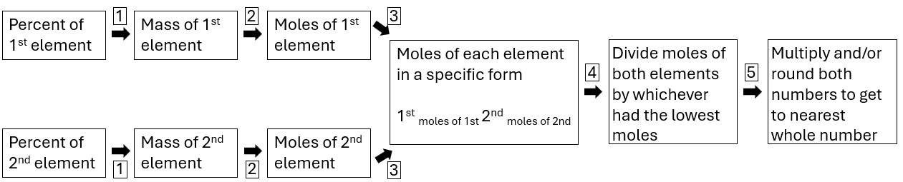
Chapter 6.2
Notes:
N₂O₅

Slide 36
Chapter 6.2
Notes:
CH₂O

