Slide 1


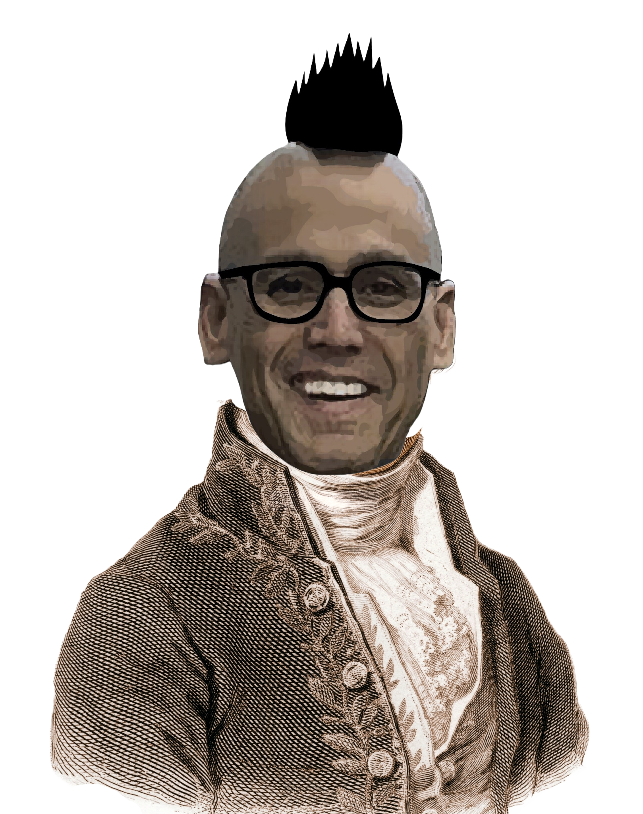
Chem
With
Com

Slide 2
Intermolecular Forces, States of Matter, and Energy
Chapter 1.3 (Physical and Chemical Properties)
Chapter 10.1 (Intermolecular Forces)
Chapter 10.2 (Properties of Liquids)
Chapter 10.3 (Phase Transitions) – heating and cooling curves only
Chapter 10.4 (Phase Diagrams)
Chapter 9.1 (Energy Basics)
Adapted From: Paul Flowers, Edward J. Neth, William R. Robinson, PhD, Klaus Theopold, Richard Langley; Chemistry: Atoms First 2e; OpenStax; Feb 14, 2019; Houston Texas; https://openstax.org/books/chemistry-atoms-first-2e/pages/1-introduction

Slide 3
Intermolecular Forces
Chapter 1.3 (Physical and Chemical Properties)
Chapter 10.1 (Intermolecular Forces)
Chapter 10.2 (Properties of Liquids)
Adapted From: Paul Flowers, Edward J. Neth, William R. Robinson, PhD, Klaus Theopold, Richard Langley; Chemistry: Atoms First 2e; OpenStax; Feb 14, 2019; Houston Texas; https://openstax.org/books/chemistry-atoms-first-2e/pages/1-introduction

Slide 4
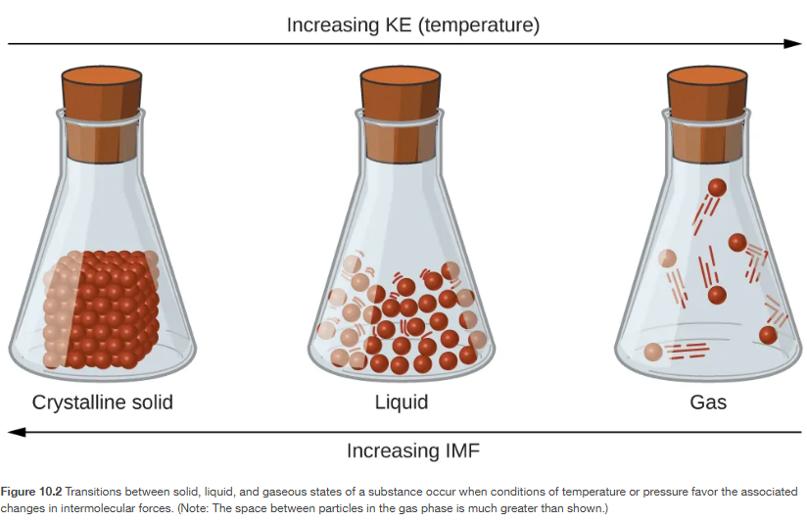
Materials experiencing physical changes have different physical properties
Conceptually a direct continuation from topic 4
Chapter 10.1

Slide 5
Intermolecular Forces govern different physical states
Chapter 10.1

Slide 6
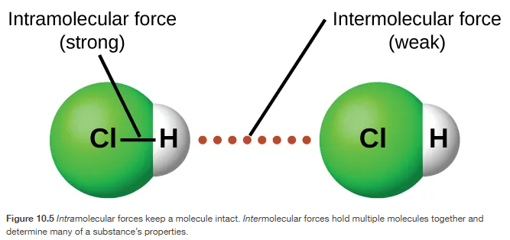
Intermolecular Forces are weaker than covalent or ionic bonds
Chapter 10.1

Slide 7
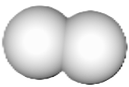
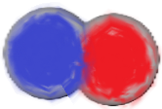
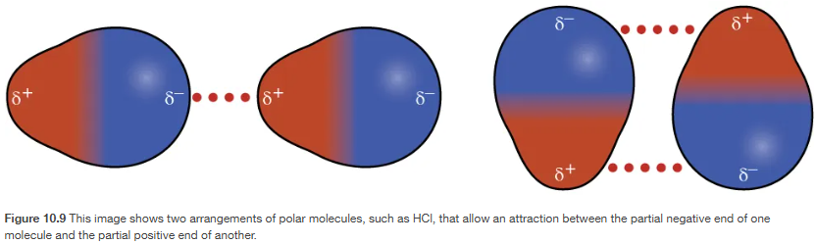
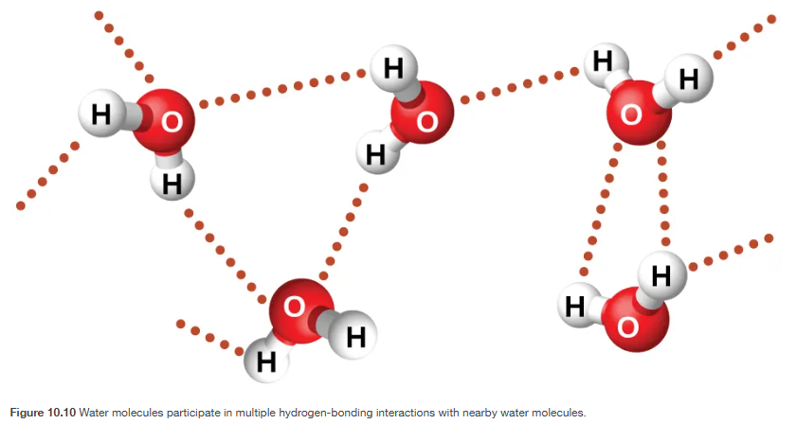
Intermolecular Forces
.
H₂
:
H₂
H₂
.
:
Dispersion Forces
Dipole-Dipole Attractions
Hydrogen Bonds
Weakest
δ-
δ-
H₂
δ+
:
δ+
Not Polar
Temporarily Polar
(no dipole)
(temporary instantaneous dipole)
Strongest
Chapter 10.1

Slide 8
Dipole-Dipole Attractions (polar-polar)
Occur between two or more polar molecules
Chapter 10.1

Slide 9
Hydrogen Bonds
Something can hydrogen bond if a hydrogen is directly covalently bonded to a nitrogen, oxygen, or fluorine (the three most electronegative atoms on the periodic table)
H-N
H-O
H-F
Chapter 10.1

Slide 10
Dispersion Forces
.
H₂
:
H₂
H₂
Temporarily dipole moment (temporarily polar) that occurs instantaneously in usually nonpolar molecules or atoms
.
:
δ-
δ-
H₂
δ+
:
δ+
Not Polar
Temporarily Polar
(no dipole)
(temporary instantaneous dipole)
Chapter 10.1

Slide 11
Intermolecular Forces govern different physical states
Chapter 10.1

Slide 12
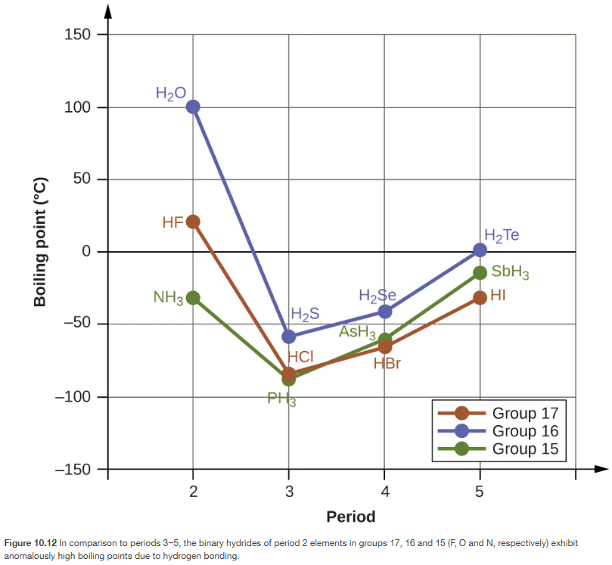
Stronger Intermolecular Forces mean higher boiling points
Chapter 10.1

Slide 13
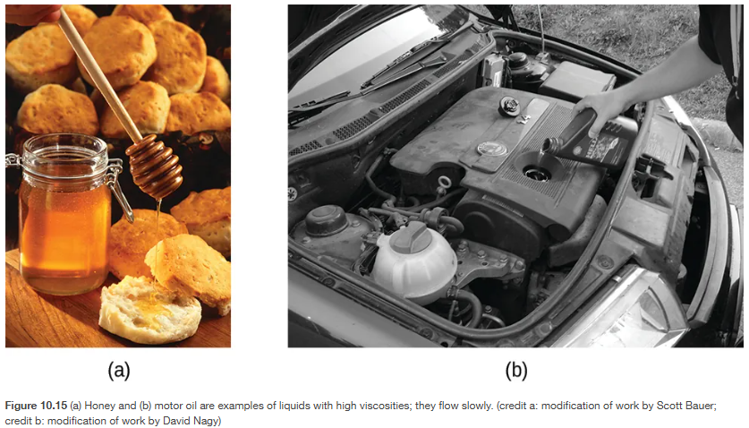
Viscosity of a liquid is a measure of its resistance to flow
Chapter 10.2

Slide 14
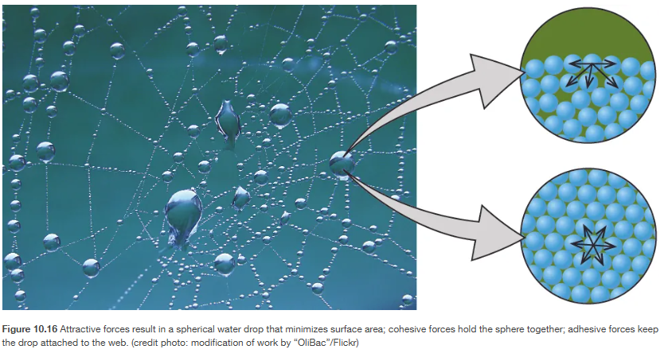
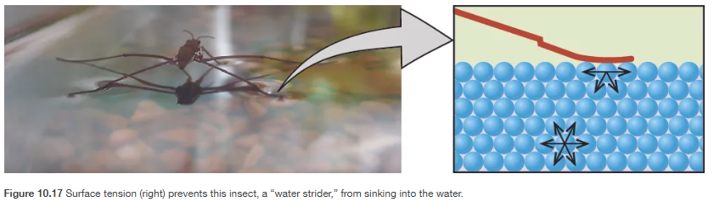
Surface Tension – IMF cause the surface of a liquid to be as small as possible
Chapter 10.2

Slide 15
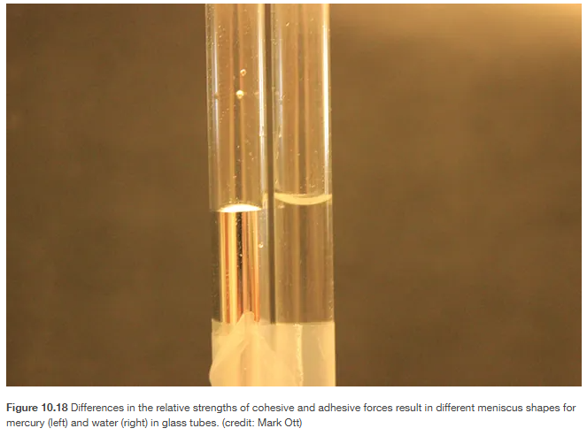
Meniscus is from IMF, the liquid is either attracted or repelled by the tube
Chapter 10.2

Slide 16
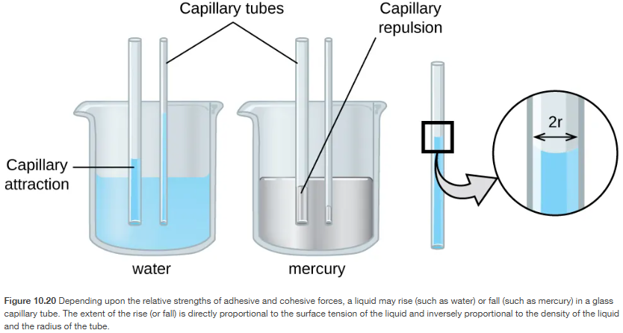
Capillary Action is from IMF, the liquid is attracted to the capillary tube
Chapter 10.2

Slide 17
States of Matter and Energy
Chapter 10.3 (Phase Transitions) – heating and cooling curves only
Chapter 10.4 (Phase Diagrams)
Chapter 9.1 (Energy Basics)
Adapted From: Paul Flowers, Edward J. Neth, William R. Robinson, PhD, Klaus Theopold, Richard Langley; Chemistry: Atoms First 2e; OpenStax; Feb 14, 2019; Houston Texas; https://openstax.org/books/chemistry-atoms-first-2e/pages/1-introduction

Slide 18
Intermolecular Forces govern different physical states
Chapter 10.1

Slide 19
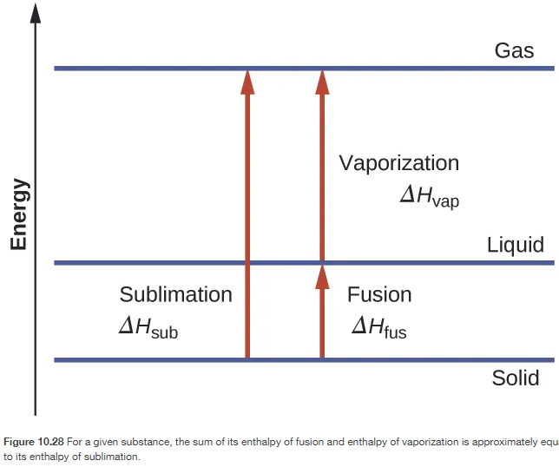
Energy can break intermolecular forces (IMF)
Vaporization
Condensation
Sublimation
Deposition
Melting (Fusion)
Freezing
Chapter 10.3

Slide 20
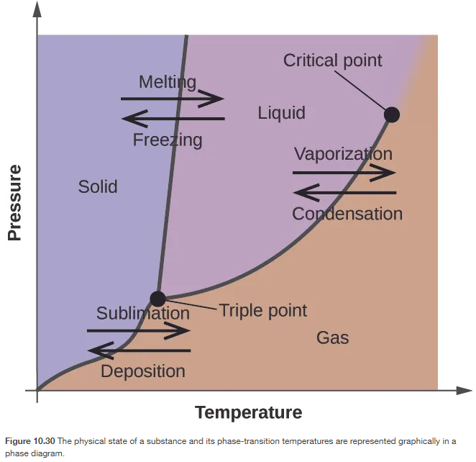
Pressure can also affect phase changes (and physical states)
Chapter 10.4

Slide 21
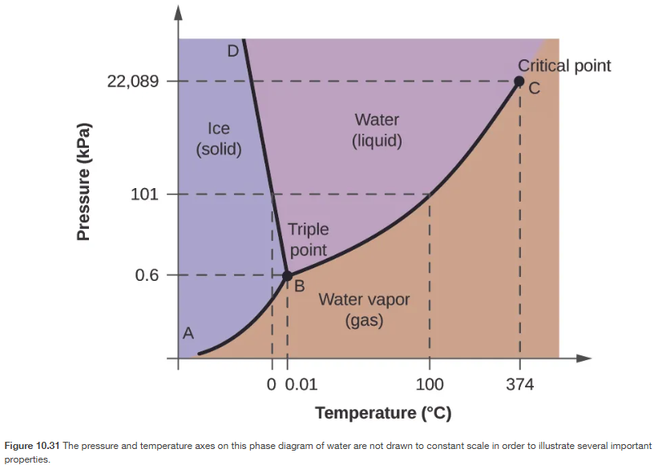
Phase diagrams can help identify the physical state of a substance
Chapter 10.4

Slide 22

Chapter 10.4
Notes:
At 0.3 kPa: "s" → "g" at −58 °C. At 50 kPa: "s" → "l" at 0 °C, l ⟶ g at 78 °C

Slide 23
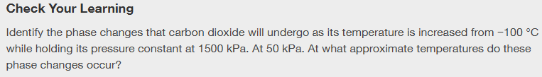
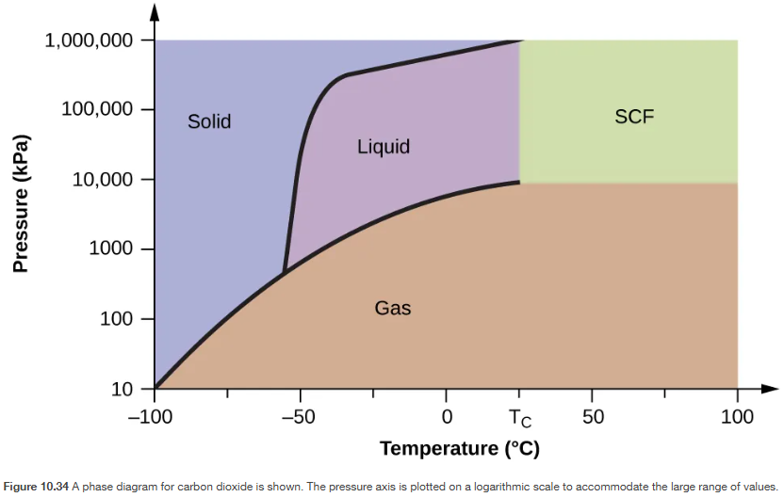
Chapter 10.4
Notes:
at 1500 kPa: "s" → "l" at −55 °C, "l" → "g" at −10 °C;
at 50 kPa: "s" → "g" at −60 °C

Slide 24
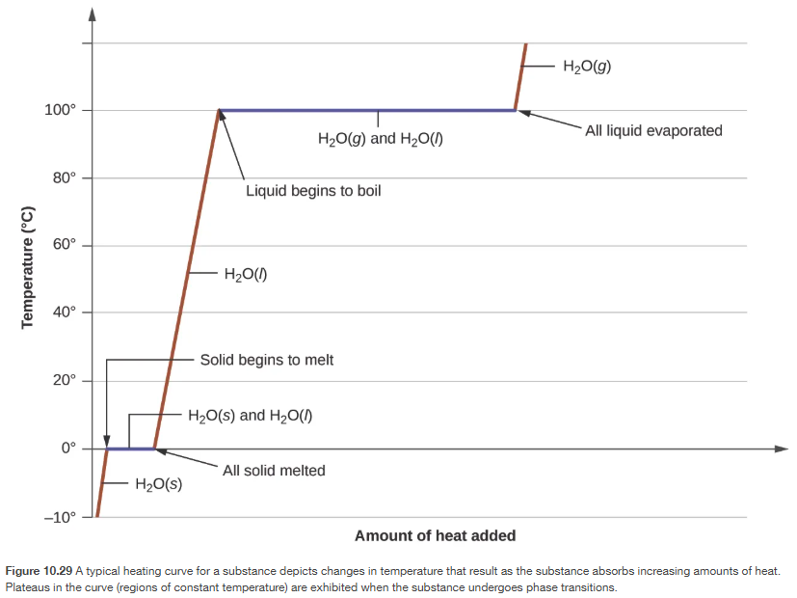
Heating and Cooling Curves
Chapter 10.3

Slide 25


Energy Key Terms
Chapter 9.1

Slide 26
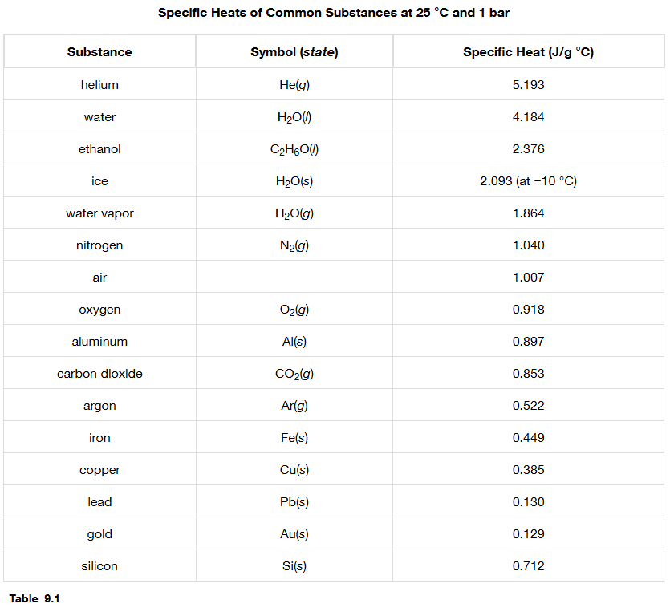

Different substances have different heat capacities
Chapter 9.1

Slide 27
Heating and Cooling Curves
Chapter 10.3

Slide 28
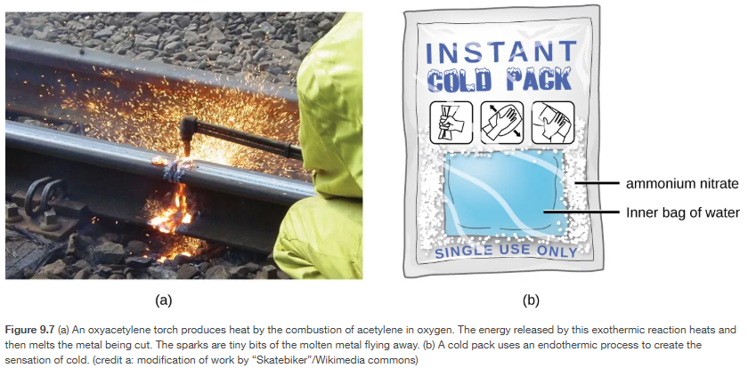
Exothermic processes release heat while endothermic reactions absorb heat.
Chapter 9.1

Slide 29

Chapter 9.1
Notes:
5.07 $×$ 10⁴ J

Slide 30

Chapter 9.1
Notes:
c = 0.451 J/g °C; the metal is likely to be iron

