Slide 1


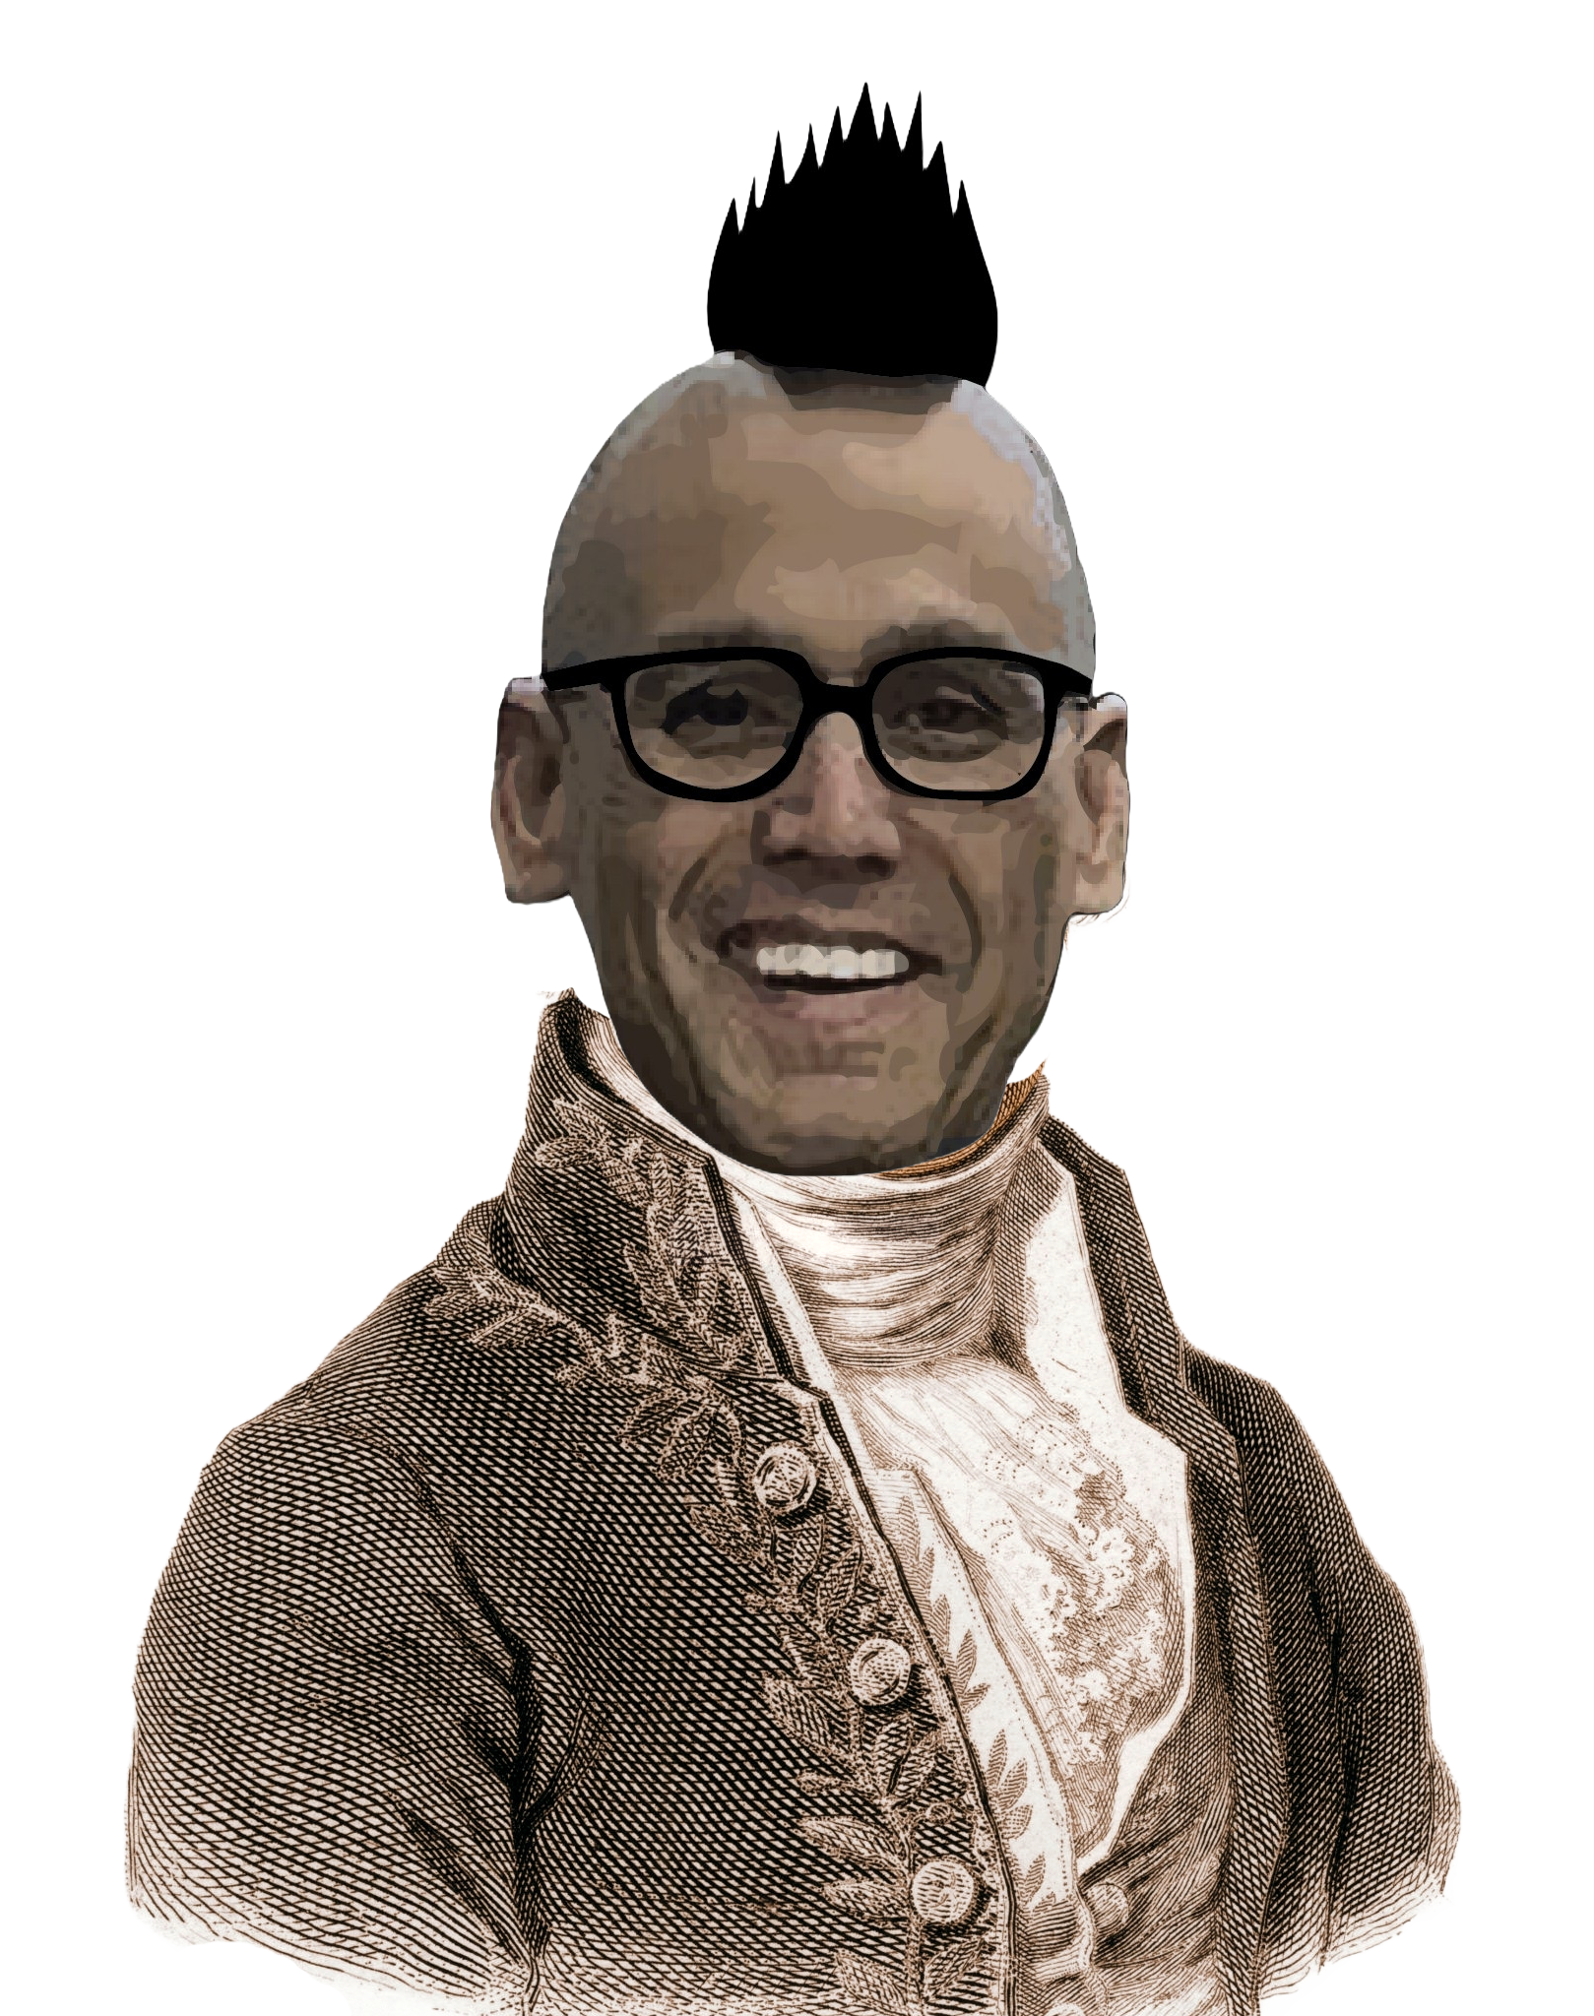
Chem
With
Com

Slide 2
Measurements, Prefixes and Dimensional Analysis
Chapter 1.4 (Measurements)
Chapter 1.5 (Measurement Uncertainty, Accuracy, and Precision)
Appendix B (Essential Mathematics)
Chapter 1.6 (Mathematical Treatment of Measurement Results)
Appendix C (Units and Conversion Factors)
2.4 (Chemical Formulas)
Adapted From: Paul Flowers, Edward J. Neth, William R. Robinson, PhD, Klaus Theopold, Richard Langley; Chemistry: Atoms First 2e; OpenStax; Feb 14, 2019; Houston Texas; https://openstax.org/books/chemistry-atoms-first-2e/pages/1-introduction

Slide 3
Units, Measurements, and Density
Chapter 1.4 (Measurements)
Chapter 1.5 (Measurement Uncertainty, Accuracy, and Precision)
Adapted From: Paul Flowers, Edward J. Neth, William R. Robinson, PhD, Klaus Theopold, Richard Langley; Chemistry: Atoms First 2e; OpenStax; Feb 14, 2019; Houston Texas; https://openstax.org/books/chemistry-atoms-first-2e/pages/1-introduction

Slide 4
Units make numbers meaningful in chemistry
1 1 what?
1 dollar now this has meaning
1 gram now this has meaning
1.00 gram what is the difference having the “.00”?
1350 grams
1.350 kilograms these are all the same number
1.350 x 10³ grams

Slide 5
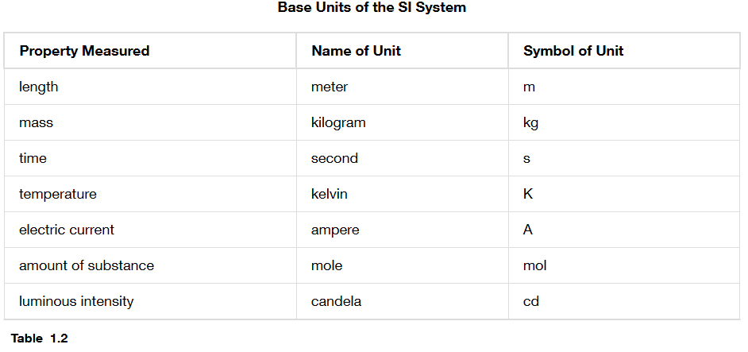
Le Système International d’Unités (SI Units)
or Celsius
or ºC
volume | liter | L
Measured numbers - last digit is an estimate/guess – all are significant
Counted numbers – these are exact numbers – infinite significant figures
Chapter 1.4

Slide 6
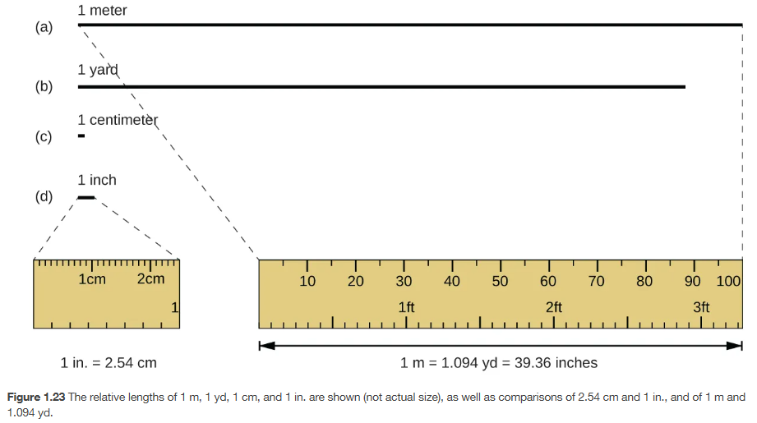
Length (distance) = meter (m)
Chapter 1.4

Slide 7
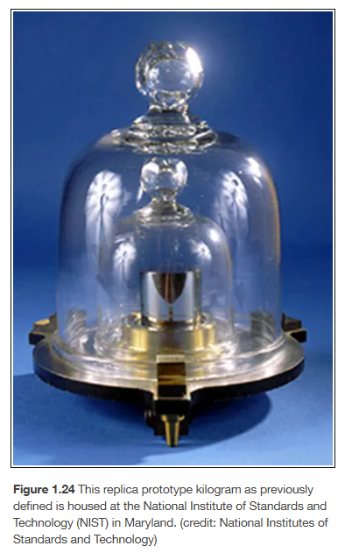
Mass (how much matter or “stuff”) – kilogram (kg)
Used to be 1 liter of water = 1 kg
Typically a balance or scale will measure mass
Weight is the force of gravity on mass
Weight is the same as mass on earth
Chapter 1.4

Slide 8
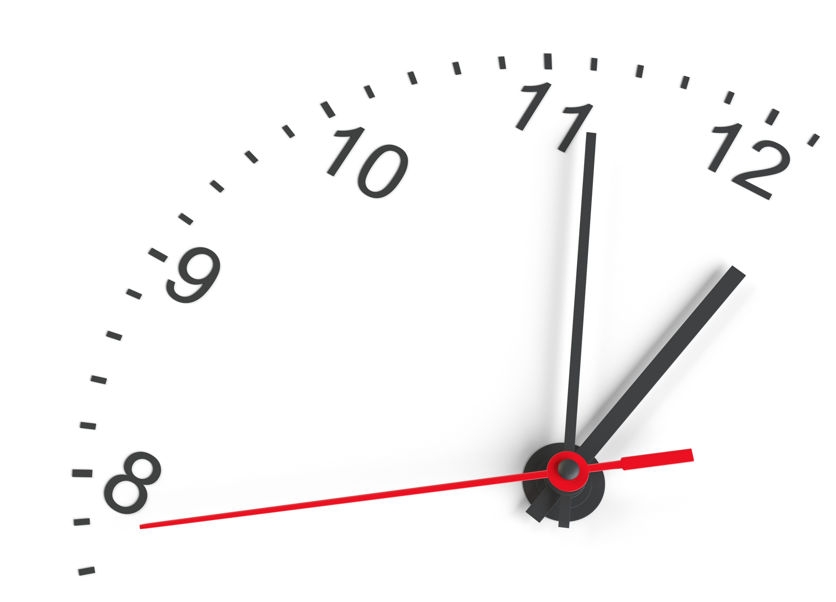
Time (progression of existence) – seconds (s)
1 second (s)
Chapter 1.4

Slide 9
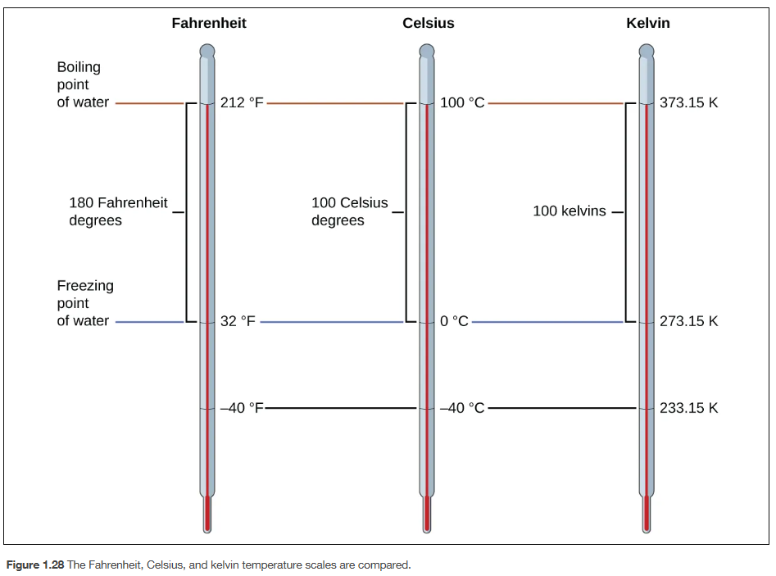
Temperature (average energy) – kelvin (K) or Celsius (ºC)
Chapter 1.4, 1.6

Slide 10
Moles (number of things) – 6.022 x 10²³ things – moles (mol)
Mole is just a word that means a number, similar to how “dozen” means “twelve”
602,200,000,000,000,000,000,000 things (usually atoms/molecules)
6.022 x 10²³ things (usually atoms/molecules)
**If you are counting a mole of things – that is an exact number. If you are calculating or measuring the amount of something in moles, that is a measured number
Measured numbers - last digit is an estimate/guess – all are significant
Counted numbers – these are exact numbers – infinite significant figures
Chapter 1.4

Slide 11
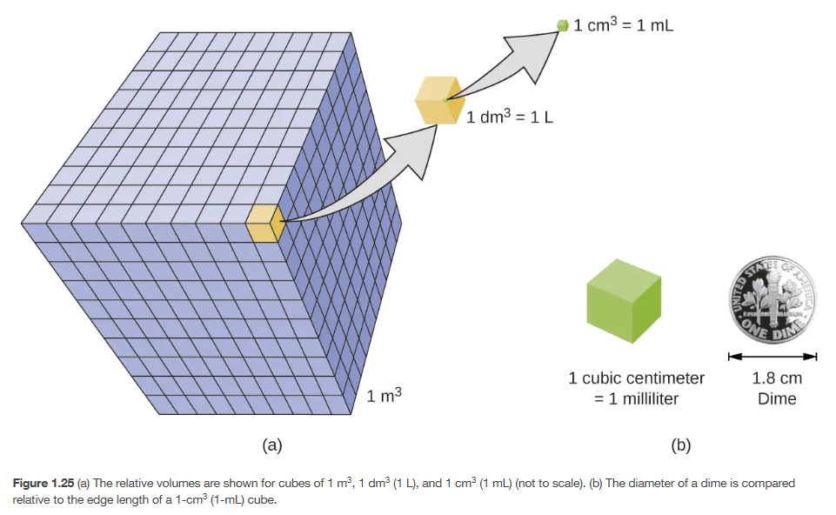
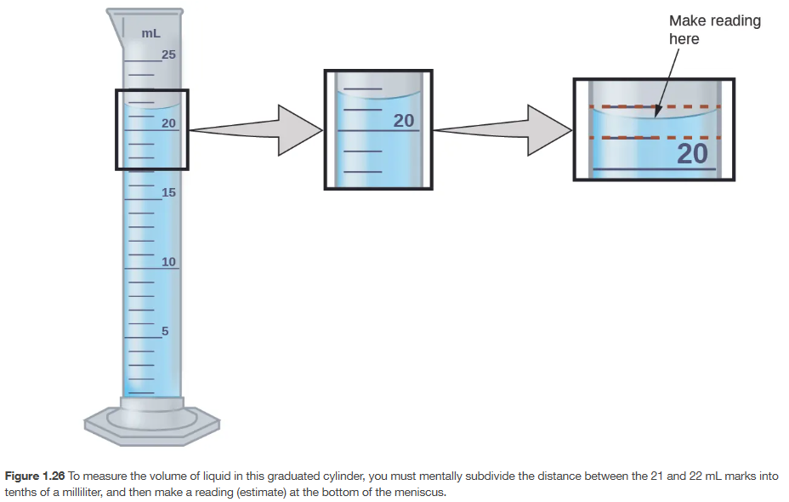
Volume (how much space something takes) – liter (L)
Important Equivalencies
  1 cm³ = 1 mL
  1000 cm³ = 1 L
1 mL = 1 cm³
1 mL
1 cm³
Chapter 1.4, 1.5

Slide 12
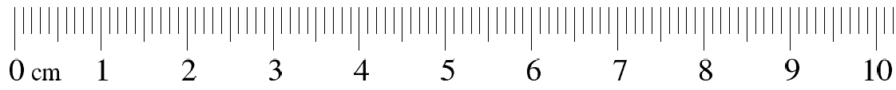
Length (distance)
1 m = 100 cm = 1000 mm
10 mm = 1 cm
Chapter 1.4, http://www.vendian.org/mncharity/dir3/paper_rulers/

Slide 13
Length (distance)
More accurate – closer to the “true” measurement
More precise – the results are closer when measured the same way
3.4 cm
5.5 cm
3.42 cm
5.50 cm = more decimals is more precise
Top ruler cannot be read to 2 decimal places because there aren’t enough measurement marks
Bottom ruler can be read to 2 decimal places so all measurements must be to 2 decimal places
Chapter 1.4, http://www.vendian.org/mncharity/dir3/paper_rulers/

Slide 14
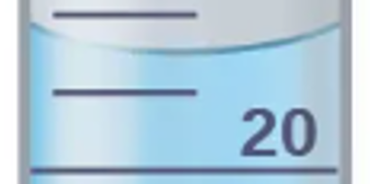
Volume (how much space something takes) – liter (L)
Important Equivalencies
  1 cm³ = 1 mL
  1000 cm³ = 1 L
Need to read from the bottom of the curve (meniscus)
22
21.5
21.45 mL
21
Since the liquid level is slightly below 21.5 mL we estimate the number to be 21.45 mL but someone could also say 21.48 mL and they would both be “correct”. Since this can be reported with 2 decimal places, all measurements from this device should be reported with 2 decimal places.
Chapter 1.4, 1.5

Slide 15

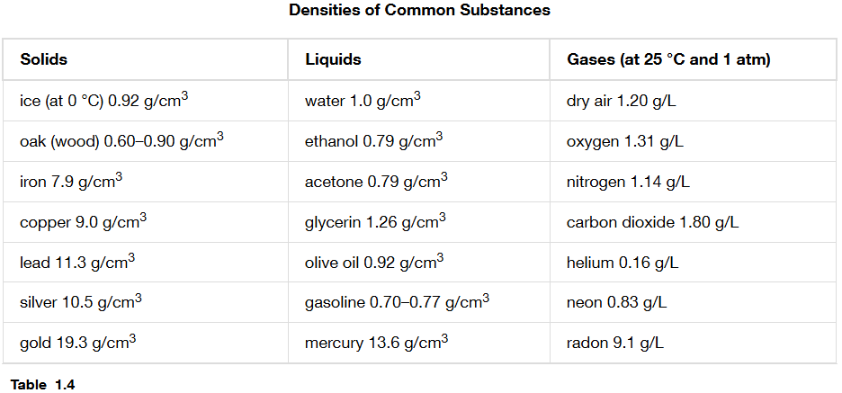
Density (how much mass in a certain volume) – mass/volume (usually g/mL)
Important Equivalencies
  1 cm³ = 1 mL
  1000 cm³ = 1 L
grams
g
g
g
=
=
=
=
cm³
mL
cm x cm x cm
milliliters or cubic centimeters
Chapter 1.4, 1.5

Slide 16
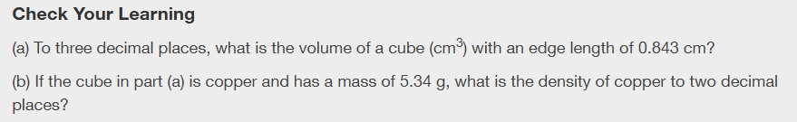

Slide 17
Prefixes and Exponential Notation
Chapter 1.4 (Measurements)
Appendix B (Essential Mathematics)
Adapted From: Paul Flowers, Edward J. Neth, William R. Robinson, PhD, Klaus Theopold, Richard Langley; Chemistry: Atoms First 2e; OpenStax; Feb 14, 2019; Houston Texas; https://openstax.org/books/chemistry-atoms-first-2e/pages/1-introduction

Slide 18
Your calculator will be very important!
Get a non-phone calculator ASAP!
Practice with it during every lecture/video
Use the same one for lecture/video, assignments, and exams
Free Online Calculators (but you need to have a physical one for the exams:
  https://ti84calc.com/
  https://ti84ce.com/
  https://www.desmos.com/scientific
  Search free online scientific calculator

Slide 19
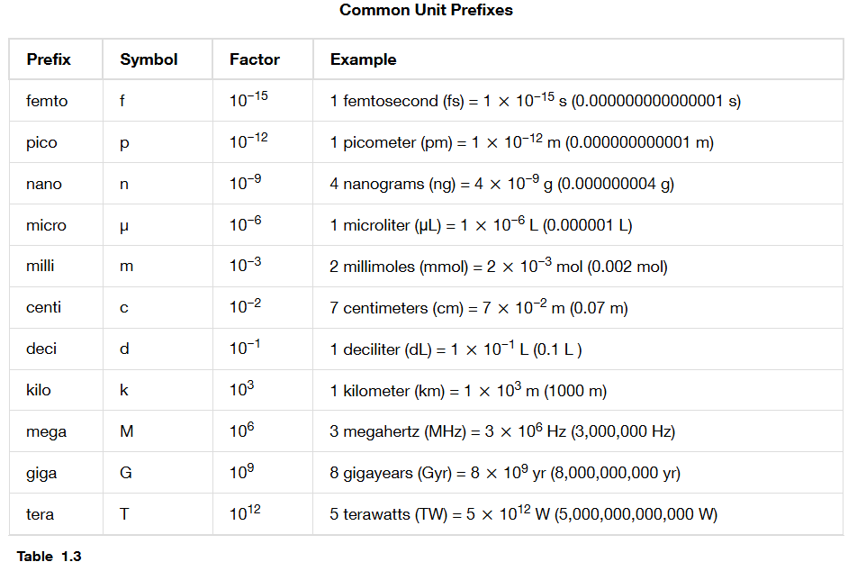
Unit Prefixes and Exponential Notation
Chapter 1.4

Slide 20
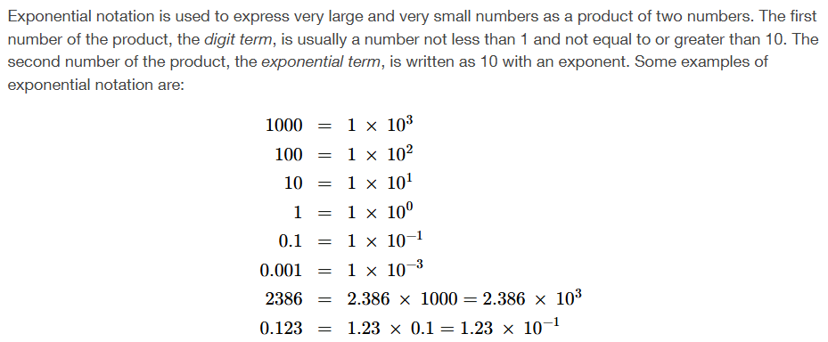
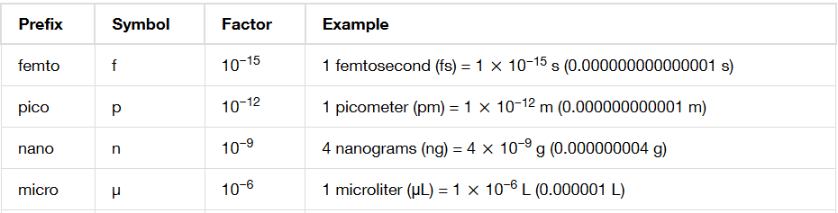
Exponential notation is used in prefixes
Appendix B, Chapter 1.4

Slide 21
Prefixes are just words that mean numbers
1357 grams
1.357 kilograms these are all the same number
1.357 x 10³ grams
kilo = 10³
kilo = 10³ = 10¹ x 10¹ x 10¹ = 1000
or
= 10³ = 10 x 10 x 10 = 1000
Chapter 1.4

Slide 22
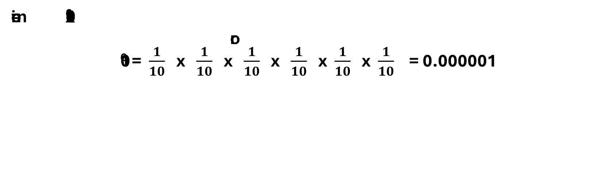
Prefixes are just words that mean numbers
270 microliters
270 x 10⁻⁶ liters
these are the same number
micro = 10⁻⁶
micro = 10⁻⁶ = 10⁻¹ x 10⁻¹ x 10⁻¹ x 10⁻¹ x 10⁻¹ x 10⁻¹ = 0.000001
or
10⁻⁶ = $\frac{1}{10}$ x $\frac{1}{10}$ x $\frac{1}{10}$ x $\frac{1}{10}$ x $\frac{1}{10}$ x $\frac{1}{10}$ = 0.000001
Chapter 1.4

Slide 23
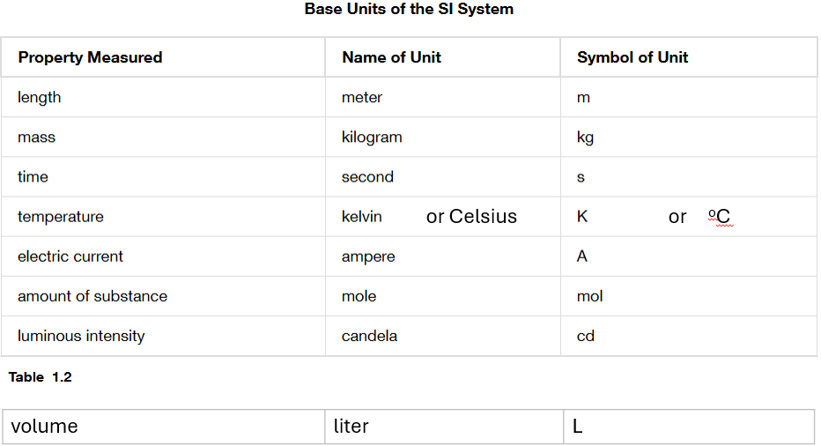
Le Système International d’Unités (SI Units)
Chapter 1.4

Slide 24
Units and Prefixes
Chapter 1.4
1357.0 grams
1.3570 kilograms these are all the same number
1.3570 x 10³ grams

Slide 25
Prefixes work with any unit
Chapter 1.4
1.3570 kilograms = 1.3570 x 10³ grams = 1.3570 x 1000 grams
1 kilogram (kg) = 10³ grams (g) = 1000 grams (g)
1 kiloliter (kL) = 10³ liter (L) = 1000 liters (L)
1 kilomole (mol) = 10³ moles (mol) = 1000 moles (mol)

Slide 26
Exponential Notation
Topic 2: Ions and Periodic Properties
Subtopic 3 of 3: Moles and Exponential Notation
The decimal moves amount of times as the number in the exponent.
  For something like 3.05 x 10⁴, you would move the decimal 4 places, since the exponent is positive, you know the final number will be greater than 1.
  For something like 2.1 x 10⁻³, you would move the decimal 3 place, since the exponent is negative, you know the final number will be less than 1.
  For 0.0078077, you would move the decimal 3 places to get to the first non-zero digit. If the number started as a number less than 1, it is a negative exponent.
  For 97,105,000 you would move the decimal 7 places to get to the first non-zero digit. If the number started as a number greater than 1, it is a positive exponent.

Slide 27
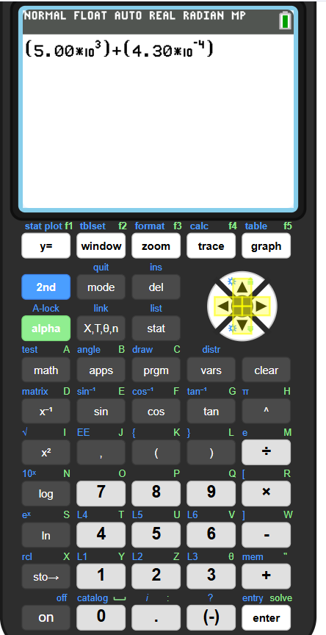
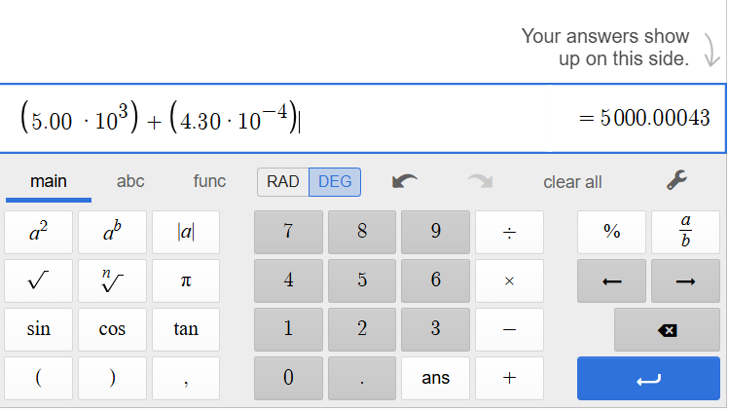
Use brackets ( ) around any exponential notation numbers when using your calculator
Example problem
5.00 x 10³ + 4.30 x 10⁻⁴
Use brackets in your calculator until you know what you’re doing

Slide 28
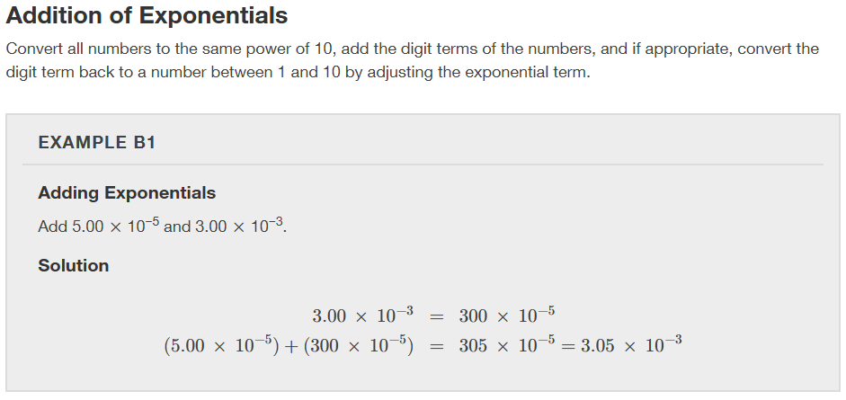
Math and Exponents – addition
Easiest way -> put it into your calculator! Use brackets for exponential notation numbers and don’t forget significant figures!
Appendix B

Slide 29
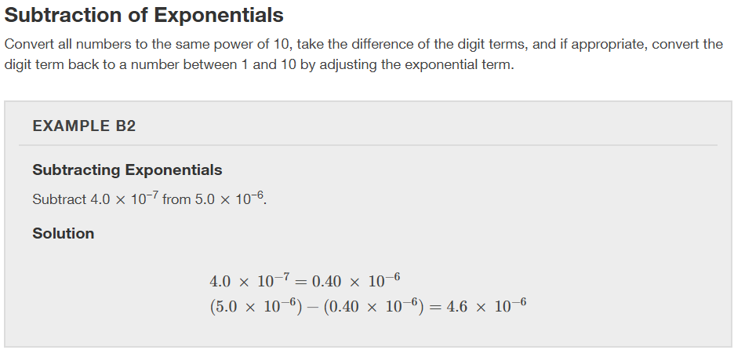
Math and Exponents – subtraction
Easiest way -> put it into your calculator! Use brackets for exponential notation numbers and don’t forget significant figures!
Appendix B

Slide 30
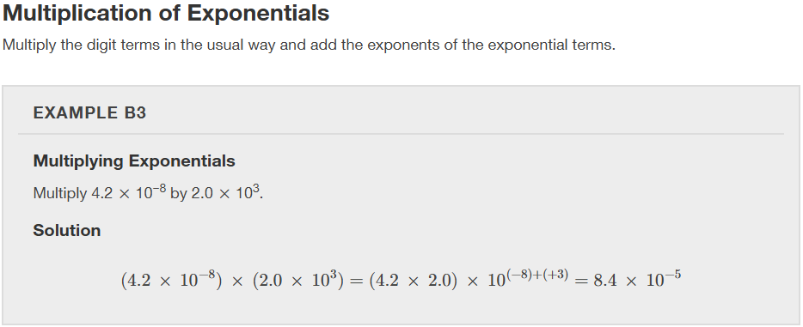
Math and Exponents – multiplication
Easiest way -> put it into your calculator! Use brackets for exponential notation numbers and don’t forget significant figures!
Appendix B

Slide 31
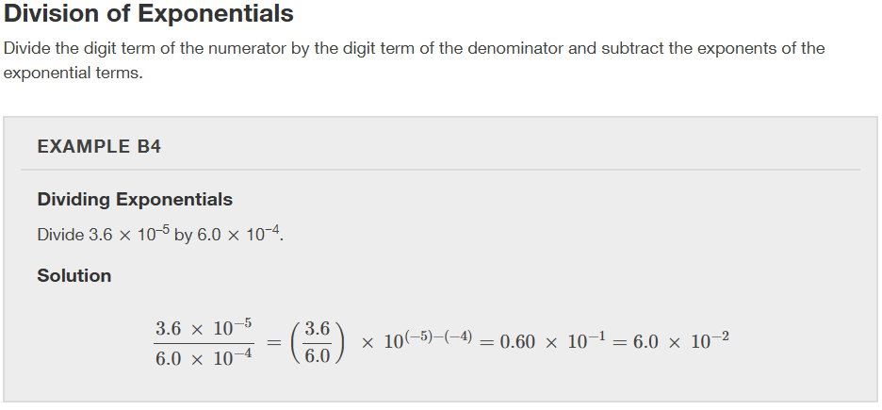
Math and Exponents – division
Easiest way -> put it into your calculator! Use brackets for exponential notation numbers and don’t forget significant figures!
Appendix B

Slide 32
Dimensional Analysis
Chapter 1.6 (Mathematical Treatment of Measurement Results)
Appendix C (Units and Conversion Factors)
Adapted From: Paul Flowers, Edward J. Neth, William R. Robinson, PhD, Klaus Theopold, Richard Langley; Chemistry: Atoms First 2e; OpenStax; Feb 14, 2019; Houston Texas; https://openstax.org/books/chemistry-atoms-first-2e/pages/1-introduction

Slide 33
Your calculator will be very important!
Get a non-phone calculator ASAP!
Practice with it during every lecture/video, assignments, and the same one for exams
Free Online Calculators (but you need to have a physical one for the exams:
  https://ti84calc.com/
  https://ti84ce.com/
  https://www.desmos.com/scientific
  Search free online scientific calculator
Put brackets around all exponential notation numbers when using your calculator!

Slide 34
Dimensional analysis is just converting things from one unit to another
Step 1: find the conversion rate
Step 2: write it as two fractions
Step 3: multiply the original value by the fraction

Slide 35
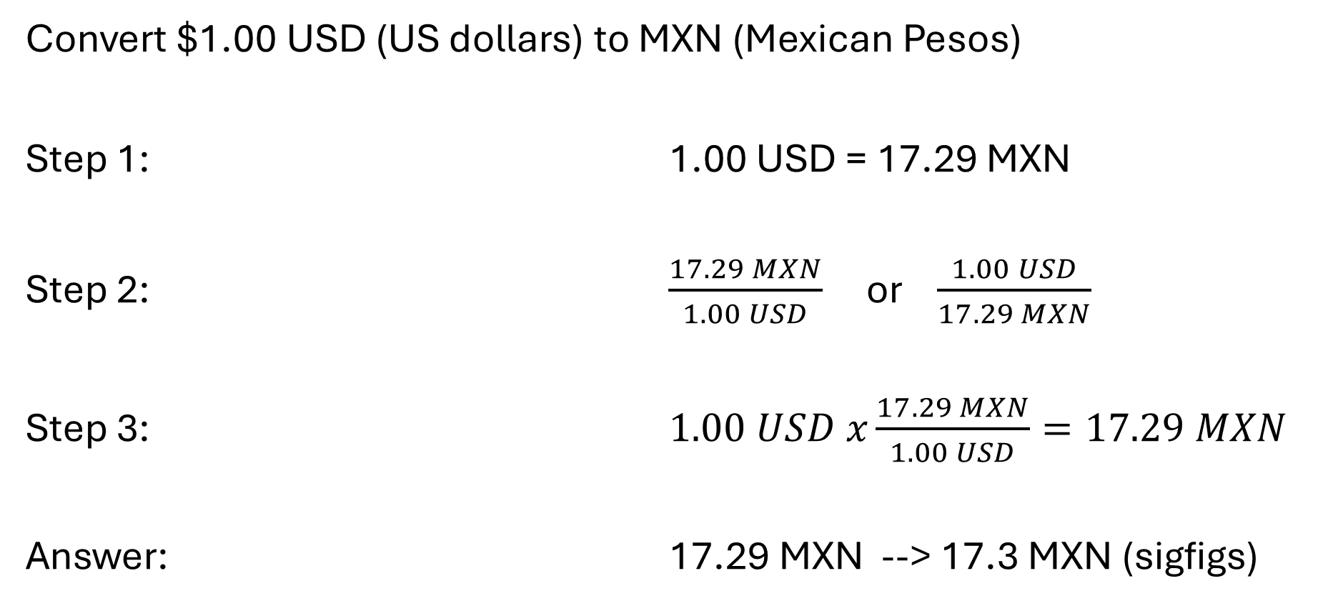
Dimensional analysis is just converting things from one unit to another
Convert $1.00 USD (US dollars) to MXN (Mexican Pesos)
Step 1: 1.00 USD = 17.29 MXN
Step 2: $\frac{17.29 MXN}{1.00 USD}$ or $\frac{1.00 USD}{17.29 MXN}$
Step 3: $1.00 USD x\frac{17.29 MXN}{1.00 USD}=17.29 MXN$
Answer: 17.29 MXN --> 17.3 MXN (sigfigs)
find the conversion rate
conversion factors are “exact” numbers
write it as two fractions
multiply the original value by the fraction

Slide 36
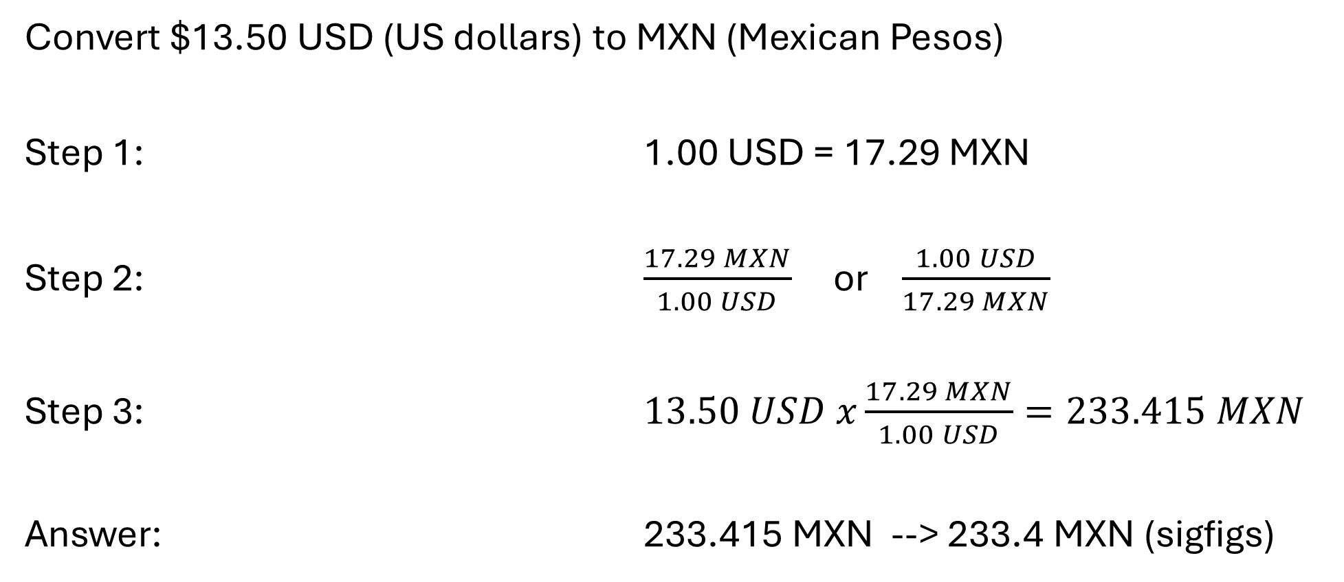
Dimensional analysis is just converting things from one unit to another
Convert $13.50 USD (US dollars) to MXN (Mexican Pesos)
Step 1: 1.00 USD = 17.29 MXN
Step 2: $\frac{17.29 MXN}{1.00 USD}$ or $\frac{1.00 USD}{17.29 MXN}$
Step 3: $13.50 USD x\frac{17.29 MXN}{1.00 USD}=233.415 MXN$
Answer: 233.415 MXN --> 233.4 MXN (sigfigs)
find the conversion rate
conversion factors are “exact” numbers
write it as two fractions
multiply the original value by the fraction

Slide 37
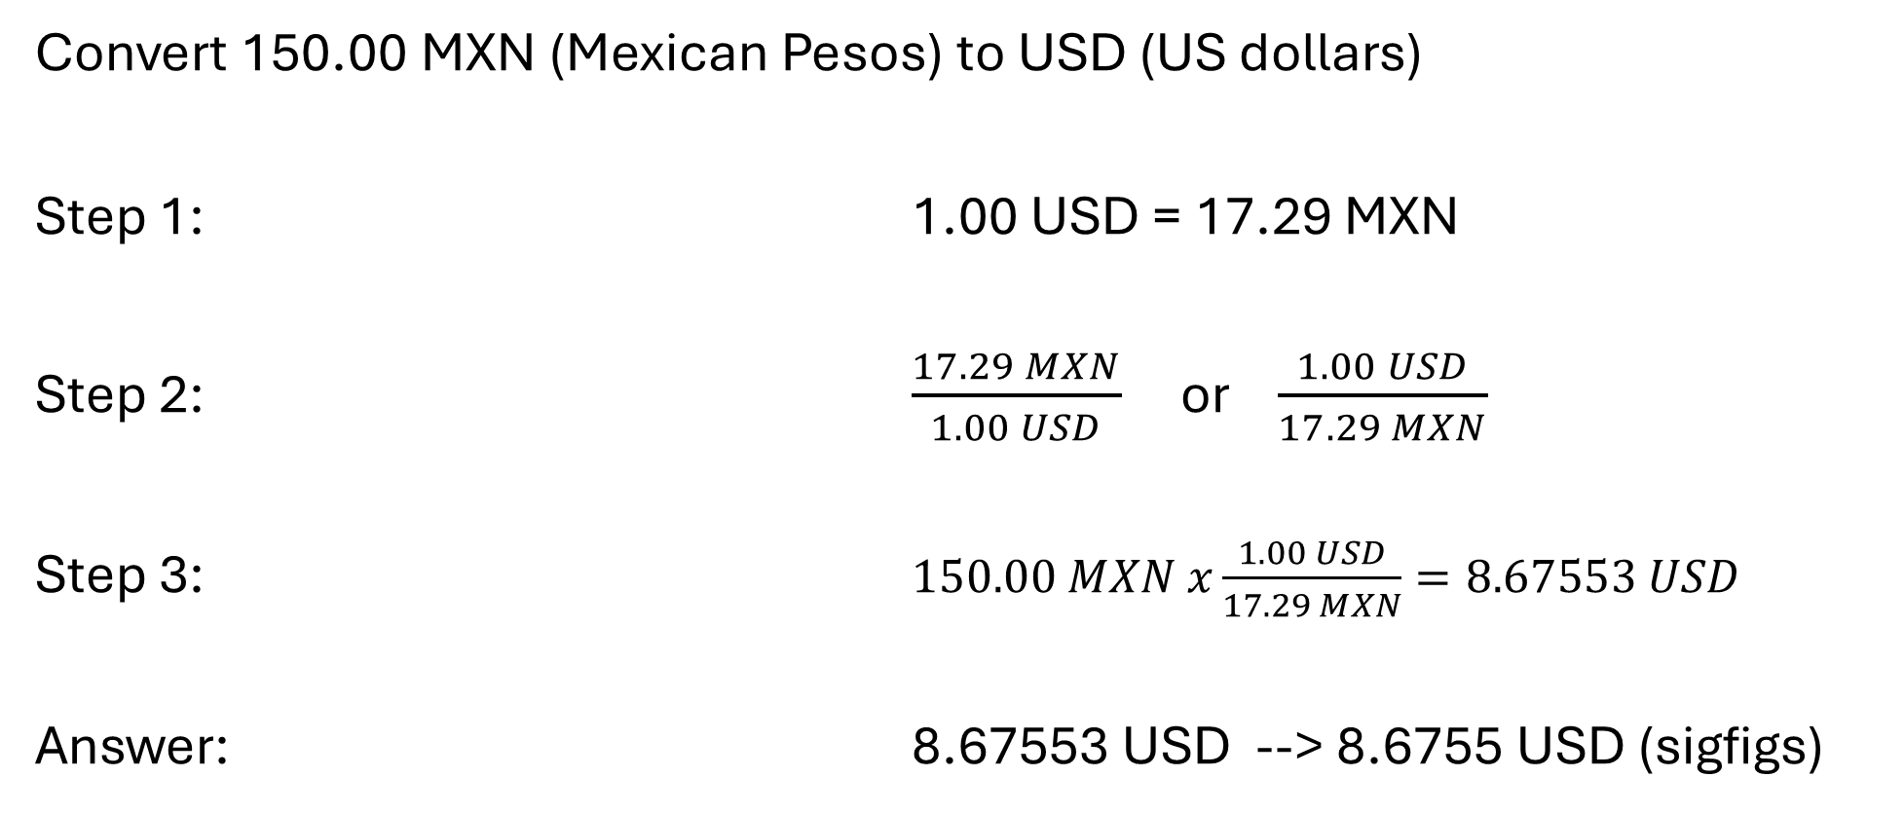
Dimensional analysis is just converting things from one unit to another
Convert 150.00 MXN (Mexican Pesos) to USD (US dollars)
Step 1: 1.00 USD = 17.29 MXN
Step 2: $\frac{17.29 MXN}{1.00 USD}$ or $\frac{1.00 USD}{17.29 MXN}$
Step 3: $150.00 MXN x\frac{1.00 USD}{17.29 MXN}=8.67553 USD$
Answer: 8.67553 USD --> 8.6755 USD (sigfigs)
find the conversion rate
conversion factors are “exact” numbers
write it as two fractions
multiply the original value by the fraction

Slide 38
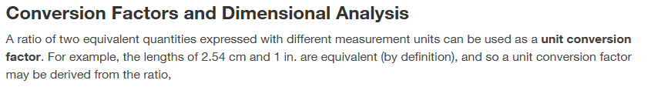
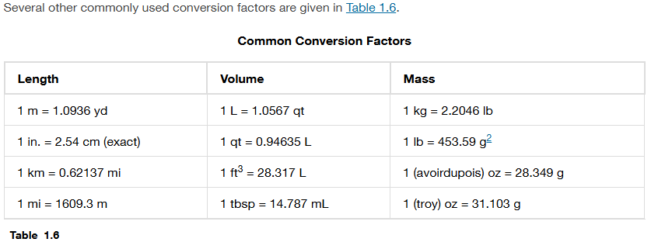
Step 1: Find the conversion rate (or factor)
NOTE: All conversion rates (or conversion factors) must have the following:
A number with a unit
An equals sign
A number with a different unit
Chapter 1.6

Slide 39


Step 2: Write the conversion rate as two fractions
$$\frac{1 in}{2.54 cm}$$
$$\frac{2.54 cm}{1 in}$$
Chapter 1.6

Slide 40
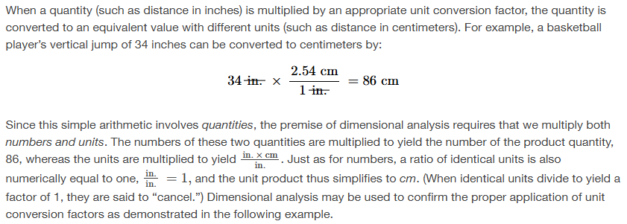
Step 3: Multiply the original value by the fraction
Important notes:
Use the fraction that has the same units as the original value on the bottom of the fraction
Cancel out any units that are the same
Chapter 1.6

Slide 41
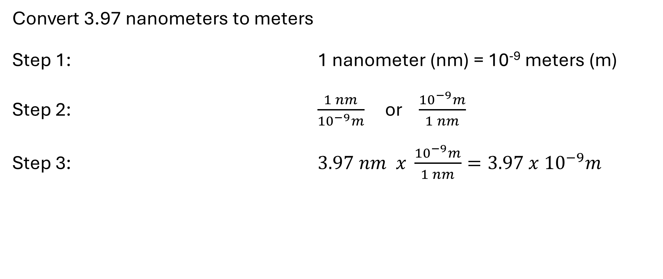
Practice Problem – 1 step conversion
Chapter 1.4
Convert 3.97 nanometers to meters
Step 1: 1 nanometer (nm) = 10⁻⁹ meters (m)
Step 2: $\frac{1 nm}{{10}^{−9}m}$ or $\frac{{10}^{−9}m}{1 nm}$
Step 3: $3.97 nm x \frac{{10}^{−9}m}{1 nm}=3.97 x {10}^{−9}m$
find the conversion rate
write it as two fractions
Multiply the original value by the fraction. Use the fraction that has the same unit as the original value on the bottom. Cancel out any units.

Slide 42
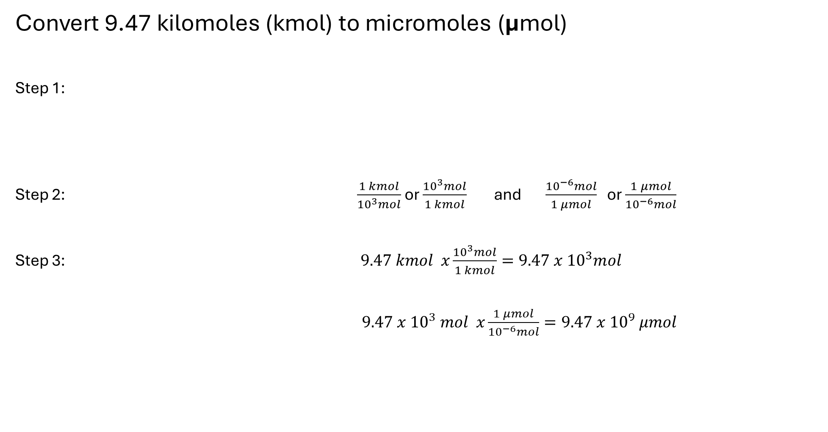
Practice Problem – 2 step conversion
Convert 9.47 kilomoles (kmol) to micromoles (μmol)
Step 1:
Step 2: $\frac{1 kmol}{{10}^{3}mol}$ or $\frac{{10}^{3}mol}{1 kmol}$ and $\frac{{10}^{−6}mol}{1 μmol}$ or $\frac{1 μmol}{{10}^{−6}mol}$
Step 3: $9.47 kmol x\frac{{10}^{3}mol}{1 kmol}=9.47 x {10}^{3}mol$
$9.47 x {10}^{3} mol x\frac{1 μmol}{{10}^{−6}mol}=9.47 x {10}^{9} μmol$
find the conversion rate
We do not have a direct conversion rate from kilo to micro so we have to do a 2-step conversion.
Conversion 1: 1 kmol = 10³ mol
Conversion 2: 1 μmol = 10⁻⁶ mol
write both as two fractions
Multiply the original value by the fraction. Use the fraction that has the same unit as the original value on the bottom. Cancel out any units.
Then repeat this with the second conversion fraction
Chapter 1.6

Slide 43

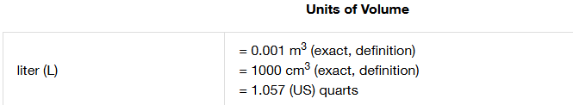
Chapter 1.6, Appendix C

Slide 44

Chapter 1.6

Slide 45
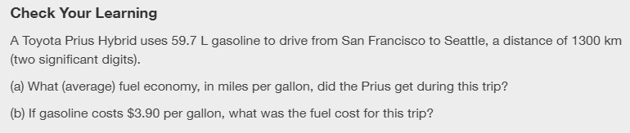
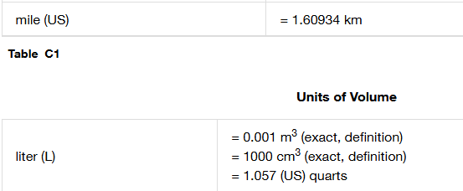
1 gallon = 4 quarts
Chapter 1.6, Appendix C

Slide 46
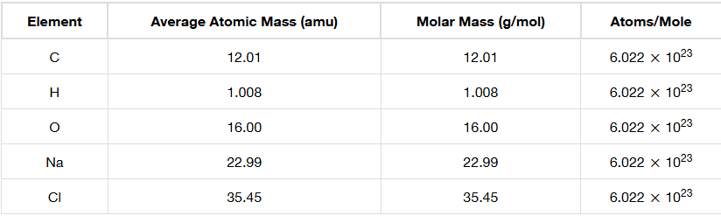
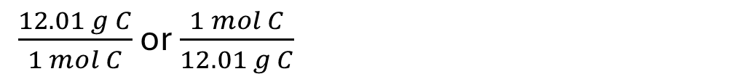
Practice Problem
How many moles in 0.26 grams of carbon?
Conversion rate: 12.01 grams of carbon = 1 mole of carbon
12.01 g C = 1 mol C
$\frac{12.01 g C}{1 mol C}$ or $\frac{1 mol C}{12.01 g C}$
Chapter 2.4

Slide 47
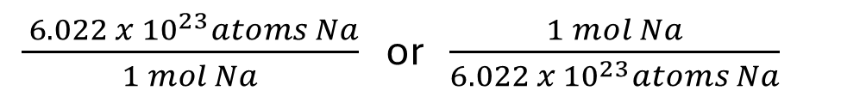
Practice Problem
How many atoms of sodium in 1.3 moles of sodium?
Conversion rate: 6.022 x 10²³ atoms of sodium = 1 mole of sodium
6.022 x 10²³ atoms Na = 1 mol Na
$\frac{ 6.022 x {10}^{23}atoms Na}{1 mol Na}$ or $\frac{1 mol Na}{6.022 x {10}^{23}atoms Na}$
Chapter 2.4

Slide 48


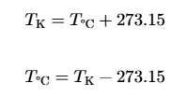
Temperature Conversions
Convert ºF to ºC
Convert ºC to ºF
Convert ºC to K
Convert K to ºC
Chapter 1.6

Slide 49

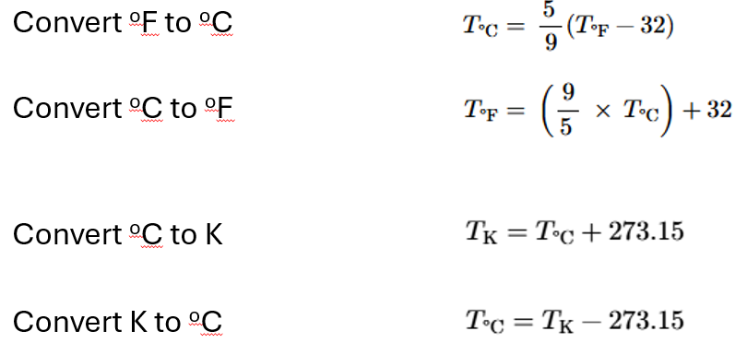
Chapter 1.6

Slide 50
Dimensional Analysis (grams to moles to units)
Chapter 2.4 (Chemical Formulas)
Adapted From: Paul Flowers, Edward J. Neth, William R. Robinson, PhD, Klaus Theopold, Richard Langley; Chemistry: Atoms First 2e; OpenStax; Feb 14, 2019; Houston Texas; https://openstax.org/books/chemistry-atoms-first-2e/pages/1-introduction

Slide 51
Your calculator will be very important!
Get a non-phone calculator ASAP!
Practice with it during every lecture/video, assignments, and the same one for exams
Free Online Calculators (but you need to have a physical one for the exams:
  https://ti84calc.com/
  https://ti84ce.com/
  https://www.desmos.com/scientific
  Search free online scientific calculator
Put brackets around all exponential notation numbers when using your calculator!

Slide 52
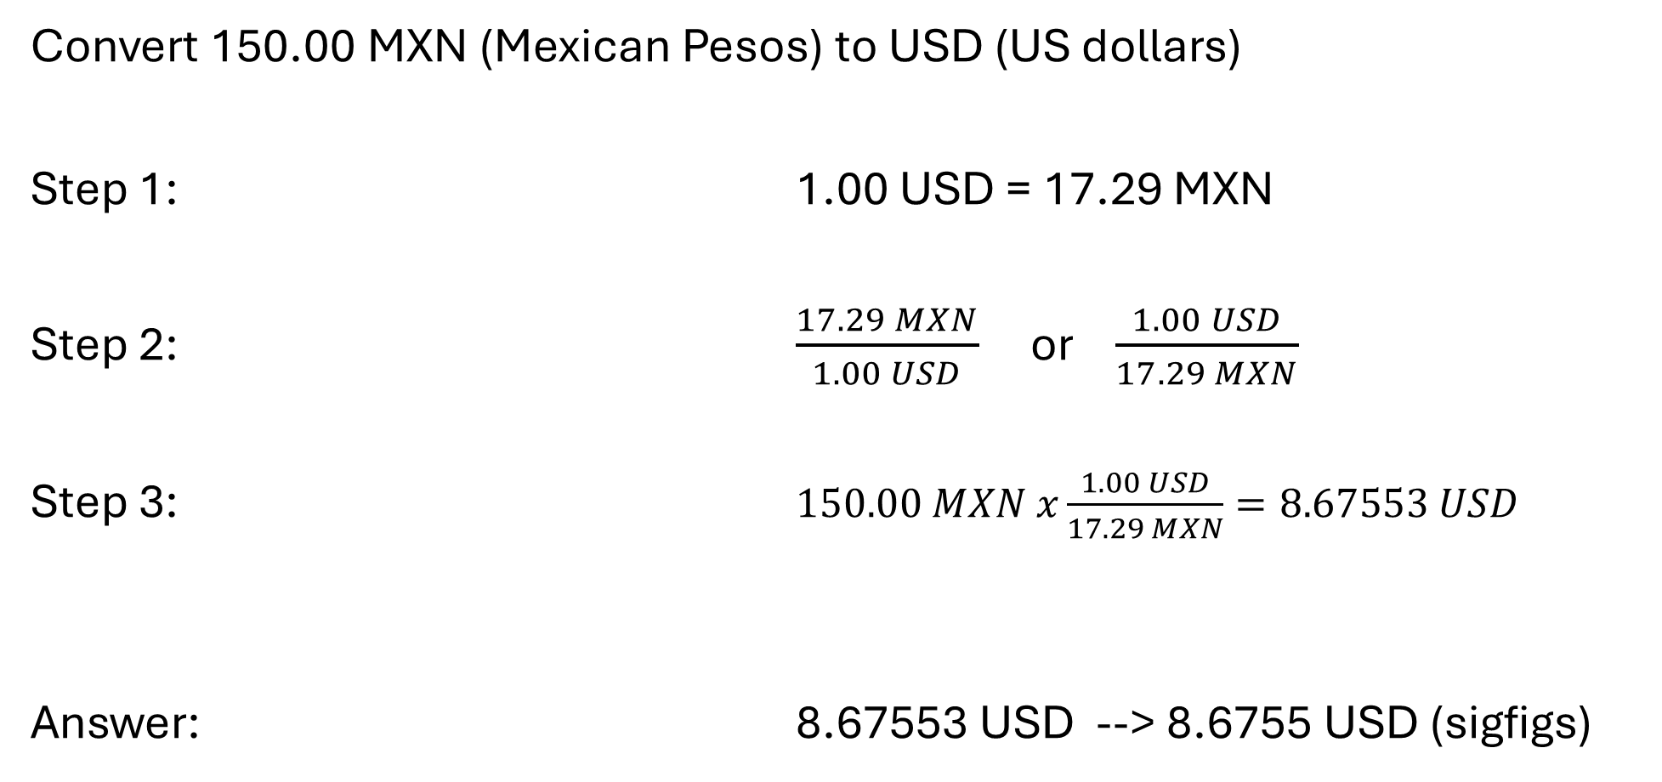
Dimensional analysis is just converting things from one unit to another
Convert 150.00 MXN (Mexican Pesos) to USD (US dollars)
Step 1: 1.00 USD = 17.29 MXN
Step 2: $\frac{17.29 MXN}{1.00 USD}$ or $\frac{1.00 USD}{17.29 MXN}$
Step 3: $150.00 MXN x\frac{1.00 USD}{17.29 MXN}=8.67553 USD$
Answer: 8.67553 USD --> 8.6755 USD (sigfigs)
find the conversion rate
conversion factors are “exact” numbers
write it as two fractions
Multiply the original value by the fraction. Use the fraction that has the same unit as the original value on the bottom.

Slide 53
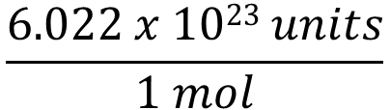
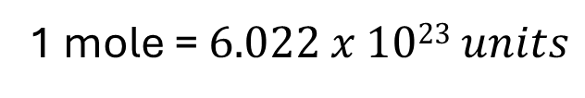
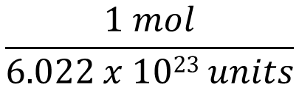
Avogadros number lets you convert from moles to units and from units to moles
Convert atoms to moles
Step 1:
Step 2:
Step 3:
Answer:
find the conversion rate
1 mole = $6.022 x 1023 units$
write it as two fractions
$$\frac{6.022 x 1023 units}{1 mol}$$
or
$$\frac{1 mol}{6.022 x 1023 units}$$
Multiply the original value by the fraction. Use the fraction that has the same unit as the original value on the bottom.
Units = anything but usually molecules or atoms in this class

Slide 54
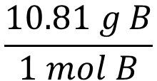

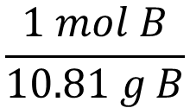
Grams per mole lets you convert from grams to moles and moles to grams
Convert moles of boron to grams of boron
Step 1:
Step 2:
Step 3:
Answer:
find the conversion rate
$$10.81 g B=1 mol B$$
write it as two fractions
$$\frac{10.81 g B}{1 mol B}$$
or
$$\frac{1 mol B}{10.81 g B}$$
Multiply the original value by the fraction. Use the fraction that has the same unit as the original value on the bottom.

Slide 55
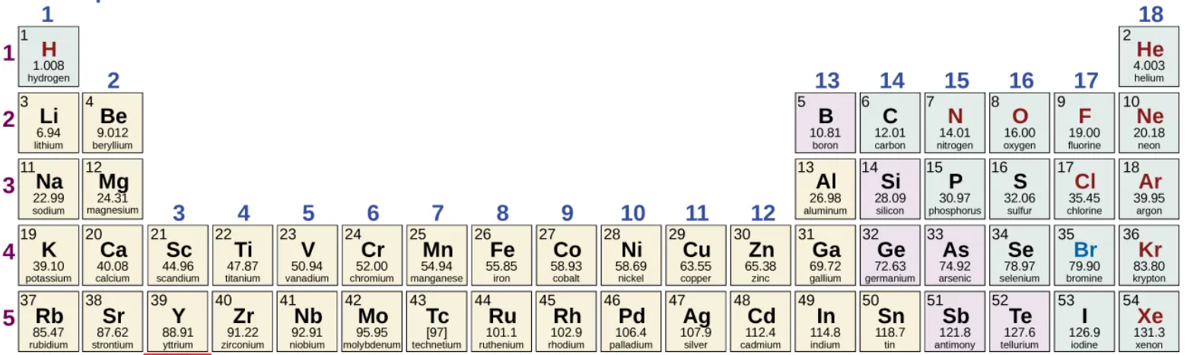

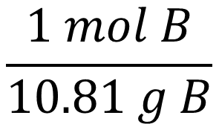
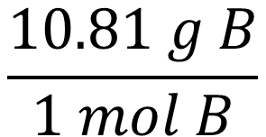
Grams per mole is found on the periodic table for atoms and molecules
$$10.81 g B=1 mol B$$
$$\frac{10.81 g B}{1 mol B}$$
$$\frac{1 mol B}{10.81 g B}$$
or
Appendix A

Slide 56
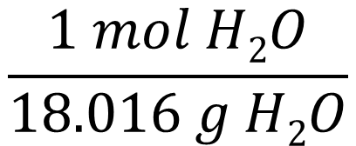
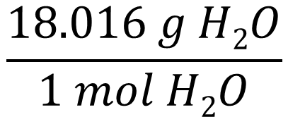
Grams per mole is found on the periodic table for atoms and molecules
H x 2 x 1.008 g/mol = 2.016 g/mol
O x 1 x 16.00 g/mol = 16.00 g/mol
------------------------------------------
H₂O = 18.016 g/mol
$$18.016 g H2O=1 mol H2O$$
$$\frac{18.016 g H2O}{1 mol H2O}$$
$$\frac{1 mol H2O}{18.016 g H2O}$$
or
Appendix A

Slide 57

It is possible to convert grams to moles to units and back
Chapter 2.4
Units = anything but usually molecules or atoms in this class

Slide 58


Chapter 2.4

Slide 59


Chapter 2.4

Slide 60

Chapter 2.4

Slide 61




Chapter 2.4

Slide 62


Chapter 2.4

Slide 63






You can make your own conversion rates from the ratio of atoms in the molecule (the mole ratio)
$$1 molecule BaF2=2 atoms F$$
$$1 molecule BaF2=1 atoms Ba$$
$$\frac{1 molecule BaF2}{2 atoms F}$$
$$\frac{2 atoms F}{1 molecule BaF2}$$
$$\frac{1 molecule BaF2}{1 atom Ba}$$
$$\frac{1 atoms Ba}{1 molecule BaF2}$$
or
or

Slide 64

Chapter 2.4

