Slide 1



Chem
With
Com

Slide 2
Polyatomic Ions and Nomenclature
Chapter 3.7 (Ionic and Molecular Compounds)
Chapter 4.3 (Nomenclature)
Adapted From: Paul Flowers, Edward J. Neth, William R. Robinson, PhD, Klaus Theopold, Richard Langley; Chemistry: Atoms First 2e; OpenStax; Feb 14, 2019; Houston Texas; https://openstax.org/books/chemistry-atoms-first-2e/pages/1-introduction

Slide 3
Polyatomic Ions and Neutral Compounds
Chapter 3.7 (Ionic and Molecular Compounds)
Adapted From: Paul Flowers, Edward J. Neth, William R. Robinson, PhD, Klaus Theopold, Richard Langley; Chemistry: Atoms First 2e; OpenStax; Feb 14, 2019; Houston Texas; https://openstax.org/books/chemistry-atoms-first-2e/pages/1-introduction

Slide 4
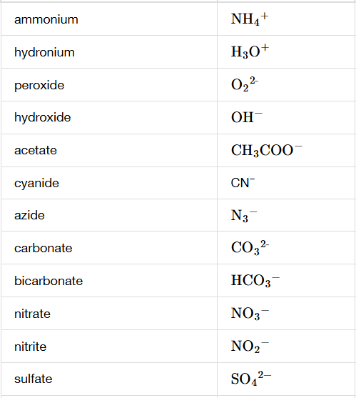
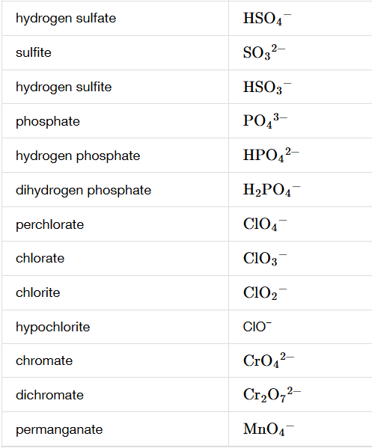
Polyatomic Ions (many atoms with a charge)
Chapter 3.7

Slide 5
Polyatomic Ions (many atoms with a charge)
Will usually stay together
“Behaves” like monoatomic ions
Collectively, the molecule has lost or gained 1 or more electrons
Chapter 3.7

Slide 6
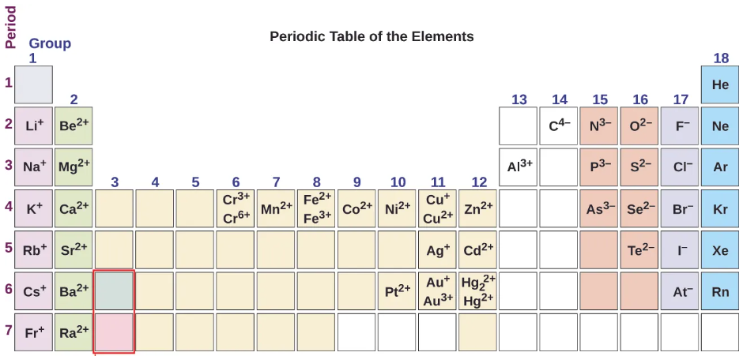

Ions and the Periodic Table
H⁺
FIXED CHARGED IONS LISTED HERE, IF NOT HERE, THEY ARE VARIABLY CHARGED (meaning they can have different charges i.e. Fe²⁺ or Fe³⁺)
B³⁺
Chapter 3.7
Notes:
These are predicted charges. Also, explain transition metals and variable charges

Slide 7
Ionic Bonds (ionic compounds)
Neutral Compound
Metal + Nonmetal
Total charges should add up to 0
Criss cross apple sauce shortcut (then use empirical formula
In this class, ionic compounds will be made up of one anion and one cation
(cation) Positive Charge Ion + Negative Charged Ion (anion)
Na¹⁺
Cl¹⁻
NaCl
Mg²⁺
O²⁻
MgO
Ca²⁺
F¹⁻
CaF₂
Fe³⁺
O²⁻
Fe³⁺
O²⁻
Fe₂O₃
Fe₂O₃
cation
NaCl
anion
MgO
Chapter 3.7

Slide 8
Ionic Bonds (ionic compounds)
Neutral Compound
cation + anion
Total charges should add up to 0
Criss cross apple sauce shortcut (then use empirical formula
In this class, ionic compounds will be made up of one anion and one cation
Na¹⁺
NO₃¹⁻
NaNO₃
Mg²⁺
SO₄²⁻
MgSO₄
NH₄¹⁺
O²⁻
(NH₄)₂O
Ca²⁺
PO₄³⁻
Ca₃(PO4)₂
Ca²⁺
PO₄³⁻
Ca₃ ( PO4)₂
cation
(NH₄)₂O
anion
Ca₃(PO4)₂
Chapter 3.7

Slide 9
Practice Problems
Write the formula for a compound containing sodium and oxygen
Write the formula for a compound containing barium and nitrogen
Write the formula for a compound containing sodium and hydroxide
Write the formula for a compound containing ammonium and sulfur
Write the formula for a compound containing ammonium and carbonate

Slide 10
Nomenclature Info and Covalent Compounds
Chapter 3.7 (Ionic and Molecular Compounds)
Chapter 4.3 (Nomenclature)
Adapted From: Paul Flowers, Edward J. Neth, William R. Robinson, PhD, Klaus Theopold, Richard Langley; Chemistry: Atoms First 2e; OpenStax; Feb 14, 2019; Houston Texas; https://openstax.org/books/chemistry-atoms-first-2e/pages/1-introduction

Slide 11
Nomenclature Classifications
Molecular Compound – two nonmetals
Ionic Compound – cation and anion (can be polyatomic ions)
Acid – H (hydrogen) on the left side of the molecule or the word acid in the name. An acid is something that can donate a H to water.
Hydrate – a water attached (i.e. molecule•4H₂O)

Slide 12
Polyatomic Ions (many atoms with a charge)
Chapter 3.7

Slide 13
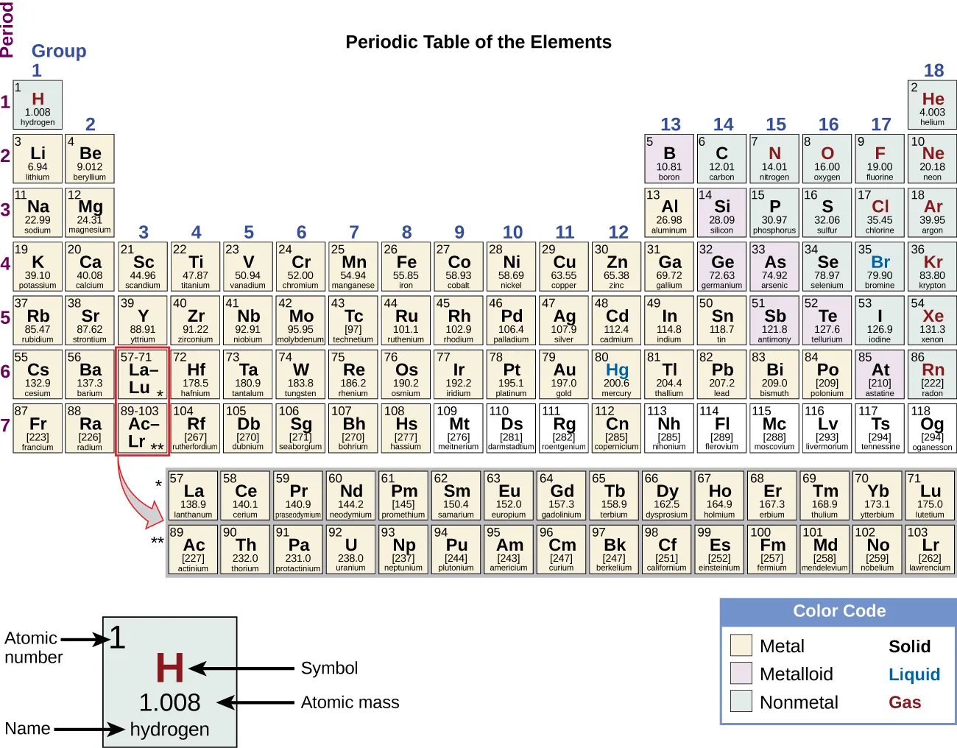
Metals vs Nonmetals (everything else)
Metals and then everything that isn’t
Nonmetals
Chapter 3.6
Notes:
Explain groups (columns) and periods (rows)

Slide 14
Fixed Charged Ions (these ions always have the same charge)
H⁺
FIXED CHARGED IONS LISTED HERE, IF NOT HERE, THEY ARE VARIABLY CHARGED (meaning they can have different charges i.e. Fe²⁺ or Fe³⁺)
B³⁺
Chapter 3.7
Notes:
These are predicted charges. Also, explain transition metals and variable charges

Slide 15
Variably Charged Ions (not complete list)
1+ | 2+ | 3+ | 4+ | 5+ | 6+
Cu¹⁺ copper(I) | Cu²⁺ copper(II)
 | Fe²⁺ Iron(II) | Fe³⁺ Iron(III)
Au¹⁺ gold(I) |  | Au³⁺ gold(III)
Hg₂²⁺ mercury(I) | Hg²⁺ mercury(II)
 |  | Cr³⁺ chromium(III) |  |  | Cr⁶⁺ chromium(VI)
 | Pb²⁺ lead(II) |  | Pb⁴⁺ lead(IV)
 | Sn²⁺ tin(II) |  | Sn⁴⁺ tin(IV)
Chapter 4.3, 3.7

Slide 16
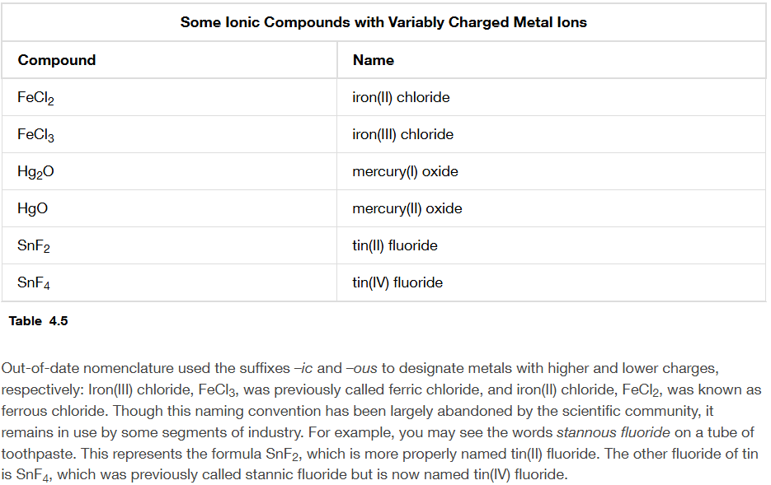
Compounds with Variably Charged Ions
Chapter 4.3

Slide 17
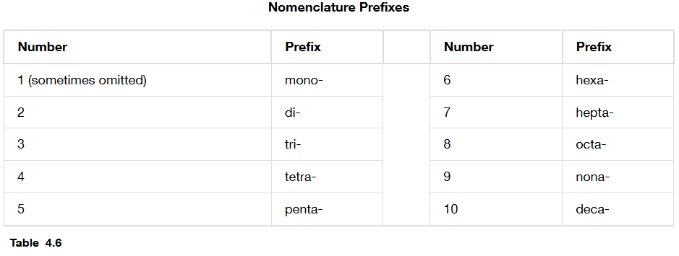
Nomenclature Prefixes for Covalent Compounds and Hydrates
Chapter 4.3

Slide 18
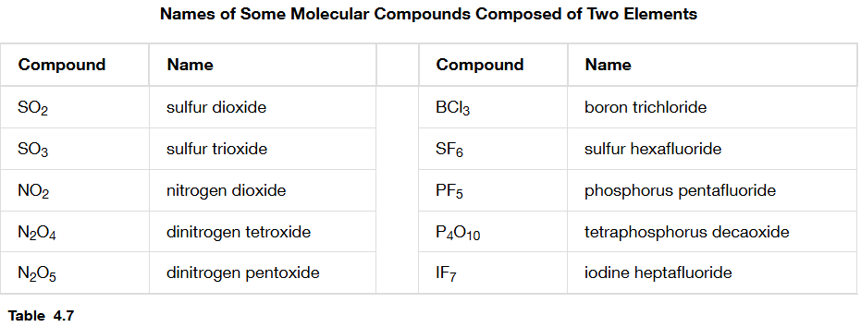
Start Here
Molecular Compound
Chapter 4.3
Does the molecule have:
Metals?
Polyatomic Ions?
H on left or the word “acid”
1st prefix + first element + 2nd prefix + second element with ending changed to “ide”
Leave out the prefix for the first element if there is only one of those atoms
YES NO
SF₆ sulfur hexafluoride
N₂O dinitrogen monoxide
Number | Prefix
1 | Mono
2 | Di
3 | Tri
4 | Tetra
5 | Penta
6 | Hexa
7 | Hepta
8 | Octa
9 | Nona
Metals?
Polyatomic ions?
H on the left or the word acid?
YES

Slide 19
Practice Problems
Name the compound: N₂O₃
Name the compound: Cl₂O₇
Name the compound: P₄O₆
Write the formula: phosphorous pentachloride
Write the formula: iodine heptafluoride
Write the formula: carbon tetrachloride
Write the formula: dihydrogen monoxide

Slide 20
Nomenclature of Ionic Compounds and Acids
Chapter 3.7 (Ionic and Molecular Compounds)
Chapter 4.3 (Nomenclature)
Adapted From: Paul Flowers, Edward J. Neth, William R. Robinson, PhD, Klaus Theopold, Richard Langley; Chemistry: Atoms First 2e; OpenStax; Feb 14, 2019; Houston Texas; https://openstax.org/books/chemistry-atoms-first-2e/pages/1-introduction

Slide 21
Polyatomic Ions (the important ones for this chapter end in –ate or –ite)
Usually C₂H₃O₂¹⁻
phosphite | PO₃³⁻
Chapter 3.7

Slide 22
How to name things:
Have your periodic table handy that tells you which elements are metals and nonmetals and which elements have fixed charges and what those charges are (preferably the one you created)
Have your polyatomic ion table handy (preferably the one you created)
Below (next slide) – start in the upper left hand side where it says “Start Here” and follow the arrows appropriately.

Slide 23
Start Here
Molecular Compound
Chapter 4.3
Does the molecule have:
Metals?
Polyatomic Ions?
H on left or the word “acid”
1st prefix + first element + 2nd prefix + second element with ending changed to “ide”
Leave out the prefix for the first element if there is only one of those atoms
YES NO
SF₆ sulfur hexafluoride
N₂O dinitrogen monoxide
Number | Prefix
1 | Mono
2 | Di
3 | Tri
4 | Tetra
5 | Penta
6 | Hexa
7 | Hepta
8 | Octa
9 | Nona
Metals?
Polyatomic ions?
H on the left or the word acid?
YES

Slide 24
Continue Here
Ionic Compound with a fixed charged metal
Chapter 4.3
Name of the metal + name of the nonmetal with the ending changed to “ide”
Make neutral compounds by making sure the charges add up to 0
Does the molecule have:
Metals?
Polyatomic ion without an H on the left side of the molecule?
NaCl sodium chloride
AgN₃ silver nitride
Is there a:
Fixed charge metal
Variably charged metal
Polyatomic Ion
Ionic Compound with a variably charged metal
NO YES
Name of the metal + charge in parentheses + name of the nonmetal with the ending changed to “ide”
Fe₂O₃ iron(III) oxide
SnO tin(II) oxide
SnO₂ tin(IV) oxide
H on the left or the word acid?
Polyatomic ion with an H on the left side of the molecule?
How do we know the charges/formulas? We still make neutral compounds and we know one of the charges. For example for SnO₂ we know there are 2 oxygens and each oxygen has a 2- charge so there is a total negative charge of 4-. We need 4+ to make a neutral compound and since there is only 1 tin atom all of the 4+ needs to go on tin so it’s tin(IV).
Ionic Compound with a polyatomic ion
Read the name of the cation + read the name of the anion and change the ending to “ide”
NH₄Br ammonium bromide
If the anion is a polyatomic ion, don’t change the ending
(NH₄)₃PO₄ ammonium phosphate

Slide 25
Continue Here
Acid without an oxygen
Chapter 4.3
Is there an oxygen in the acid:
No
Yes
Hydro + name of the non-H atom/molecule with the ending changed to “ic” + acid
    HCl hydrochloric acid
    HCN hydrocyanic acid
H on the left or the word acid?
NO YES
Acid with an oxygen
Identify the polyatomic ion in the acid and see if it ends in –ate or –ite. Remove all the H’s and whatever is left is the polyatomic ion.
If ending in “ate” say the base name of the ion and then change the ending to “ic” + acid
  HNO₃ (polyatomic ion = nitrate) nitric acid
  H₂CO₃ (polyatomic ion = carbonate) carbonic acid
If ending in “ite” say the base name of the ion and then change the ending to “ous” + acid
  HClO₂ (polyatomic ion = chlorite) chlorous acid
  HClO (polyatomic ion = hypochlorite) hypochlorous acid
Sometimes the base names are weird and don’t exactly follow the rules
H₂SO₄ should be sulfic acid but it’s actually sulfuric acid
H₂PO₃ should be phosphous acid but it’s actually phosphorous acid
You messed up, go back to the first slide on nomenclature
If the acid is written as a gas i.e. HCl (g) or H₂SO₄ (g) then it is not an acid because it cannot donate the hydrogen to water to it would be named as a molecular compound i.e. HCl (g) is hydrogen chloride

Slide 26
Other Situations - hydrates
Regular name of the ionic compound + prefix and “hydrate”
MgSO₄ • 7H₂O magnesium sulfate heptahydrate epsom salts
Na₂CO₃ • 10H₂O sodium carbonate decahydrate washing soda
Number | Prefix
1 | Mono
2 | Di
3 | Tri
4 | Tetra
5 | Penta
6 | Hexa
7 | Hepta
8 | Octa
9 | Nona
10 | Deca

Slide 27
How to figure out formulas? Make neutral compounds. Use the information that we know.
Fe₂O₃ – we know oxygen is 2- and there are 3 of them so the total negative charge is 6-. Since the molecule is neutral, it must have 6+ charges. There are 2 Fe atoms so each Fe atom has a 3+ charge so the name is iron(III) oxide.
FeO
PbF₂
PbF₄

Slide 28
How to figure out formulas? Make neutral compounds. Use the information that we know.
Sulfurous Acid – since the acid ends in “ous”, the polyatomic ion is sulfite which is SO₃²⁻, each hydrogen is H¹⁺ so you would need 2 hydrogen to make a neutral compound so it is H₂SO₃
Phosphoric Acid -
Nitrous Acid -
Acetic Acid -

Slide 29
More Practice Problems
What is the name for this compound: MgCl₂
What is the name for this compound: CuCl₂
What is the name for this compound: (NH₄)₂CO₃
What is the formula for this compound: ammonium sulfate
What is the name for this compound: NaHSO₄
What is the name for this compound: H₂Cr₂O₇
What is the name for this compound (pay attention to the (g): HCl (g)

