Slide 1



Chem
With
Com

Slide 2
Molecular Structure and Polarity
Chapter 4.6 (Molecular Structure and Polarity)
Chapter 4.2 (Covalent Bonding)
Adapted From: Paul Flowers, Edward J. Neth, William R. Robinson, PhD, Klaus Theopold, Richard Langley; Chemistry: Atoms First 2e; OpenStax; Feb 14, 2019; Houston Texas; https://openstax.org/books/chemistry-atoms-first-2e/pages/1-introduction

Slide 3
Molecular Structure
Chapter 4.6 (Molecular Structure and Polarity)
Adapted From: Paul Flowers, Edward J. Neth, William R. Robinson, PhD, Klaus Theopold, Richard Langley; Chemistry: Atoms First 2e; OpenStax; Feb 14, 2019; Houston Texas; https://openstax.org/books/chemistry-atoms-first-2e/pages/1-introduction

Slide 4
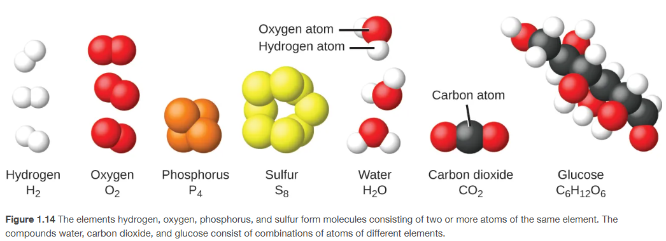
Shapes of Molecules and Compounds
Compounds
(two or more different atoms)
molecules
(more than one atom)
Chapter 1.2

Slide 5
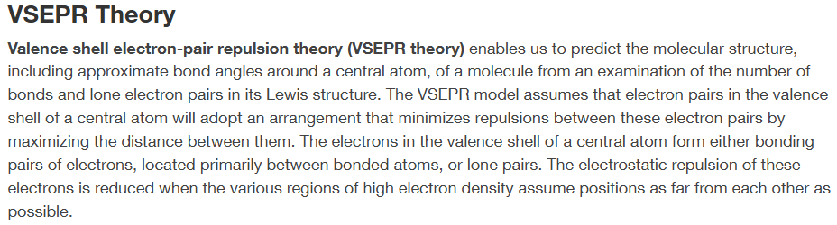
Very Science Version
Chapter 4.6

Slide 6
Com’s Version
When atoms start covalently bonding (sharing of valence electrons) to form molecules, the atoms that are bonding to the “central” atom stay as far apart as possible.
  imagine getting on a bus and there is 1 stranger sitting, would you sit next to them or give them space?
This is because the outsides of atoms have exterior unbonded electrons and they are negatively charged. And same charges repel each other just like magnets with the same magnetic poles.
When molecules start forming, they take on 2 and 3 dimensional shapes around the “central” atom and this is called the electron geometry

Slide 7
3D Simulation
https://phet.colorado.edu/en/simulations/molecule-shapes

Slide 8
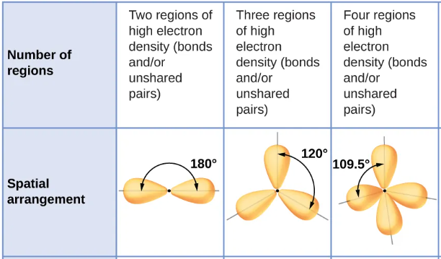
Electron-Pair Geometry (Electron Geometry)
Connections to center atom | 1 or 2 | 3 | 4
*Connections (regions of high electron density) =
  Atoms
  Lone pairs
Atoms
+
Lone Pairs
____________
Connections
Electron Geometry | Linear | Trigonal planar | tetrahedral
Chapter 4.6

Slide 9
Covalent Bonds and Lewis Structures (com’s way)
Count total valence electrons of all atoms
  Negative charges mean add electrons, positive charges mean subtract electrons
Draw the skeletal structure with these tips
  symmetrical
  H, F, Cl, Br, I on the outsides
Place bonding electrons in pairs to connect atoms
Put rest of electrons on the outsides in pairs following the “octet” rule
  If an atom doesn’t have all it’s electrons, share your neighbor’s electron pairs
Other common things (usual but not always):
  C = 4 bonds, 0 lone pair
  N = 3 bonds, 1 lone pair
  O = 2 bonds, 2 lone pairs
  halogens = 1 bond, 3 lone pairs
REVIEW Topic 03: Lewis Structures, Bonding, and Molecules; Subtopic 2 of 3: Lewis Structures and Covalent Bonds

Slide 10
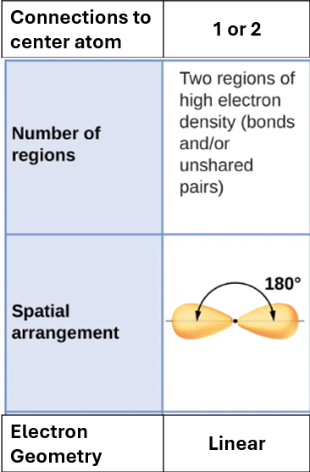
Lewis Structures to Electron Geometry
CO
+
Atoms
Lone Pairs
____________
Connections
CO₂
+
Atoms
Lone Pairs
____________
Connections

Slide 11
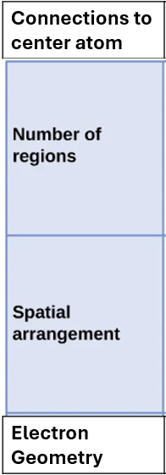
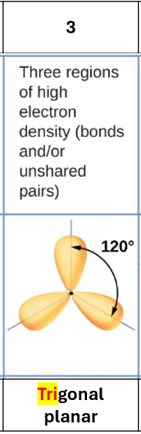
Lewis Structures to Electron Geometry
CH₂O
+
Atoms
Lone Pairs
____________
Connections
Chapter 4.6

Slide 12
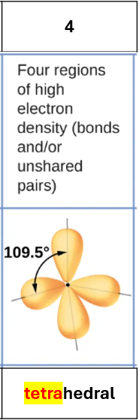
Lewis Structures to Electron Geometry
CCl₄
+
Atoms
Lone Pairs
____________
Connections
Chapter 4.6

Slide 13
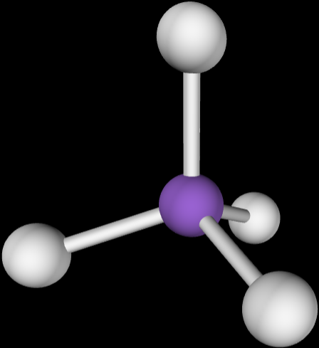

Drawing 3D Molecules
Cl
On the screen (solid line)
C
Cl
Cl
Cl
Going into the screen away from you (dashed wedge)
Coming out of the screen toward you (solid wedge)
https://phet.colorado.edu/sims/html/molecule-shapes/latest/molecule-shapes_all.html

Slide 14
Drawing 3D Molecules
Cl
On the screen (solid line)
C
Cl
Cl
Cl
Going into the screen away from you (dashed wedge)
Coming out of the screen toward you (solid wedge)

Slide 15
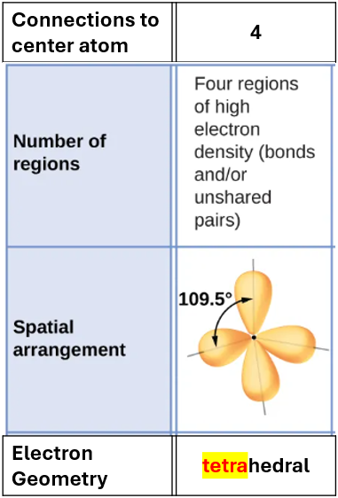
Electron Geometry and Molecular Structure
H₂O
+
Atoms
Lone Pairs
____________
Connections
Molecular Structure (no lone pairs) | bent
Chapter 4.6

Slide 16
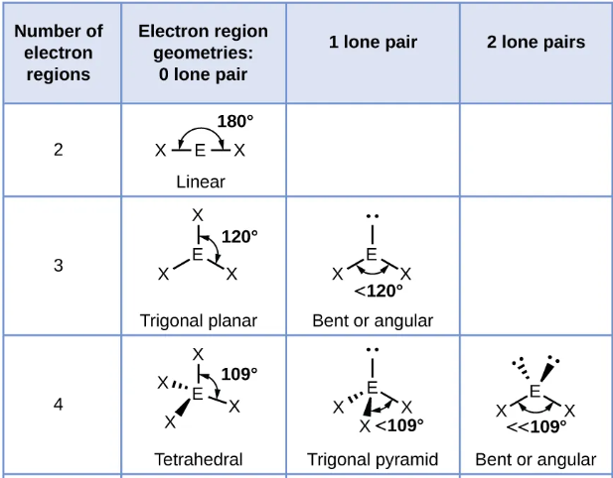
Electron Geometry and Molecular Structure
If there are lone pairs on the center atom, the molecular structure is different than the electron geometry
Com’s Way
Electron Geometry - draw the 3D molecule with all the atoms and lone pairs and that’s the electron geometry
Molecular Structure – put out your thumb like you’re giving me a thumbs up, close one eye, and cover up the lone pairs with your thumb and that’s the molecular shape
Chapter 4.6

Slide 17
Electron Geometry and Molecular Structure
NH₃
+
Atoms
Lone Pairs
____________
Connections
Molecular Structure (no lone pairs) | Trigonal pyramidal
Chapter 4.6

Slide 18

Chapter 4.6

Slide 19

Chapter 4.6

Slide 20
Electronegativity and Polar Covalent Bonds
Chapter 4.2 (Covalent Bonding)
Adapted From: Paul Flowers, Edward J. Neth, William R. Robinson, PhD, Klaus Theopold, Richard Langley; Chemistry: Atoms First 2e; OpenStax; Feb 14, 2019; Houston Texas; https://openstax.org/books/chemistry-atoms-first-2e/pages/1-introduction

Slide 21
Pure Covalent VS Polar Covalent Bonds (Polar Bonds)
Pure Covalent Bonds
  Nonmetal + nonmetal
  Held together by covalent bonds
  Covalent bonds are formed by atoms sharing electrons
Polar Covalent Bonds (Polar Bonds)
  Nonmetal + nonmetal
  Held together by covalent bonds
  Covalent bonds are formed by atoms sharing electrons unequally

Slide 22
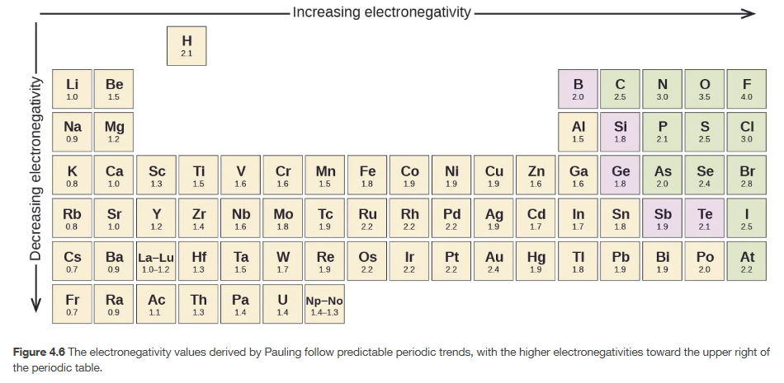
Electronegativity
How much an atom pulls electrons toward itself
Highest electronegativity
Lowest electronegativity
Chapter 4.2

Slide 23
Lewis Structures and Sharing of Electrons
H₂
Cl₂
HCl

Slide 24
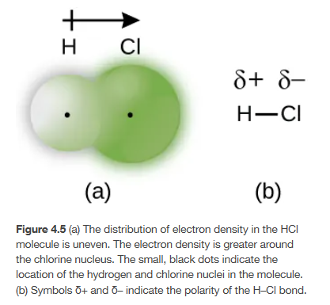
Lewis Structures and Sharing of Electrons
HCl
Symbol for partial positive (delta)
Symbol for partial negative (delta)
Polarity vector, with arrow showing which side of the molecule the electrons are. The small plus sign is where there is less electron density
Chapter 4.2

Slide 25
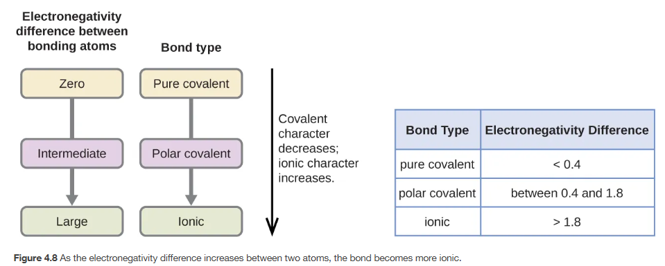


Lewis Structures and Sharing of Electrons
HCl
Chapter 4.2

Slide 26
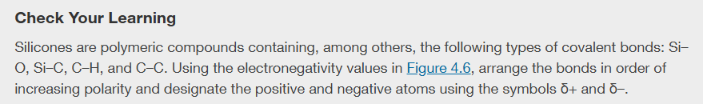

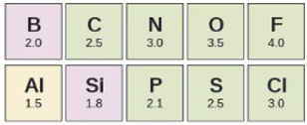
Chapter 4.2

Slide 27
Molecular Polarity
Chapter 4.6 (Molecular Structure and Polarity)
Chapter 4.2 (Covalent Bonding)
Adapted From: Paul Flowers, Edward J. Neth, William R. Robinson, PhD, Klaus Theopold, Richard Langley; Chemistry: Atoms First 2e; OpenStax; Feb 14, 2019; Houston Texas; https://openstax.org/books/chemistry-atoms-first-2e/pages/1-introduction

Slide 28
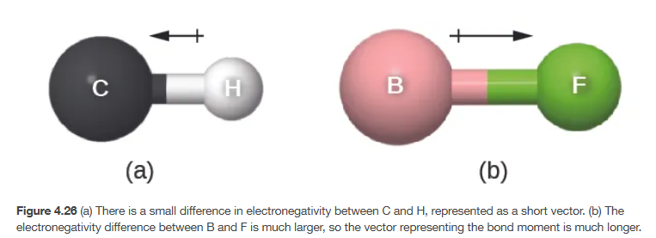
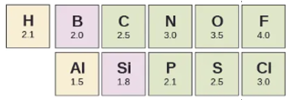
Polar Bonds
Chapter 4.2, 4.6

Slide 29
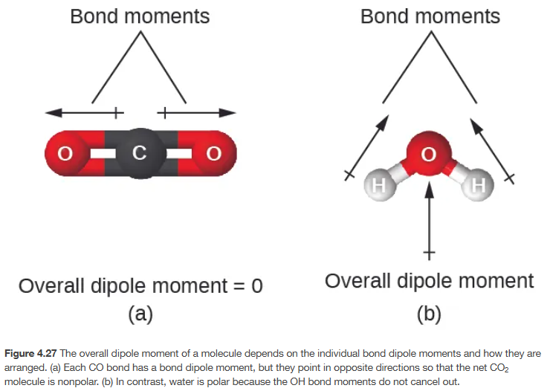
Polar Molecules?
Chapter 4.6

Slide 30
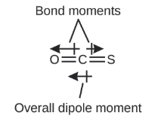
Polar Molecules?
Chapter 4.6

Slide 31
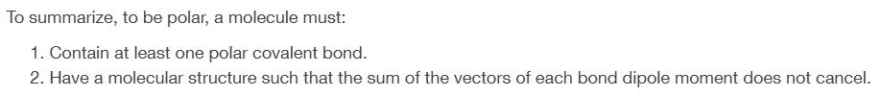
Is something polar?
Book Version
Com’s Way (works most of the time)
Draw the 3D structure of the molecule (most of the time the Lewis structure works).
Label all exterior atoms with their electronegativities (δ- and δ+) based on periodic table trends. (up and to the right are most electronegative)
Try to draw a straight line that separates the δ- and δ+ atoms. If you can, it’s polar, if you can’t it’s nonpolar.

Slide 32
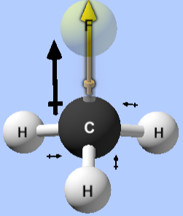
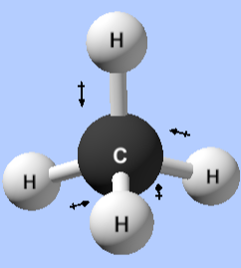
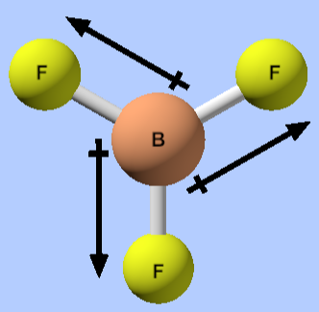
Polar and Nonpolar
https://phet.colorado.edu/sims/html/molecule-polarity/latest/molecule-polarity_all.html

Slide 33
Practice Problems
Draw the 3D structures for the following molecules, label each exterior atom with their partial charges (δ- and δ+): H₂, Cl₂, HCl, CO, CO₂, CH₂O, CCl₄, CH₄, CH₃F, H₂O, NH₃.
Indicate if they are polar or not and if so, draw the dipole moment.
Do not use the periodic table for electronegativity values, just use the trend of atoms higher and to the right on the periodic table are more electronegative.
Chapter 4.2

Slide 34
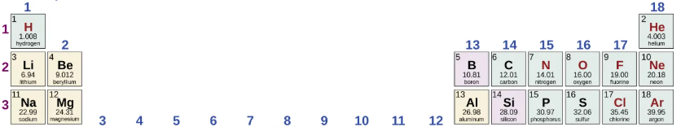
H₂ Cl₂
HCl CO
CO₂ CH₂O
Chapter 4.2

Slide 35
CCl₄ CH₄
CH₃F H₂O
NH₃
Chapter 4.2

Slide 36
Polarity Simulation
https://phet.colorado.edu/en/simulations/molecule-polarity

