Slide 1


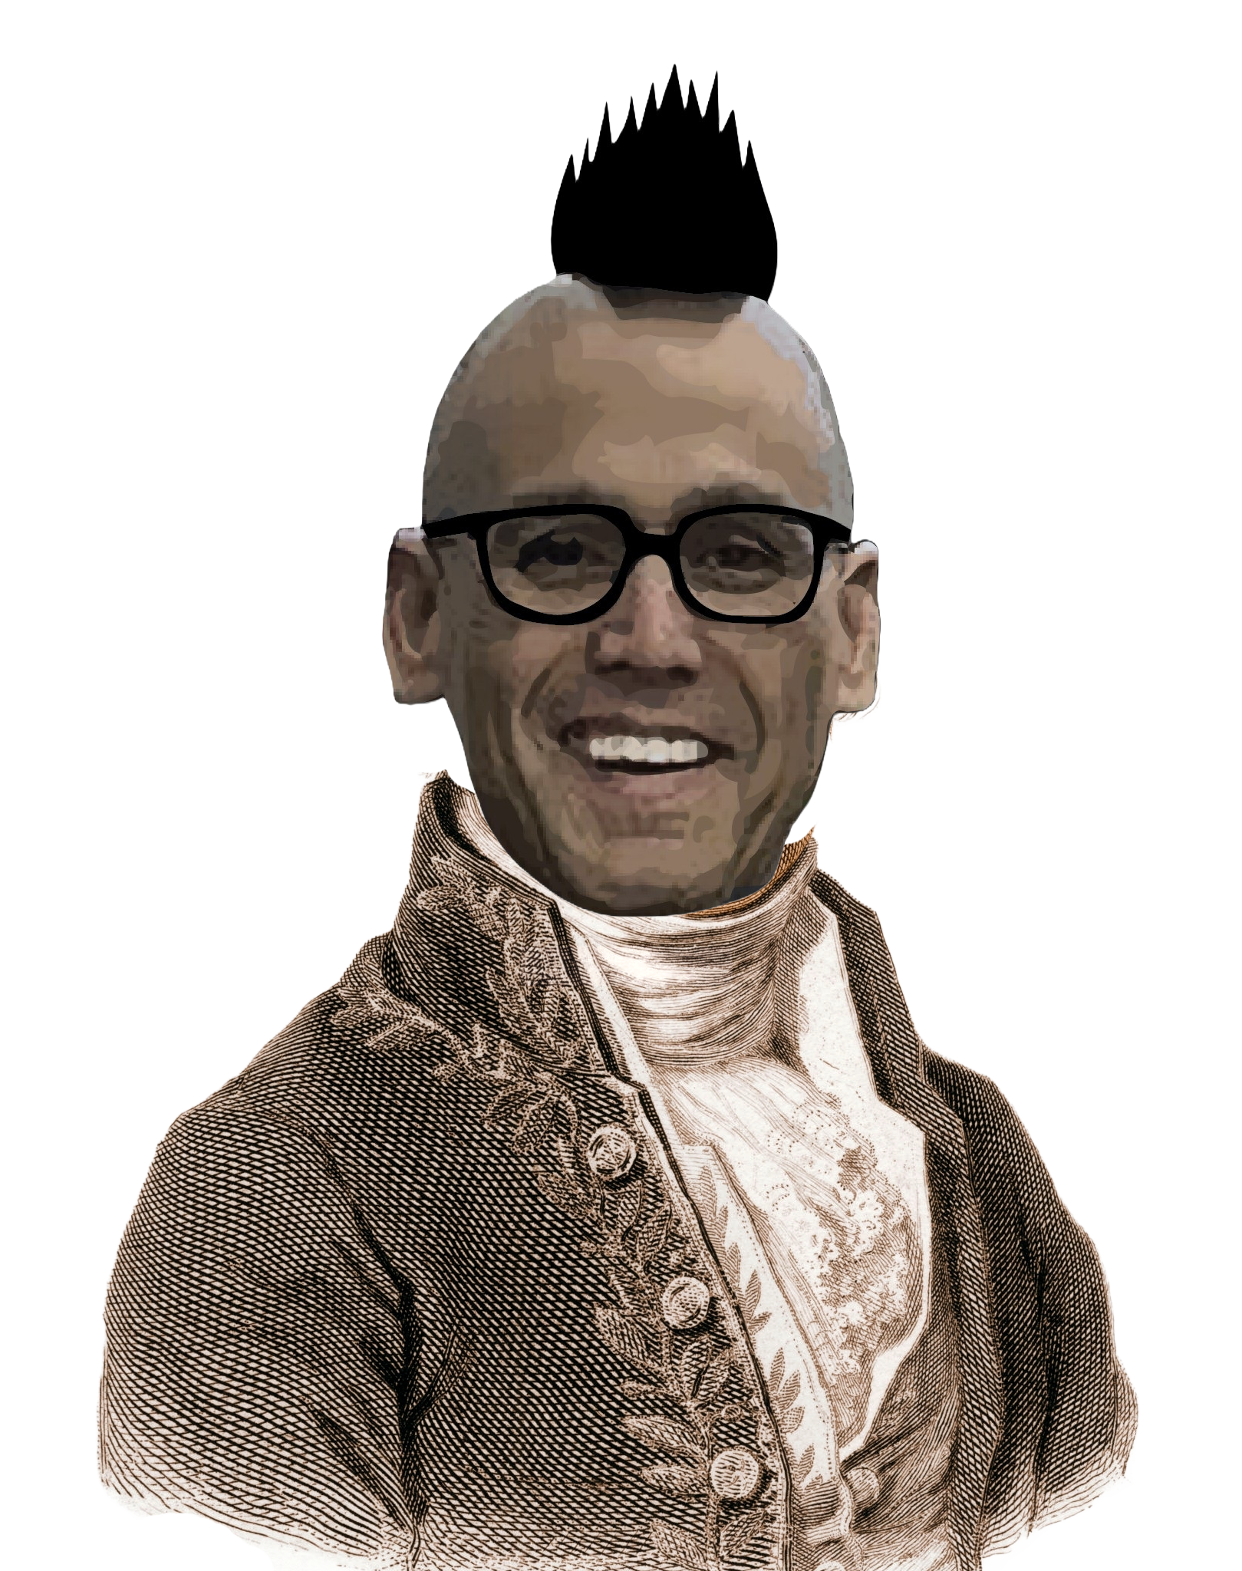
Chem
With
Com

Slide 2
Lewis Structures, Bonding, and Molecules
Chapter 2.4 (Chemical Formulas)
Chapter 4.4 (Lewis Symbols and Structures)
Chapter 3.6 (The Periodic Table)
Chapter 3.7 (Ionic and Molecular Compounds)
Chapter 1.2 (Phases and Classifications of Matter)
Adapted From: Paul Flowers, Edward J. Neth, William R. Robinson, PhD, Klaus Theopold, Richard Langley; Chemistry: Atoms First 2e; OpenStax; Feb 14, 2019; Houston Texas; https://openstax.org/books/chemistry-atoms-first-2e/pages/1-introduction

Slide 3
Lewis Symbols, Octet Rule, and Ionic Bonds
Chapter 4.4 (Lewis Symbols and Structures)
Chapter 3.6 (The Periodic Table)
Chapter 3.7 (Ionic and Molecular Compounds)
Adapted From: Paul Flowers, Edward J. Neth, William R. Robinson, PhD, Klaus Theopold, Richard Langley; Chemistry: Atoms First 2e; OpenStax; Feb 14, 2019; Houston Texas; https://openstax.org/books/chemistry-atoms-first-2e/pages/1-introduction

Slide 4
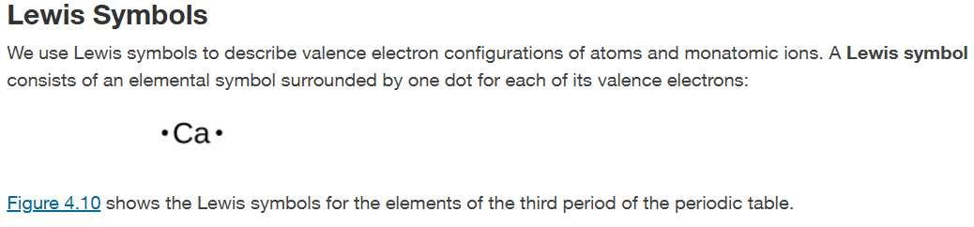
Lewis Symbols and Structures
Chapter 4.4

Slide 5
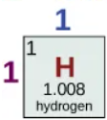
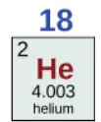












Ions
Rows (periods) = energy levels
Columns (groups) = valence electrons
Columns (groups) = predicted charge (usually)
Chapter 3.6
Notes:
Draw energy levels, explain valence vs core, ions/charges – very fast because we did already

Slide 6
Lewis Symbols and Structures
Rows (periods) = energy levels
Columns (groups) = valence electrons
Columns (groups) = predicted charge (usually)
Octet Rule (Chapter 4.4)
Guideline that states that main group atoms will “want” 8 electrons
Chapter 3.6
Notes:
Show Lewis dot structures here and similarities in columns

Slide 7
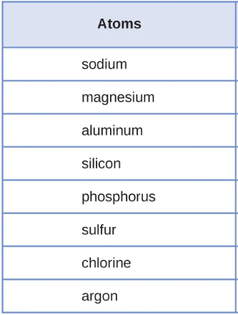
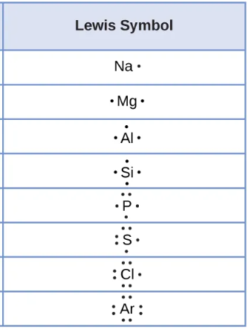

Lewis Structures
Chapter 4.4

Slide 8
Draw the lewis structure for sodium.
Draw the lewis structure for helium.
Draw the lewis structure for phosphorous.
Draw the lewis structure for calcium.

Slide 9

Octet Rule
Chapter 3.6 and 4.4
Notes:
Everything wants 8 electrons

Slide 10
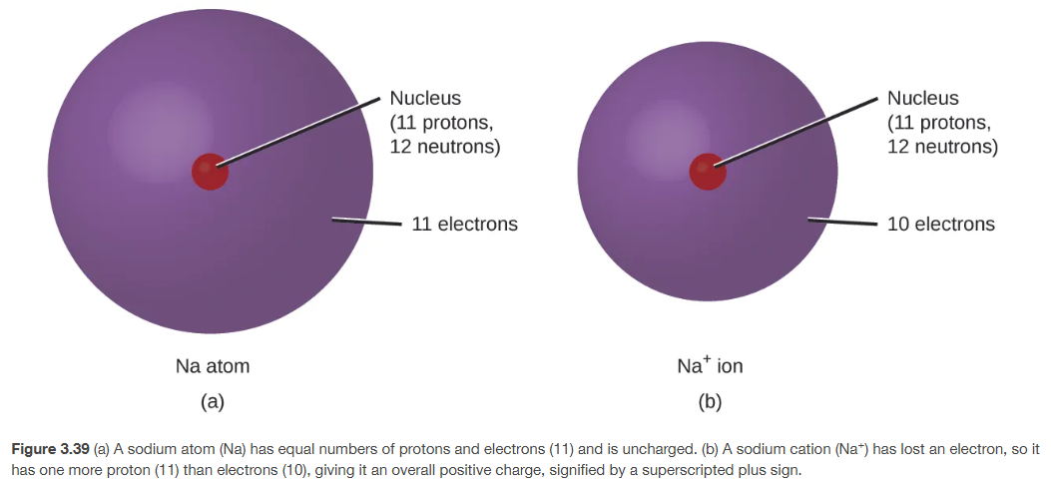
Ionic Bonds (ionic compounds)
Metal + Nonmetal
Metal = gives away electrons, nonmetal = takes electrons
Chapter 3.7

Slide 11
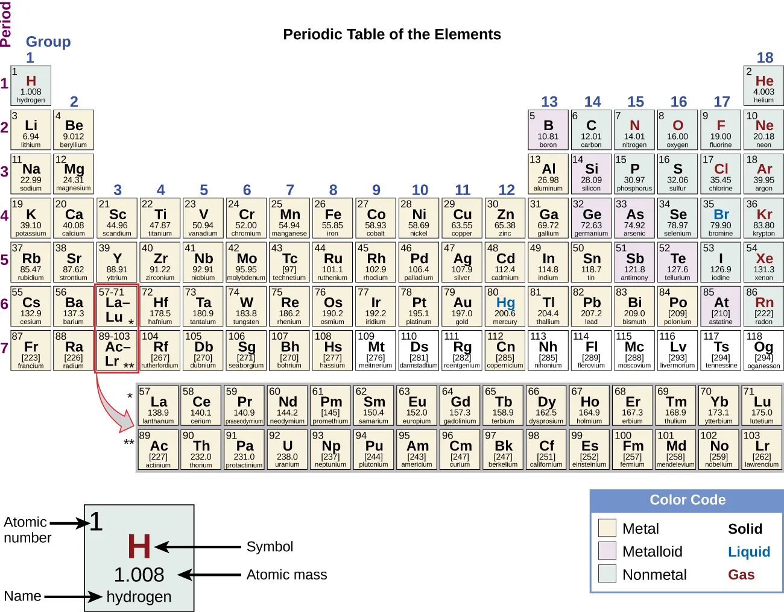
The Periodic Table
Chapter 3.6
Notes:
Location of metals and nonmetals

Slide 12
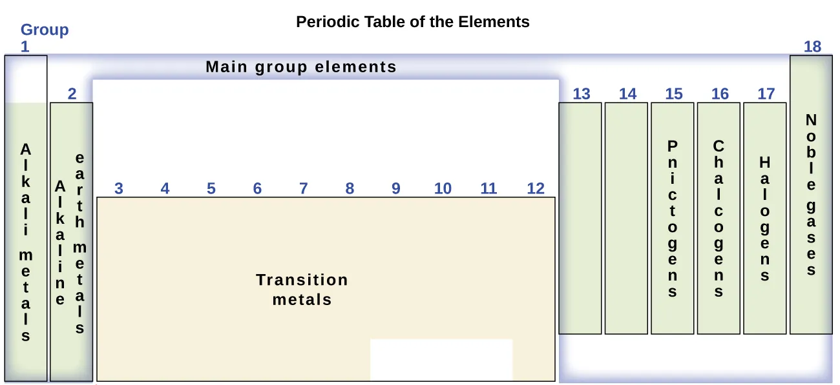
The Periodic Table
Chapter 3.6
Notes:
Location of metals and nonmetals

Slide 13
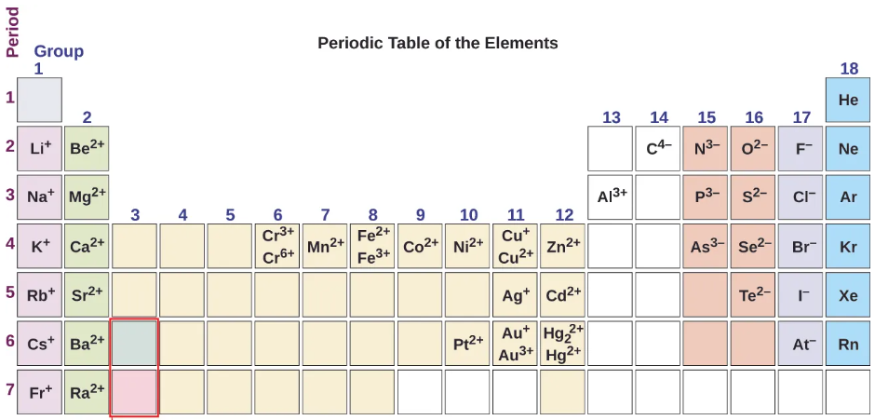

Ionic Bonds
H⁺
B³⁺
Chapter 3.7

Slide 14
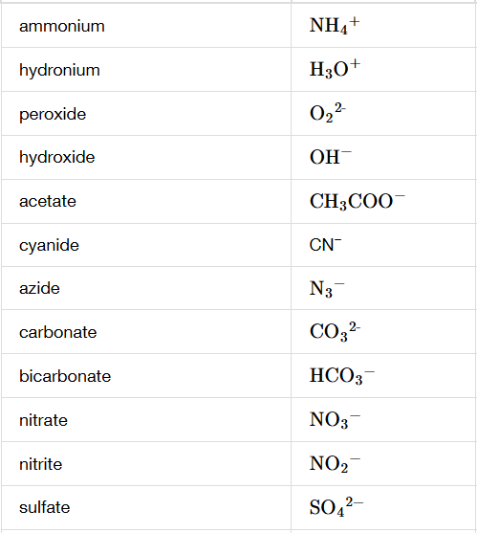
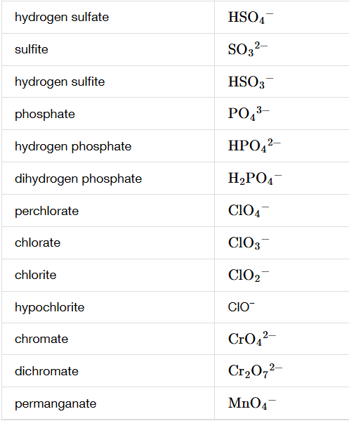
Polyatomic Ions

Slide 15
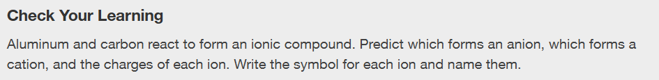
Ions
Chapter 3.7

Slide 16
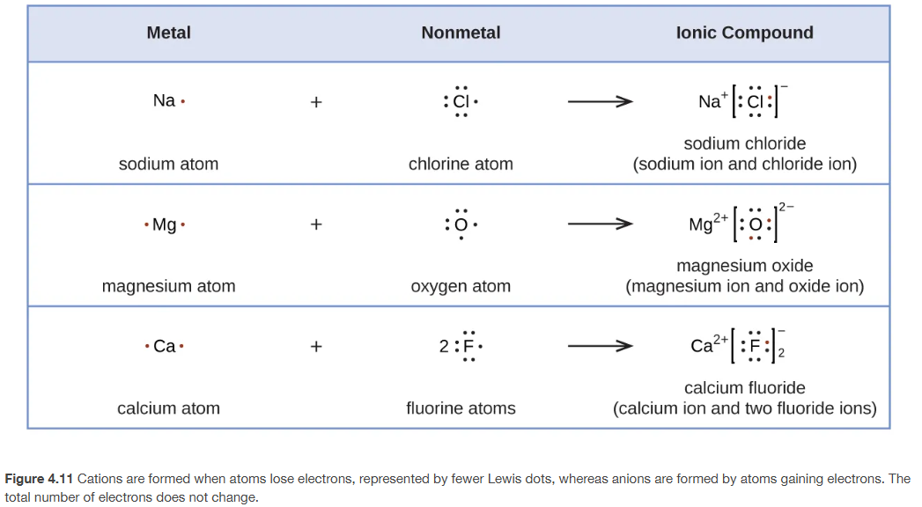
Ionic Bonds
Chapter 4.4

Slide 17
Ionic Bonds
Make neutral compounds
The charges of the ions should add up to 0.
You can’t change the charge of the ions but you can just “find” additional ions with the same charge so the charges add up to 0.

Slide 18
Ionic Bonds
KF
Li₂S
BaBr₂
Notes:
Do some

Slide 19
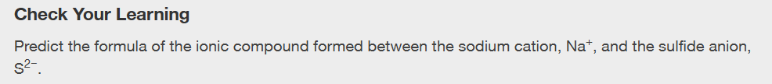
Ionic Bonds
Chapter 3.7

Slide 20
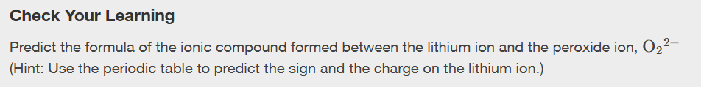
Ionic Bonds
Chapter 3.7

Slide 21
Ionic Bonds
Ionic compounds
  Held together by ionic bonds (+/- charges)
  Ionic bonds are formed by atoms giving and taking electrons
  Occurs between metals and nonmetals
  Usually comes apart in water

Slide 22
Lewis Structures and Covalent Bonds
Chapter 4.4 (Lewis Symbols and Structures)
Chapter 3.7 (Ionic and Molecular Compounds)
Adapted From: Paul Flowers, Edward J. Neth, William R. Robinson, PhD, Klaus Theopold, Richard Langley; Chemistry: Atoms First 2e; OpenStax; Feb 14, 2019; Houston Texas; https://openstax.org/books/chemistry-atoms-first-2e/pages/1-introduction

Slide 23
Ionic Bonds and Covalent Bonds
Ionic compounds
  Held together by ionic bonds (+/- charges)
  Ionic bonds are formed by atoms giving and taking electrons
  Occurs between metals and nonmetals
  Usually comes apart in water.
Molecular compounds
  Held together by covalent bonds
  Covalent bonds are formed by atoms sharing electrons
  Occurs between two nonmetals
  Usually doesn’t come apart in water

Slide 24
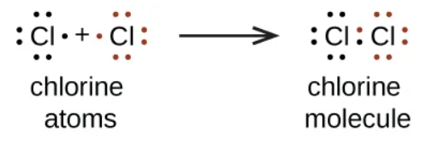

Covalent Bonds (molecular compounds)
Nonmetal + Nonmetal
nonmetal = takes electrons
Two nonmetals = sharing electrons
Chapter 4.4

Slide 25
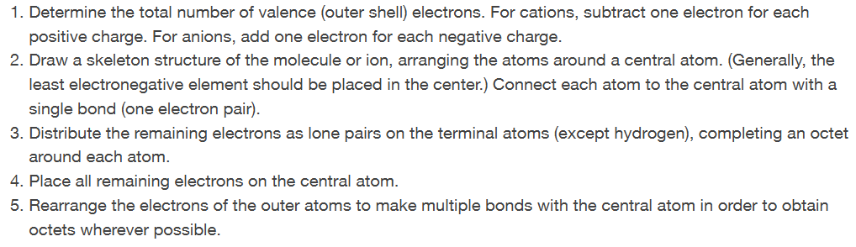
Covalent Bonds and Lewis Structures
Chapter 4.4

Slide 26
Covalent Bonds and Lewis Structures (com’s way)
Count total valence electrons of all atoms
  Negative charges mean add electrons, positive charges mean subtract electrons
Draw the skeletal structure with these tips
  symmetrical
  H, F, Cl, Br, I on the outsides
Place bonding electrons in pairs to connect atoms
Put rest of electrons on the outsides in pairs following the “octet” rule
  If an atom doesn’t have all it’s electrons, share your neighbor’s electron pairs
Other common things (usual but not always):
  C = 4 bonds, 0 lone pair
  N = 3 bonds, 1 lone pair
  O = 2 bonds, 2 lone pairs
  halogens = 1 bond, 3 lone pairs

Slide 27
Covalent Bonds and Lewis Structures
Count total valence electrons of all atoms
  Negative charges mean add electrons, positive charges mean subtract electrons
Draw the skeletal structure with these tips
  symmetrical
  H, F, Cl, Br, I on the outsides
Place bonding electrons in pairs to connect atoms
Put rest of electrons on the outsides in pairs following the “octet” rule
  If an atom doesn’t have all it’s electrons, share your neighbor’s electron pairs
Other common things (usual but not always):
  C = 4 bonds, 0 lone pair
  N = 3 bonds, 1 lone pair
  O = 2 bonds, 2 lone pairs
  halogens = 1 bond, 3 lone pairs
CCl₄
CH₂O

Slide 28
Covalent Bonds and Lewis Structures
Count total valence electrons of all atoms
  Negative charges mean add electrons, positive charges mean subtract electrons
Draw the skeletal structure with these tips
  symmetrical
  H, F, Cl, Br, I on the outsides
Place bonding electrons in pairs to connect atoms
Put rest of electrons on the outsides in pairs following the “octet” rule
  If an atom doesn’t have all it’s electrons, share your neighbor’s electron pairs
Other common things (usual but not always):
  C = 4 bonds, 0 lone pair
  N = 3 bonds, 1 lone pair
  O = 2 bonds, 2 lone pairs
  halogens = 1 bond, 3 lone pairs
CO
CO₂

Slide 29
Covalent Bonds and Lewis Structures
Count total valence electrons of all atoms
  Negative charges mean add electrons, positive charges mean subtract electrons
Draw the skeletal structure with these tips
  symmetrical
  H, F, Cl, Br, I on the outsides
Place bonding electrons in pairs to connect atoms
Put rest of electrons on the outsides in pairs following the “octet” rule
  If an atom doesn’t have all it’s electrons, share your neighbor’s electron pairs
Other common things (usual but not always):
  C = 4 bonds, 0 lone pair
  N = 3 bonds, 1 lone pair
  O = 2 bonds, 2 lone pairs
  halogens = 1 bond, 3 lone pairs
CO₃²⁻
NH₄ ¹⁺

Slide 30
Covalent Bonds and Lewis Structures
Count total valence electrons of all atoms
  Negative charges mean add electrons, positive charges mean subtract electrons
Draw the skeletal structure with these tips
  symmetrical
  H, F, Cl, Br, I on the outsides
Place bonding electrons in pairs to connect atoms
Put rest of electrons on the outsides in pairs following the “octet” rule
  If an atom doesn’t have all it’s electrons, share your neighbor’s electron pairs
Other common things (usual but not always):
  C = 4 bonds, 0 lone pair
  N = 3 bonds, 1 lone pair
  O = 2 bonds, 2 lone pairs
  halogens = 1 bond, 3 lone pairs
H₂O
NH₃

Slide 31
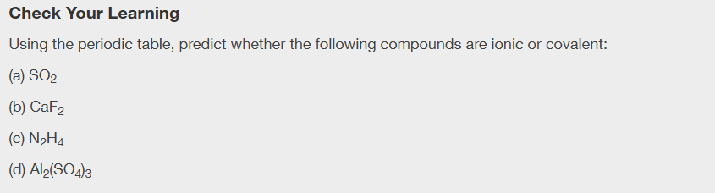
Ionic and Molecular Compounds
Chapter 3.7

Slide 32
Molecules, Compounds, and Chemical Formulas
Chapter 2.4 (Chemical Formulas)
Chapter 3.6 (The Periodic Table)
Chapter 1.2 (Phases and Classifications of Matter)
Adapted From: Paul Flowers, Edward J. Neth, William R. Robinson, PhD, Klaus Theopold, Richard Langley; Chemistry: Atoms First 2e; OpenStax; Feb 14, 2019; Houston Texas; https://openstax.org/books/chemistry-atoms-first-2e/pages/1-introduction

Slide 33
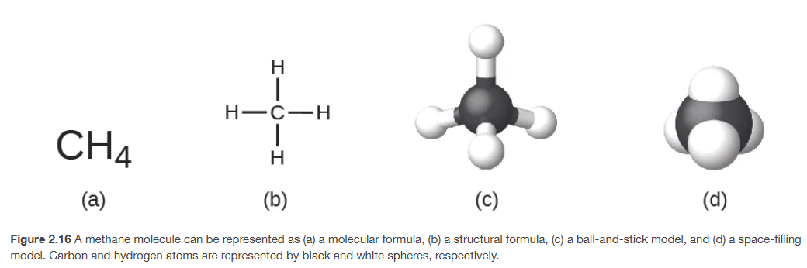
Chemical Formulas
Chapter 2.4

Slide 34
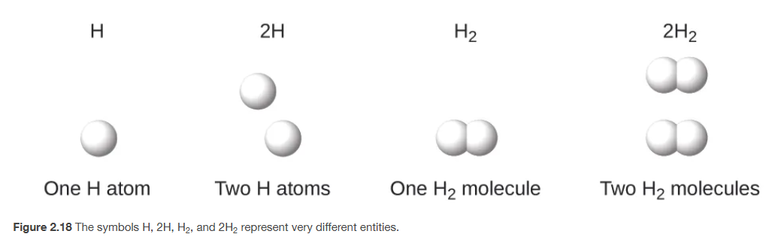
Atoms and Molecules
molecules
(more than one atom)
atoms
all elements
Chapter 2.4

Slide 35
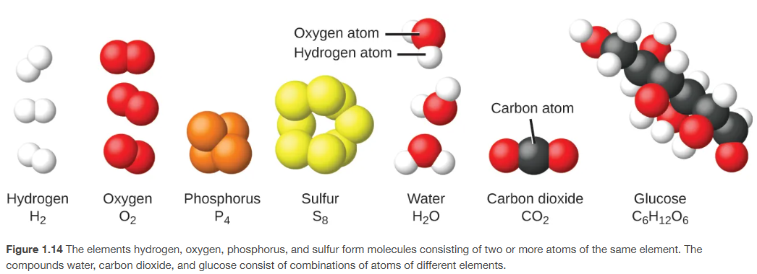
Molecules and Compounds
Compounds
(two or more different atoms)
molecules
(more than one atom)
Chapter 1.2

Slide 36
What are things called?
Atoms/elements
Molecules (more than one atom)
Compounds (two or more different atoms)
Molecular Element (multiple of the same atom)
Molecular Compound (two different nonmetals)
Ionic Compound (metal and a nonmetal)
What is He?
What is NO?
What is H₂O?
What is Fe?
What is H₂?
What is NaCl

Slide 37
Chemical Formulas
Subscript numbers (small and to the bottom right is just for what is immediately to the left of it. If there are parentheses it’s the number of things in the parentheses
Number on the left of molecule is the coefficient and tells you how many total molecules there are
H
H₂
H₂O
H₂O₂
2(H₂O₂)
2(NH₄)₂ SO₄
Notes:
Do some

Slide 38
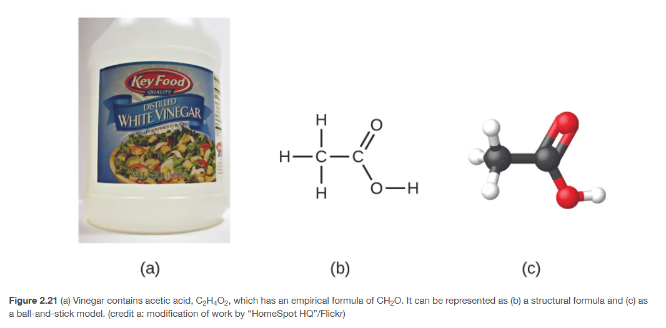
Molecular vs Empirical Formula
Chapter 2.4

Slide 39
Molecular vs Empirical Formula
Molecular Formula
Empirical Formula
Chapter 2.4

Slide 40
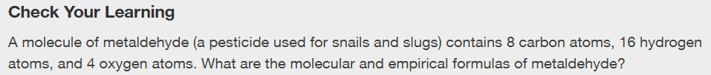
Molecular vs Empirical Formula
Chapter 2.4

Slide 41
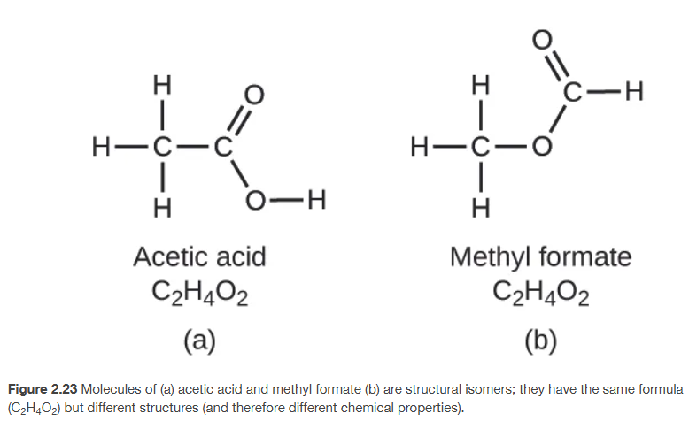
Isomers
Chapter 2.4

Slide 42
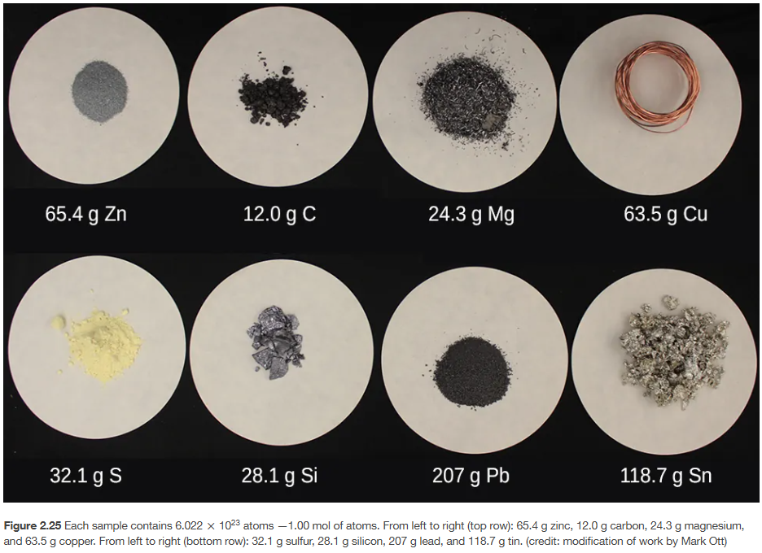
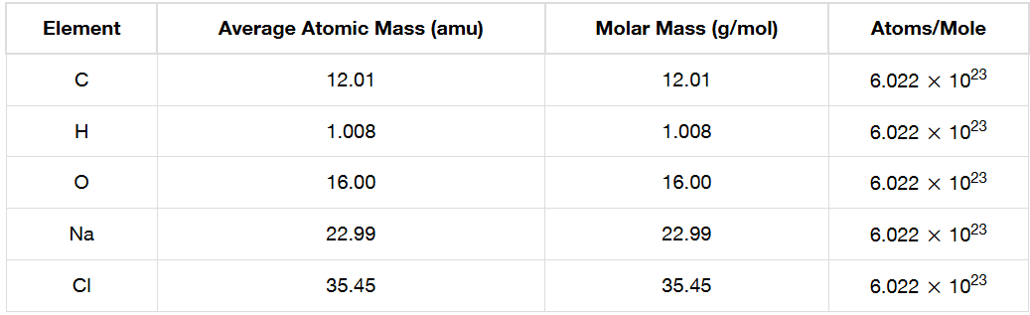
Grams Per Mole!
H
H₂
H₂O
2H₂O
Chapter 2.4

Slide 43
Grams Per Mole of Molecules
Chapter 3.6 and 2.4
Notes:
Use these to practice the nomenclature and introduce the concept of atomic mass and significant figures

Slide 44
Grams Per Mole of Molecules
Calculate Grams Per Mole for the empirical and molecular formula.
Chapter 3.6 and 2.4
Notes:
Use these to practice the nomenclature and introduce the concept of atomic mass and significant figures

