Slide 1


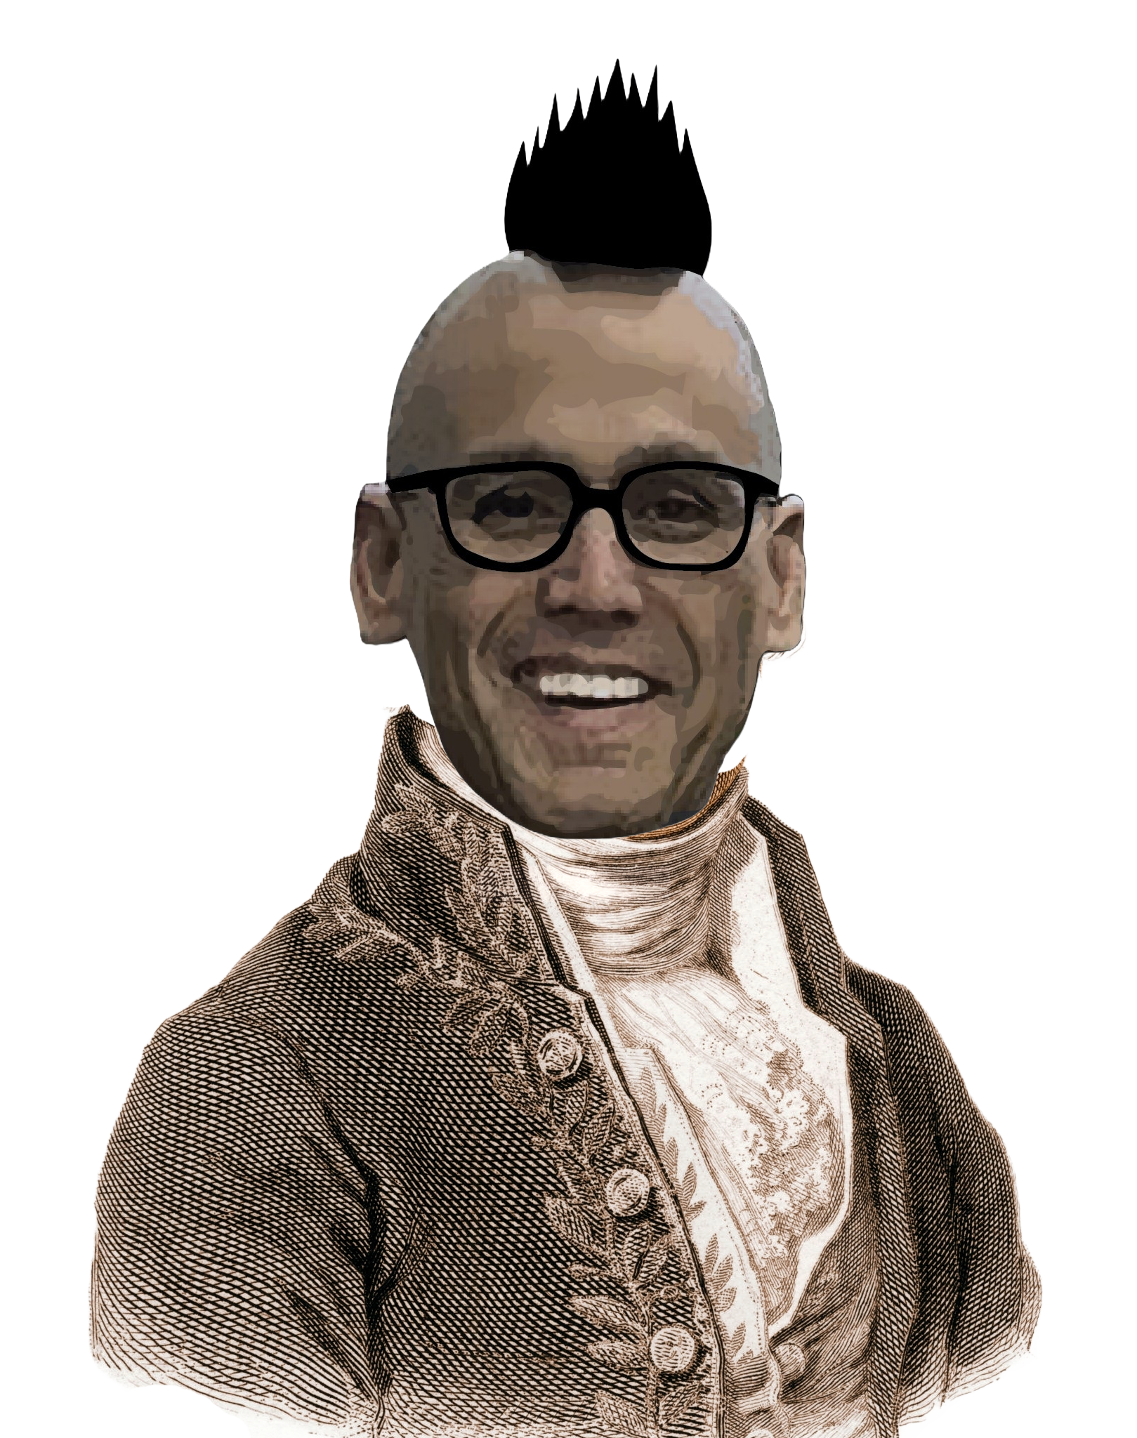
Chem
With
Com

Slide 2
Ions, Periodic Properties, and Moles
Chapter 2.3 (Atomic Structure and Symbolism)
Chapter 3.6 (The Periodic Table)
Chapter 3.7 (Ionic and Molecular Compounds)
Chapter 2.4 (Chemical Formulas)
Appendix B (Essential Mathematics)
Adapted From: Paul Flowers, Edward J. Neth, William R. Robinson, PhD, Klaus Theopold, Richard Langley; Chemistry: Atoms First 2e; OpenStax; Feb 14, 2019; Houston Texas; https://openstax.org/books/chemistry-atoms-first-2e/pages/1-introduction

Slide 3
Ions
Chapter 2.3 (Atomic Structure and Symbolism)
Chapter 3.6 (The Periodic Table)
Chapter 3.7 (Ionic and Molecular Compounds)
Adapted From: Paul Flowers, Edward J. Neth, William R. Robinson, PhD, Klaus Theopold, Richard Langley; Chemistry: Atoms First 2e; OpenStax; Feb 14, 2019; Houston Texas; https://openstax.org/books/chemistry-atoms-first-2e/pages/1-introduction

Slide 4
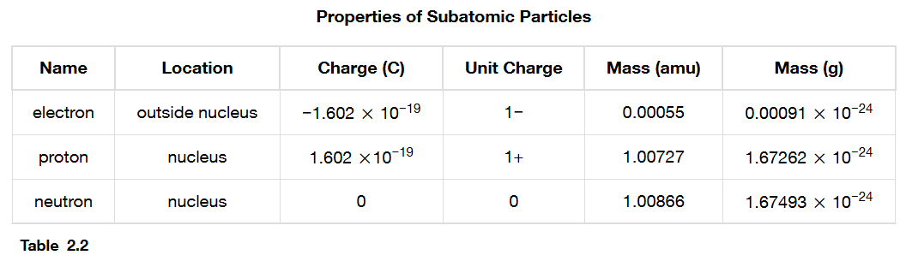
Ions
Neutral Atoms: protons (+) = electrons (-)
Chapter 2.3
Notes:
Explain what ions are

Slide 5
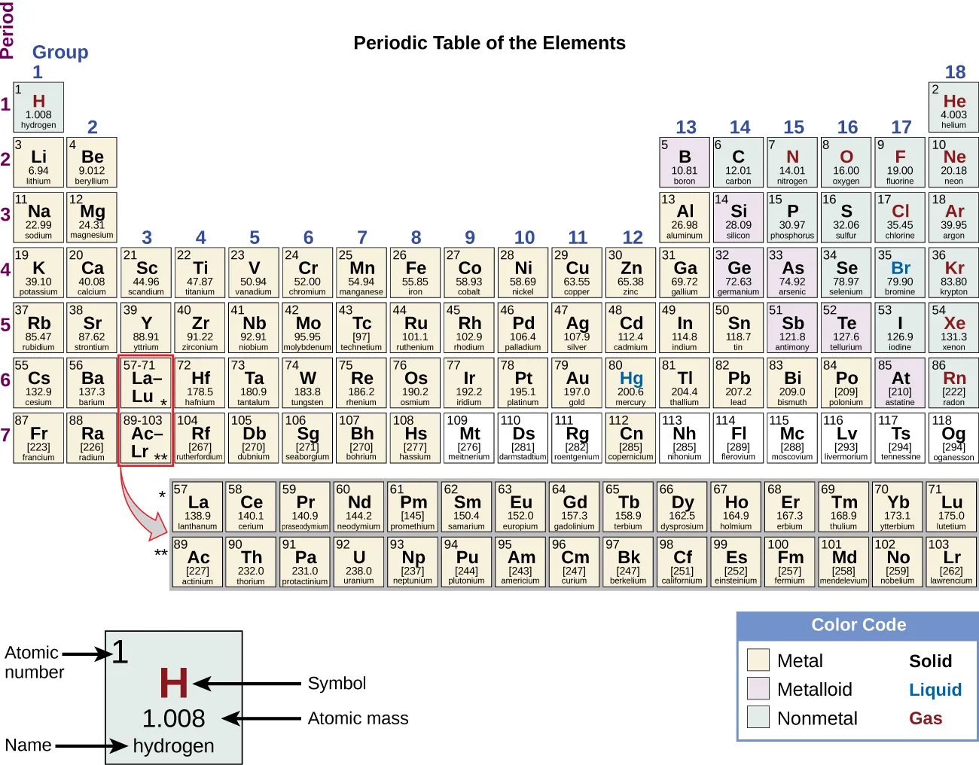
The Periodic Table
Neutral Atoms: protons (+) = electrons (-)
Chapter 3.6

Slide 6
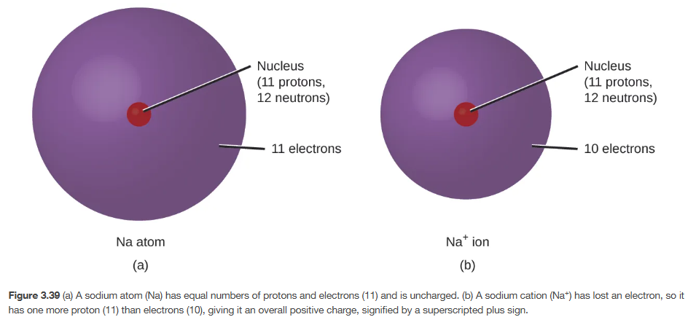
Ions
Chapter 3.7

Slide 7
Ions
Neutral Atoms: protons (+) = electrons (-)
Cations (+)
Anions (-)
Chapter 2.3

Slide 8
Questions
True/False – A neutral atom has the same amount of electrons and protons
An atom with more electrons than protons is called a(n) _______?
An atom with more protons than electrons is called a(n) _______?
How many electrons in H¹⁺ ?
How many electrons in Cl¹⁻ ?
How many electrons in Al³⁺ ?
How many electrons in OH¹⁻ ?
How many electrons in NH₄¹⁺ ?

Slide 9
Ions
Chapter 3.7

Slide 10
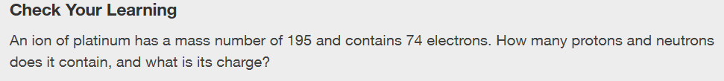
Ions
Chapter 2.3

Slide 11
Periodic Table
Chapter 2.3 (Atomic Structure and Symbolism)
Chapter 3.6 (The Periodic Table)
Chapter 3.7 (Ionic and Molecular Compounds)
Adapted From: Paul Flowers, Edward J. Neth, William R. Robinson, PhD, Klaus Theopold, Richard Langley; Chemistry: Atoms First 2e; OpenStax; Feb 14, 2019; Houston Texas; https://openstax.org/books/chemistry-atoms-first-2e/pages/1-introduction

Slide 12
The Periodic Table
Metals and the “everything that isn’t”
Chapter 3.6
Notes:
Explain groups (columns) and periods (rows)

Slide 13
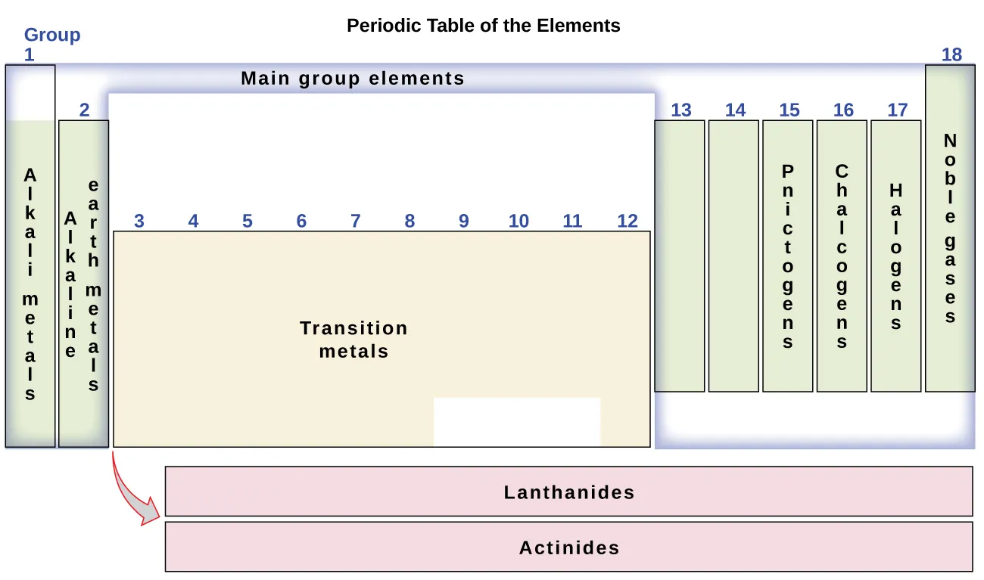
The Periodic Table
Chapter 3.6
Notes:
Explain groups (columns) and periods (rows)

Slide 14
The Periodic Table
Metals and the everything that isn’t
Is lithium a metal or nonmetal?
Is chlorine a metal or nonmetal?
Is hydrogen a metal or nonmetal?
Is silicon a metal or nonmetal?
Chapter 3.6
Notes:
Explain groups (columns) and periods (rows)

Slide 15
The Periodic Table
Chapter 3.6
Notes:
Will expand these next slide

Slide 16
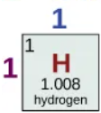
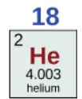












Ions
Rows (periods) = energy levels
Columns (groups) = valence electrons
Columns (groups) = predicted charge (usually)
Octet Rule (Chapter 4.4)
Guideline that states that main group atoms will “want” 8 electrons
Chapter 3.6
Notes:
Draw energy levels, explain valence vs core, ions/charges

Slide 17
The Periodic Table
Chapter 3.6
Notes:
Will expand these next slide

Slide 18
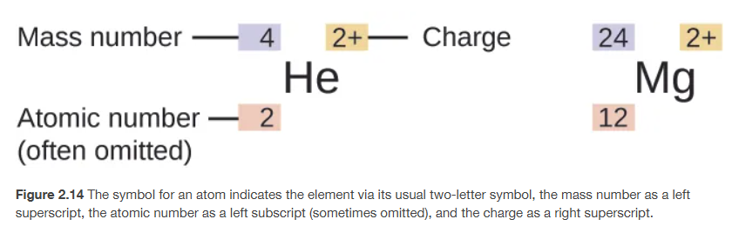
Chemical Symbols and Annotations
Chapter 2.3
Notes:
This is the original slide I showed

Slide 19
Annotations for Ions
Chapter 2.3
Notes:
Now include charges

Slide 20
Write the symbol, atomic number, mass number, and charge for calcium with 18 electrons and 19 neutrons.
Write the symbol, atomic number, mass number, and charge for nitrogen with 10 electrons and 7 neutrons.

Slide 21
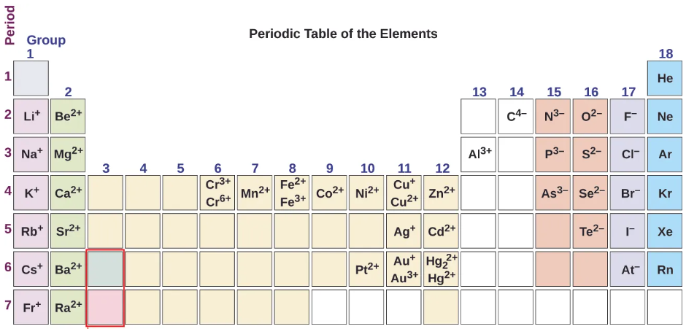

Ions and the Periodic Table
H⁺
B³⁺
Chapter 3.7
Notes:
These are predicted charges. Also, explain transition metals and variable charges

Slide 22
Practice/Review
Predict the charge of Mg
Predict the charge of F
Predict the charge of Kr
Combine atoms of Mg and F to make a neutral compound (the charges added together equal 0)

Slide 23
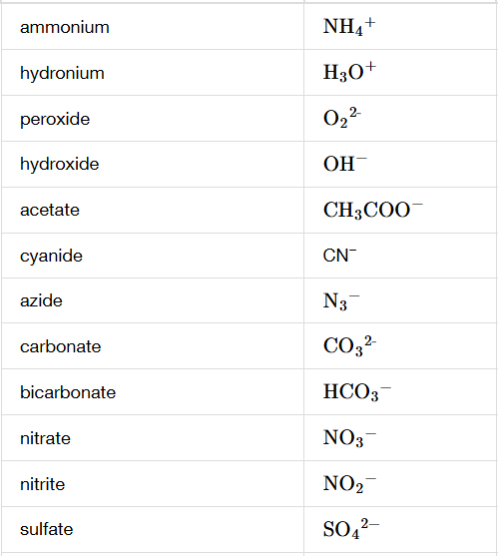
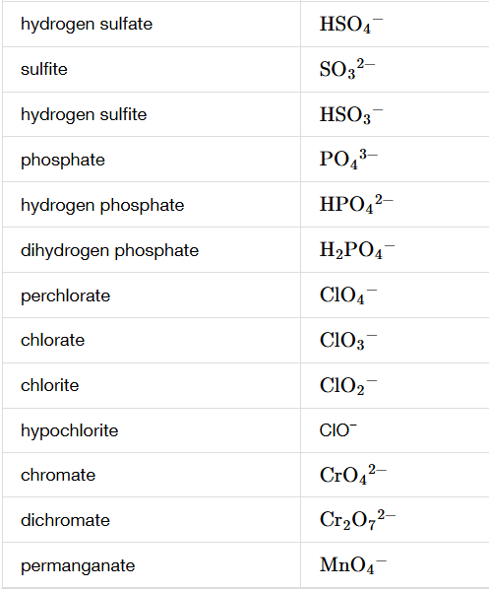
Polyatomic Ions

Slide 24
Moles and Exponential Notation
Chapter 2.4 (Chemical Formulas)
Appendix B (Essential Mathematics)
Adapted From: Paul Flowers, Edward J. Neth, William R. Robinson, PhD, Klaus Theopold, Richard Langley; Chemistry: Atoms First 2e; OpenStax; Feb 14, 2019; Houston Texas; https://openstax.org/books/chemistry-atoms-first-2e/pages/1-introduction

Slide 25
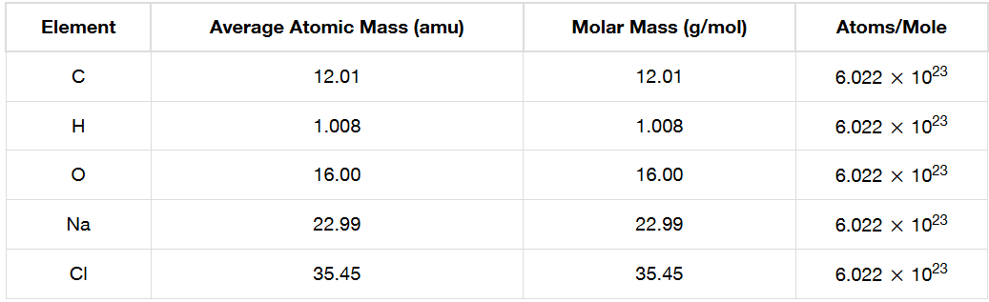
Grams Per Mole?
The atomic masses on the periodic table are in the units of grams per mole (g/mol) and sometimes atomic mass units (amu)
Grams (g) = unit of mass
  mass is how much matter something has
  weight is the effect of gravity on mass, on earth mass is the same as weight
Moles = a specific number of things (6.022 x 10²³)
  dozen = 12, tetra = 4, pair = 2, cent = 100
Chapter 2.4

Slide 26
What is a mole? (The Chemist’s Dozen)
Chapter 2.4

Slide 27
Exponential Notation
#.#### x 10#
  A number followed by a decimal and then however many significant figures there are
  The things in red are in every exponential notation number
  The things in black are optional (but there most of the time)
3.14 x 10⁶
2 x 10⁻⁶
6.022 x 10²³
Appendix B

Slide 28
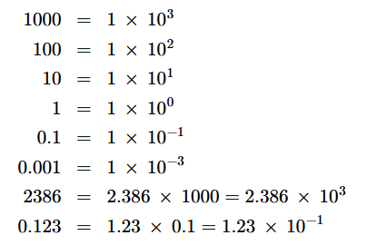
Exponential Notation
Appendix B

Slide 29
Exponential Notation and Standard Notation
Exponential Notation
Standard Notation
3.14 x 10⁶ = 3,140,000
2 x 10⁻⁶ = 0.000002
6.022 x 10²³ = 602,200,000,000,000,000,000,000
Appendix B

Slide 30
Exponential Notation
The decimal moves amount of times as the number in the exponent.
  For something like 3.05 x 10⁴, you would move the decimal 4 places, since the exponent is positive, you know the final number will be greater than 1.
  For something like 2.1 x 10⁻³, you would move the decimal 3 place, since the exponent is negative, you know the final number will be less than 1.
  For 0.0078077, you would move the decimal 3 places to get to the first non-zero digit. If the number started as a number less than 1, it is a negative exponent.
  For 97,105,000 you would move the decimal 7 places to get to the first non-zero digit. If the number started as a number greater than 1, it is a positive exponent.
Appendix B

Slide 31
Exponential Notation
The decimal moves amount of times as the number in the exponent.
  For something like 3.05 x 10⁴, you would move the decimal 4 places, since the exponent is positive, you know the final number will be greater than 1.
  For something like 2.1 x 10⁻³, you would move the decimal 3 place, since the exponent is negative, you know the final number will be less than 1.
Appendix B

Slide 32
Exponential Notation
The decimal moves amount of times as the number in the exponent.
  For 0.0078077, you would move the decimal 3 places to get to the first non-zero digit. If the number started as a number less than 1, it is a negative exponent.
  For 97,105,000 you would move the decimal 7 places to get to the first non-zero digit. If the number started as a number greater than 1, it is a positive exponent.
Appendix B

Slide 33
Exponential Notation to Standard Notation
Exponential Notation
Standard Notation
= 70,602,020,000
2 x 10⁶ =
= 0.000197345
9.27542 x 10⁻⁷ =
Appendix B

Slide 34
Grams Per Mole?
Chapter 2.4

Slide 35
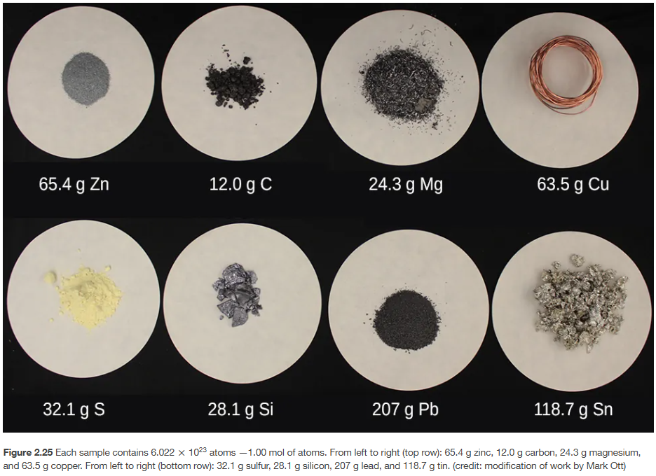
Grams Per Mole!
Chapter 2.4

Slide 36
Grams Per Mole!
What is a mole?
12 g C. How many moles?
6 g C. How many moles?
1 mol Si. How many grams?
2 mols C. How many grams?
Chapter 2.4

