Slide 1



Chem
With
Com

Slide 2
Atomic Structure and Significant Figures
Chapter 2.1 (Early Ideas in Atomic Theory)
Chapter 2.3 (Atomic Structure and Symbolism)
Chapter 3.6 (The Periodic Table)
Chapter 1.5 (Significant Figures)
Adapted From: Paul Flowers, Edward J. Neth, William R. Robinson, PhD, Klaus Theopold, Richard Langley; Chemistry: Atoms First 2e; OpenStax; Feb 14, 2019; Houston Texas; https://openstax.org/books/chemistry-atoms-first-2e/pages/1-introduction

Slide 3
Atomic Structure
Chapter 2.3 (Atomic Structure and Symbolism)
Chapter 3.6 (The Periodic Table)
Adapted From: Paul Flowers, Edward J. Neth, William R. Robinson, PhD, Klaus Theopold, Richard Langley; Chemistry: Atoms First 2e; OpenStax; Feb 14, 2019; Houston Texas; https://openstax.org/books/chemistry-atoms-first-2e/pages/1-introduction

Slide 4
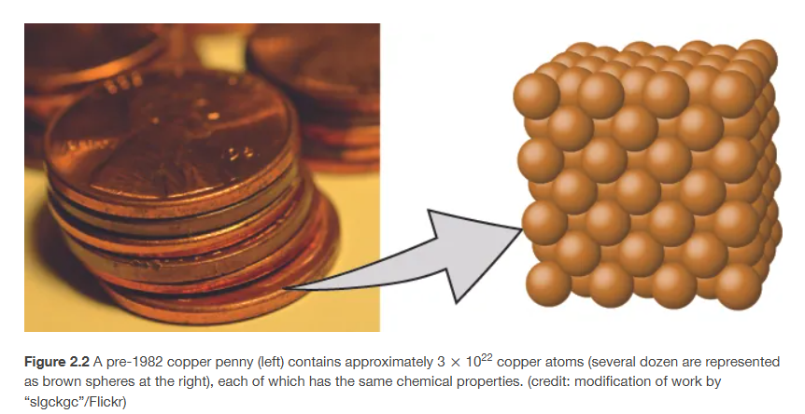
What are atoms? (and matter?)
Chapter 2.1
Notes:
Atoms are smallest unit of “matter”. I.e. keep breaking penny apart until 1 atom and that’s as far as you can go.

Slide 5
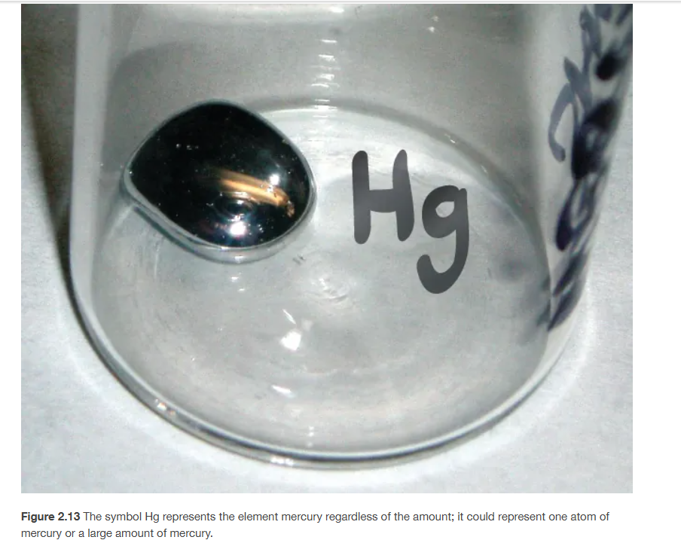
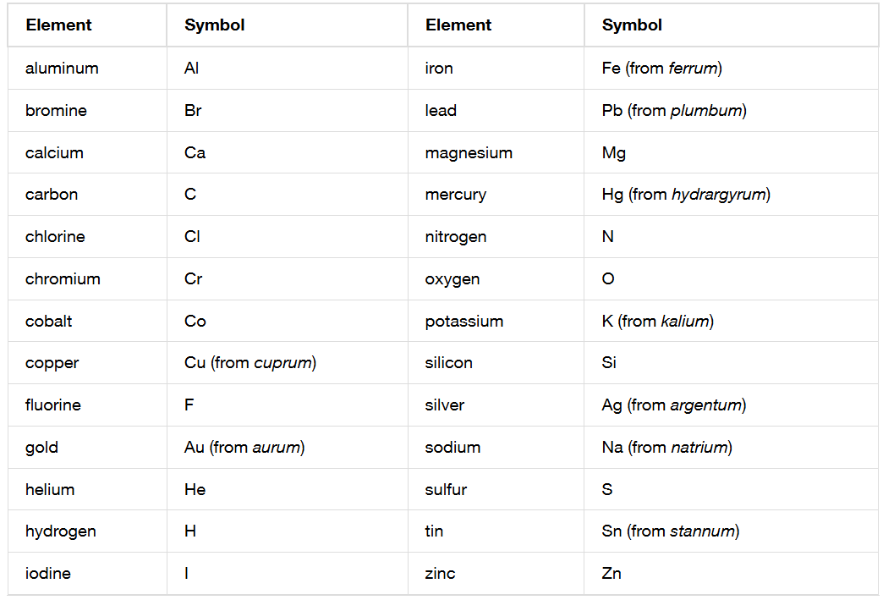
Chemical Symbols
Chapter 2.3
Notes:
Individual atoms or elements have distinct properties. Symbols are usually related but some have their old Latin names.

Slide 6
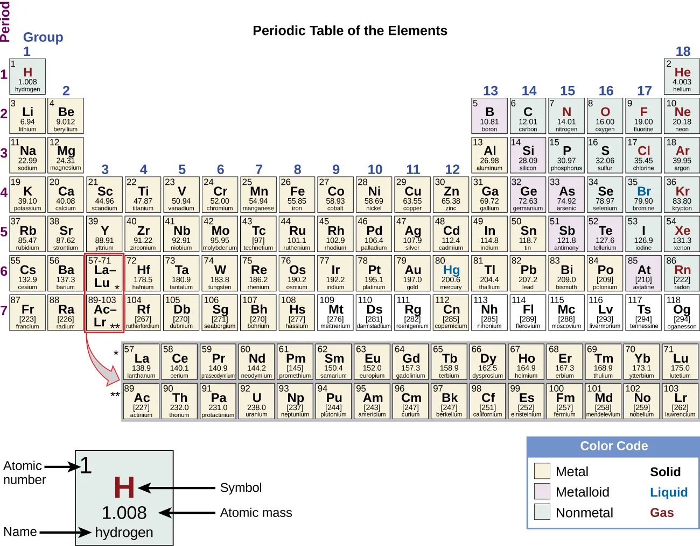
The Periodic Table
Units of the periodic table
grams/mole (g/mol)
atomic mass units (amu)
Chapter 3.6
Notes:
This is a complete periodic table.

Slide 7
The Periodic Table
Units of the periodic table
grams/mole (g/mol)
atomic mass units (amu)
Chapter 3.6
Notes:
This is the stuff we mostly use in class.

Slide 8
The Periodic Table
Units of the periodic table
grams/mole (g/mol)
atomic mass units (amu)
Chapter 3.6
Notes:
This is what we’ll do most of our learning on. Say these.

Slide 9
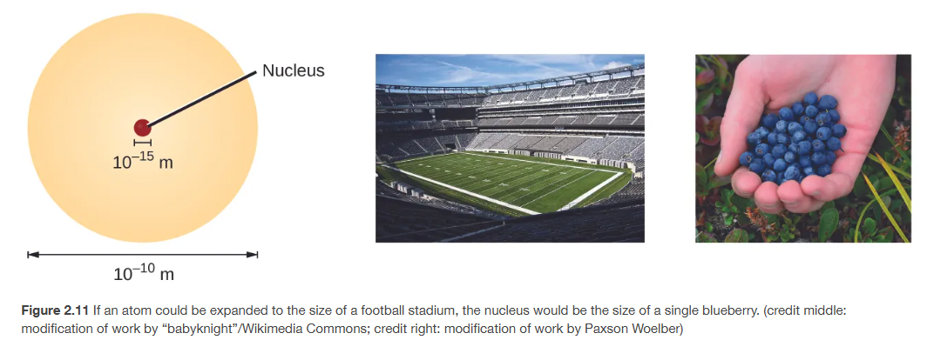
Atomic Structure
Chapter 2.3
Notes:
Grain of sand would be an electron

Slide 10
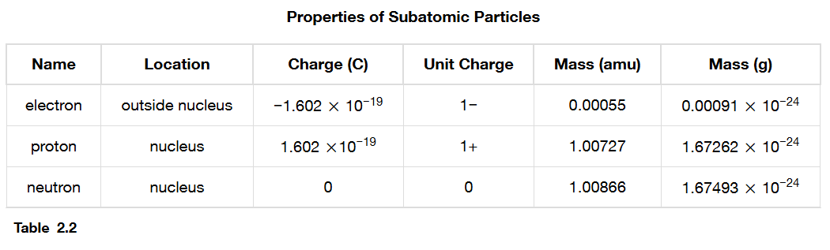
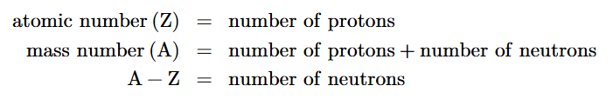
Atomic Structure
grams/mole (g/mol)
atomic mass units (amu)
Chapter 2.3

Slide 11
Atomic Structure
What is the charge of an electron?
What is the charge of a proton?
What is the charge of a neutron?
What has more mass, an electron or proton?
T or F, a proton is about the same size as a neutron?
Where are electrons located?
Where are protons located?
Where are neutrons located?
What particle defines the element or gives that element it’s specific properties?
What is an atomic number?
What is a mass number?
What are the two different units of mass on the periodic table?
grams/mole (g/mol)
atomic mass units (amu)
Chapter 2.3

Slide 12
comstgermain.com/chem-with-com

Slide 13
Isotopes and Significant Figures
Chapter 2.3 (Atomic Structure and Symbolism)
Chapter 3.6 (The Periodic Table)
Chapter 1.5 (Significant Figures)
Adapted From: Paul Flowers, Edward J. Neth, William R. Robinson, PhD, Klaus Theopold, Richard Langley; Chemistry: Atoms First 2e; OpenStax; Feb 14, 2019; Houston Texas; https://openstax.org/books/chemistry-atoms-first-2e/pages/1-introduction

Slide 14
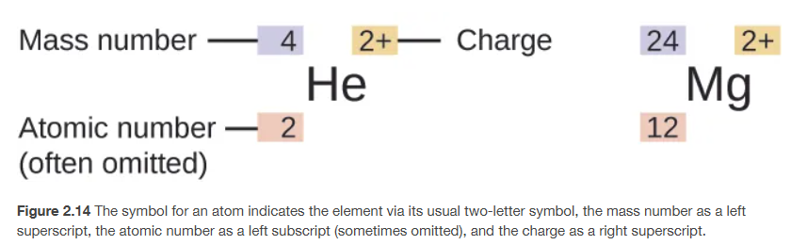
Isotopes
The same element (same number of protons) with different numbers of neutrons.
Chapter 2.3

Slide 15
Isotope Practice
Write the symbol, mass number, and atomic number for the following isotopes:
  carbon with 6 neutrons
  chlorine with 18 neutrons
  silver with 62 neutrons

Slide 16
The Periodic Table
Chapter 3.6
Notes:
Use these to practice the nomenclature and introduce the concept of atomic mass and significant figures

Slide 17
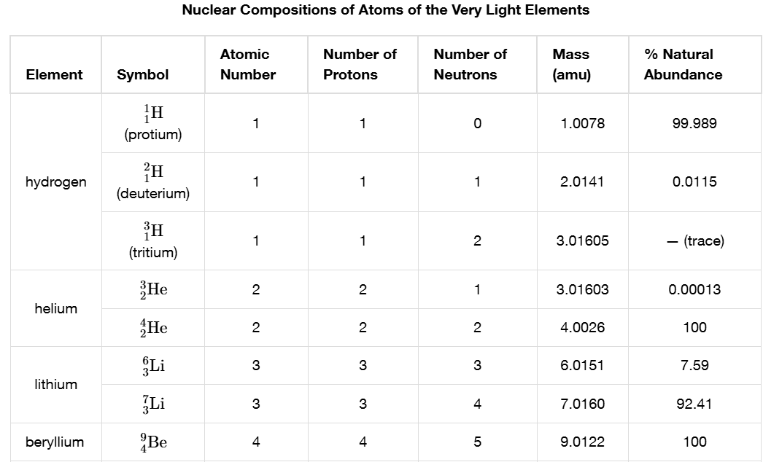
Isotopes
grams/mole (g/mol)
atomic mass units (amu)
Chapter 2.3

Slide 18
Significant Figures
Significant
Nonzero numbers
Zeros between nonzero numbers
Right-end zeros only if there is a decimal anywhere in the number
Not Significant
Everything else
Chapter 1.5

Slide 19
Significant Figures
Significant
Nonzero numbers
Zeros between nonzero numbers
Right-end zeros only if there is a decimal anywhere in the number
Examples
111
924.19
0.3527
10000001
909
80980
1100
0.070580
0.0000010
# of Sig Figs
3
5
4
8
3
5?
2
5
2
Chapter 1.5

Slide 20
Significant Figures
Significant
Nonzero numbers
Zeros between nonzero numbers
Right-end zeros only if there is a decimal anywhere in the number
Examples
Chapter 1.5

Slide 21
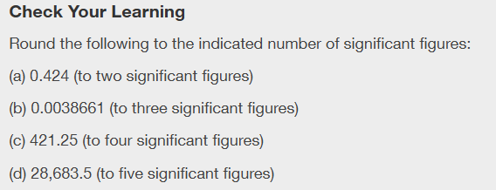
Significant Figures
Chapter 1.5

Slide 22
comstgermain.com/chem-with-com

Slide 23
Atomic Mass and Math with SigFigs
Chapter 2.3 (Atomic Structure and Symbolism)
Chapter 3.6 (The Periodic Table)
Chapter 1.5 (Significant Figures)
Adapted From: Paul Flowers, Edward J. Neth, William R. Robinson, PhD, Klaus Theopold, Richard Langley; Chemistry: Atoms First 2e; OpenStax; Feb 14, 2019; Houston Texas; https://openstax.org/books/chemistry-atoms-first-2e/pages/1-introduction

Slide 24
Chemistry can be difficult but you can do it and you will be successful if you can commit the required time to it.
It requires time, consistent practice, repetition, and patience with yourself.

Slide 25


Slide 26
Isotopes
grams/mole (g/mol)
atomic mass units (amu)
Chapter 2.3

Slide 27

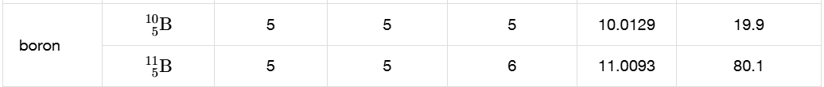
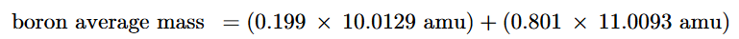
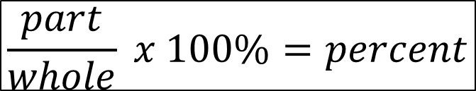
Atomic Mass
The average mass of all of the isotopes of an element
grams/mole (g/mol)
atomic mass units (amu)
PEMDAS
Parentheses
Exponents
Multiplication
Division
Addition
Subtraction
$$\frac{part}{whole} x 100\%=percent$$
Chapter 2.3
Notes:
How many sig figs are we supposed to keep?

Slide 28
Significant Figures
Addition/Subtraction
Use the least amount of DECIMALS in the problem
Multiplication/Division
Use the least amount of SIG FIGS in the problem
Chapter 1.5
Notes:
Show examples

Slide 29
Significant Figures
Addition/Subtraction
Use the least amount of DECIMALS in the problem
Multiplication/Division
Use the least amount of SIG FIGS in the problem
Has both?
Use both!
Use an overline to keep track of the significant figures and keep going
Round – if digit to the right of the last sigfig is 5 or greater, round up, if 4 or below, round down. *other rounding rules in the future!!
Chapter 1.5

Slide 30
Significant Figures
Addition/Subtraction
Use the least amount of DECIMALS in the problem
Multiplication/Division
Use the least amount of SIG FIGS in the problem
Chapter 1.5
Notes:
Show examples

Slide 31
Significant Figures
Addition/Subtraction
Use the least amount of DECIMALS in the problem
Multiplication/Division
Use the least amount of SIG FIGS in the problem
Has both? Use both!
Use an overline to keep track of the significant figures and keep going
Round – if digit to the right of the last sigfig is 5 or greater, round up, if 4 or below, round down. *other rounding rules in the future!!
Chapter 1.5
Notes:
Show examples of both

Slide 32
Significant Figures
Addition/Subtraction
Use the least amount of DECIMALS in the problem
Multiplication/Division
Use the least amount of SIG FIGS in the problem
Chapter 1.5
Notes:
Show examples

Slide 33
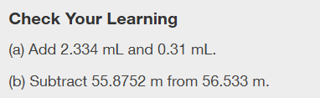
Math and Sig Figs
Chapter 1.5

Slide 34

Math and Sig Figs
Chapter 1.5

Slide 35
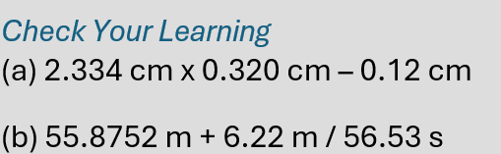
Math and Sig Figs
( )
( )
Chapter 1.5

Slide 36
Atomic Mass
grams/mole (g/mol)
atomic mass units (amu)
Chapter 2.3
Notes:
Do the math with sig figs for this problem

Slide 37
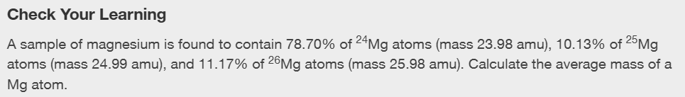
Atomic Mass
What is atomic mass?
Chapter 2.3

Slide 38
comstgermain.com/chem-with-com

